Slide 1
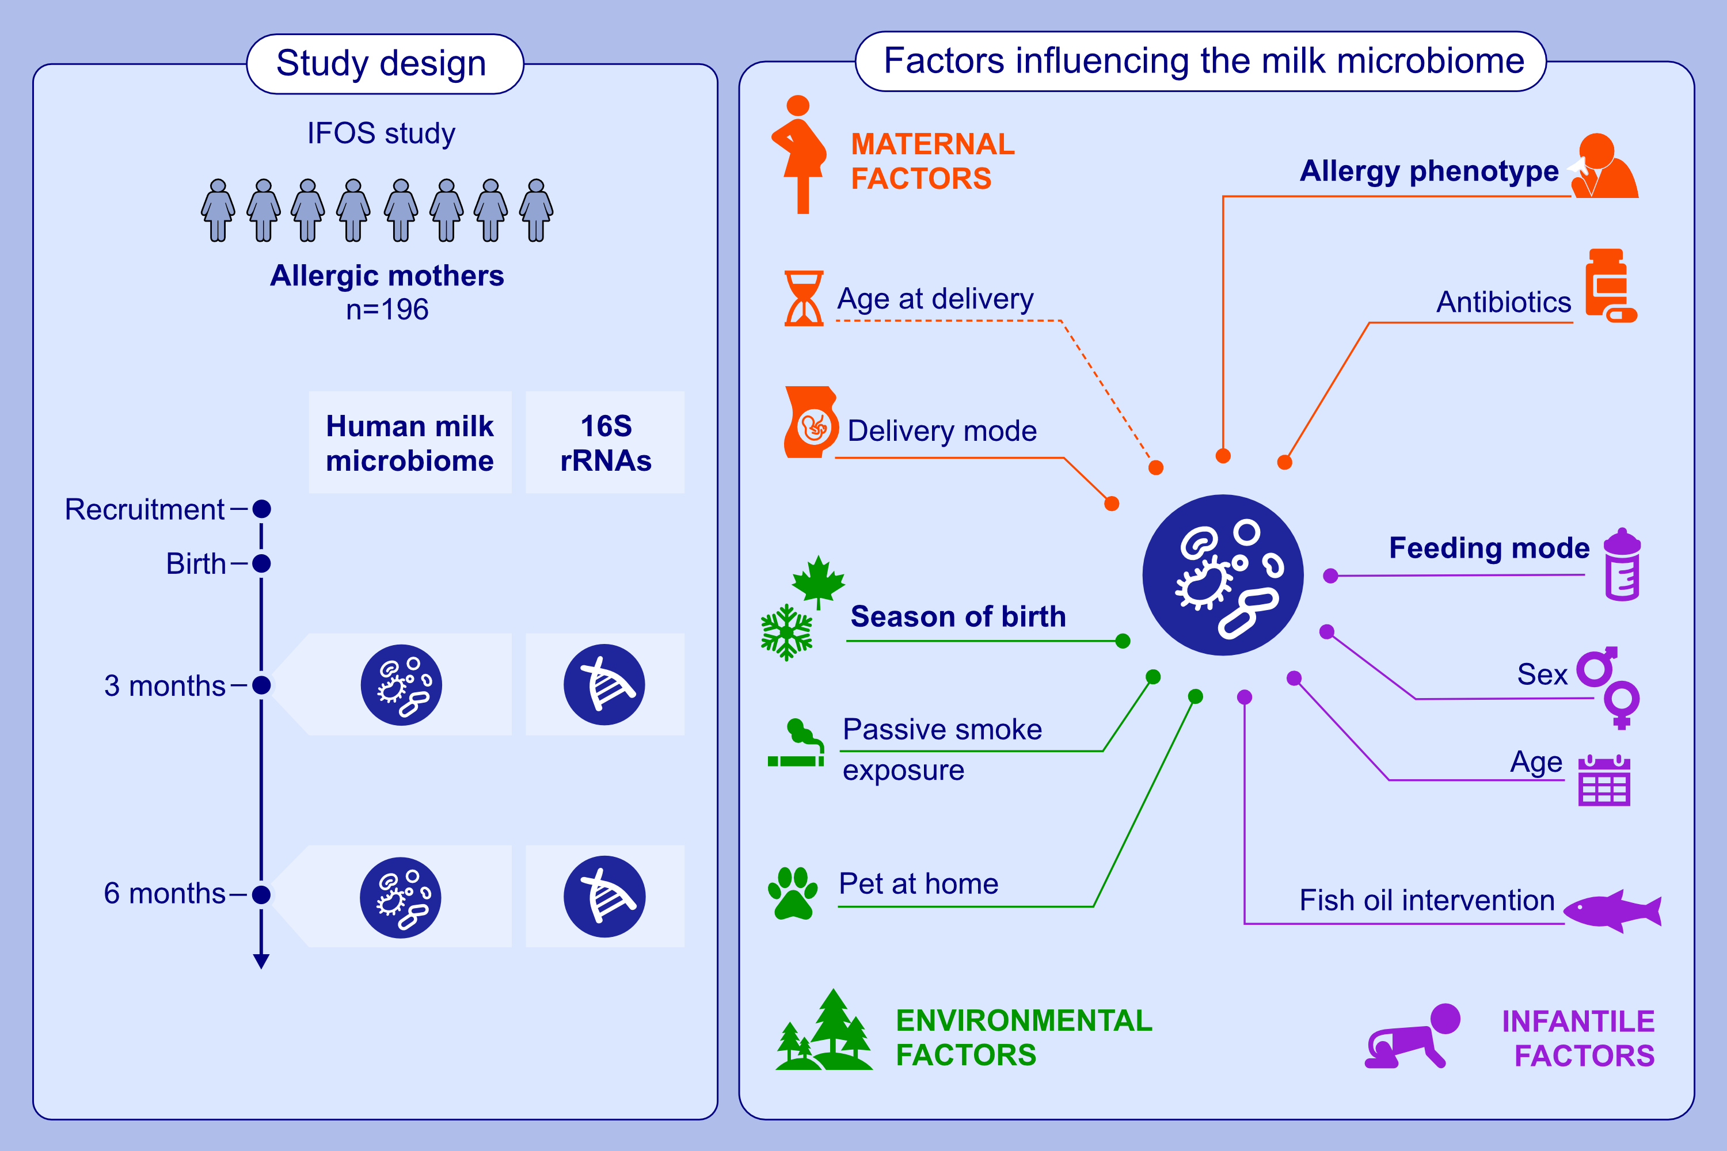
Maternal Allergic Disease Phenotype and Infant Birth Season Influence the Human Milk Microbiome
Jie Ma, Debra J. Palmer, Donna Geddes, Ching Tat Lai, Alethea Rea, et al.
Allergy. Pages:1967-1981
https://doi.org/10.1111/all.16442
© 2019 EAACI and John Wiley and Sons A/S. Published by John Wiley and Sons Ltd.
Notes:
HIGHLIGHTS
• This study aims to identify maternal, infantile, and environmental determinants of the milk microbiome in a large cohort of allergic mothers. • Season of infant birth is the strongest determinant for the milk microbiome of allergic mothers.
• The milk microbiome also varied according to the type of maternal allergic disease. • Exclusive breastfeeding significantly lower milk microbiome richness. .

