Slide 1
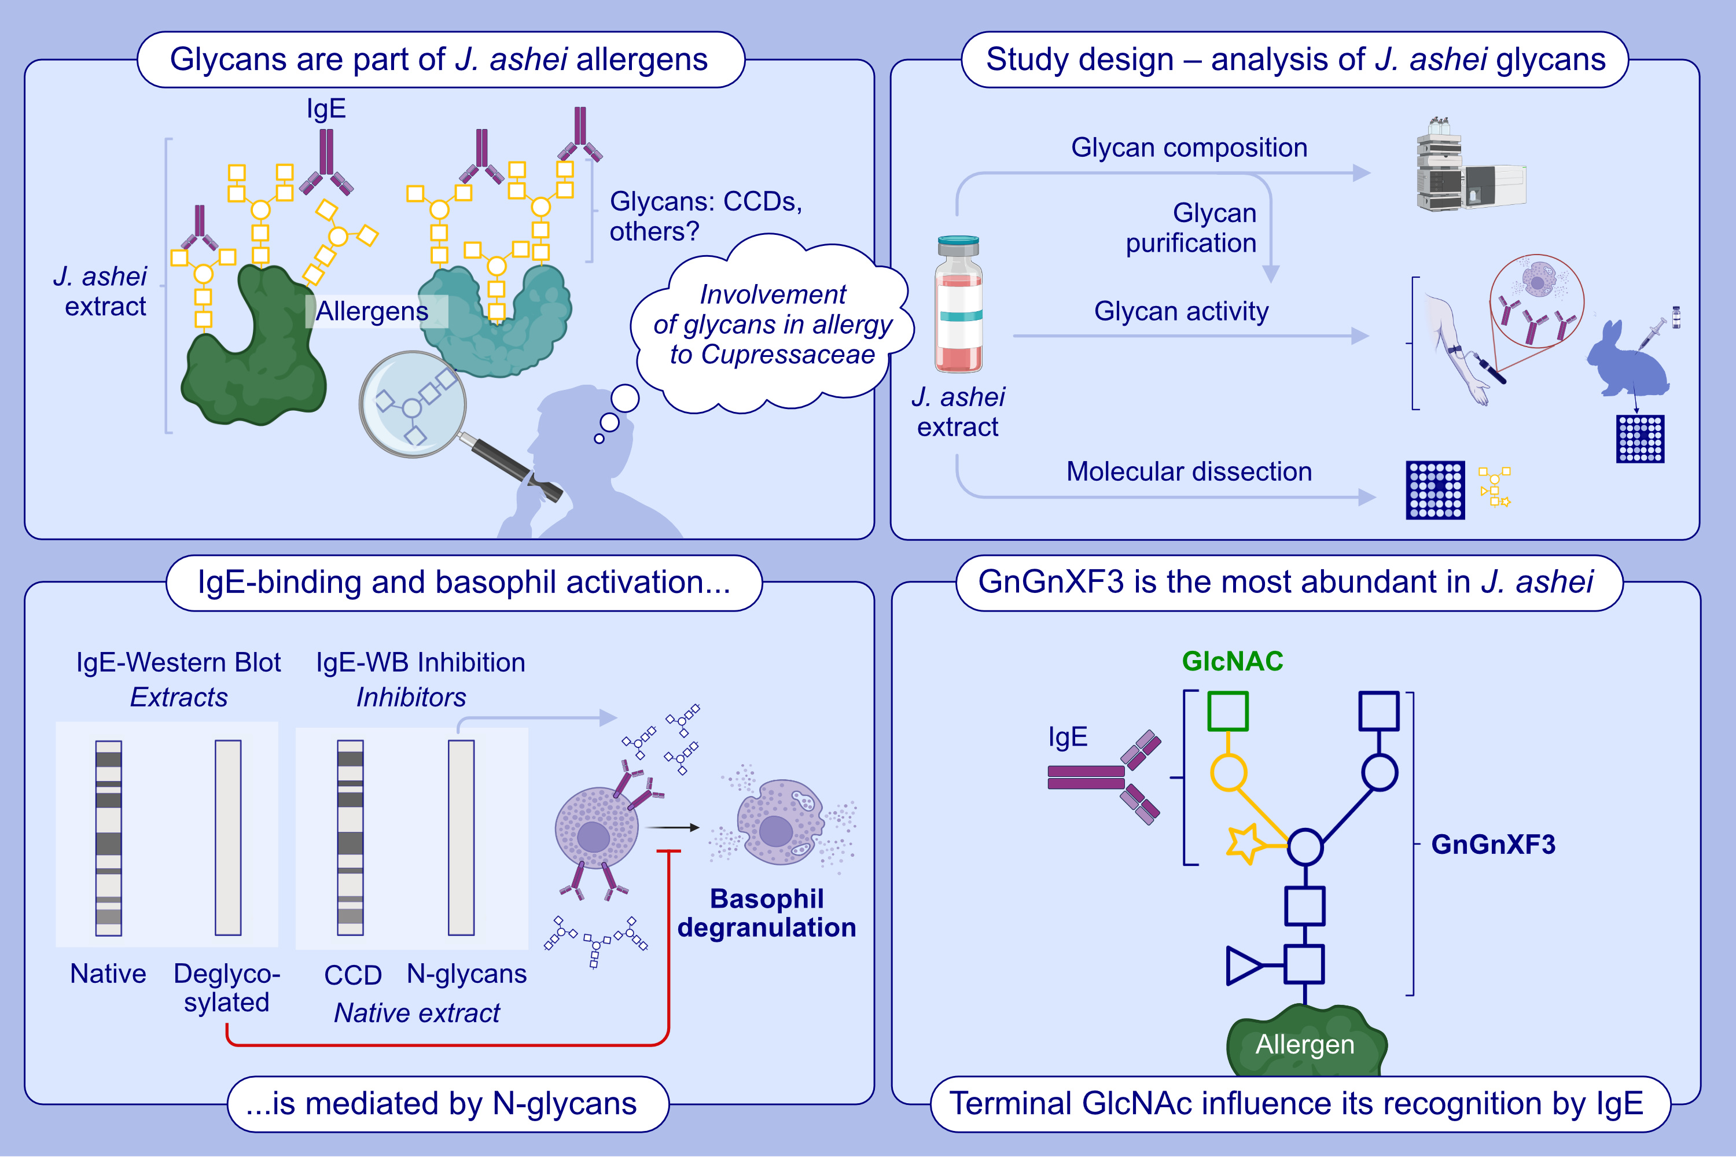
Correlation Between N-Glycan GnGnXF3 and the Allergic Immune Response Against Juniperus ashei Pollen
Javier Álvarez, Nuria Parody, David Calzada, Tamara Aranda, Ana Renshaw, et al.
Allergy. Pages:1935-1944
https://doi.org/10.1111/all.16475
© 2019 EAACI and John Wiley and Sons A/S. Published by John Wiley and Sons Ltd.
Notes:
HIGHLIGHTS
• IgE-binding to Juniperus ashei allergens is mediated by N-glycans different to classic CCDs. •N-glycan from J. ashei pollen triggers basophil activation. •GnGnXF3 is the most abundant glycan in J. ashei extract and contains a novel IgE-glycotope. .

