Slide 1
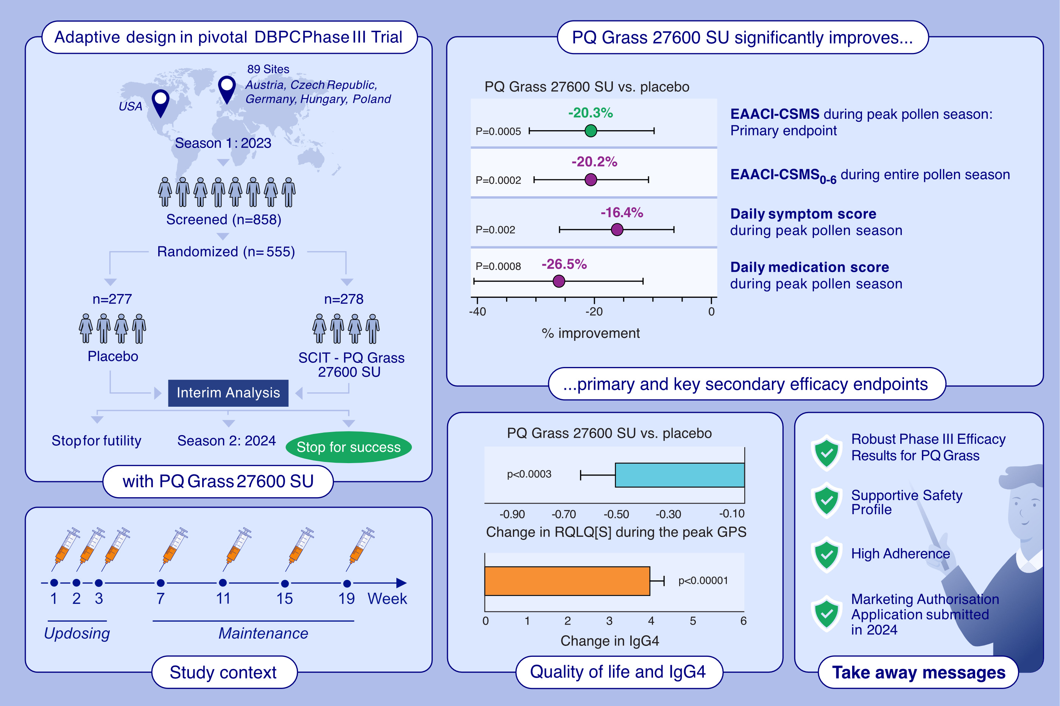
Six Injections of Modified Adjuvanted PQ Grass Is Effective and Well-Tolerated in a Pivotal Phase III Trial
Stefan Zielen, Jonathan A. Bernstein, Gunter J. Sturm, Marek Jutel, Oliver Pfaar, et al.
Allergy. Pages: 1982-1994
https://doi.org/10.1111/all.16491
© 2019 EAACI and John Wiley and Sons A/S. Published by John Wiley and Sons Ltd.
Notes:
HIGHLIGHTS
• A pivotal Phase III DBPC adaptive trial was conducted with PQ Grass 27600 SU. •The primary endpoint EAACI-CSMS0-6 demonstrated a highly significant, clinically meaningful improvement for PQ Grass of -0.27 points (95% CI: -0.42 to -0.12), corresponding to a relative difference of -20.3% (p=0.0005) over placebo. • Highly consistent secondary endpoints and a supportive safety profile was confirmed.
• .

