Slide 1
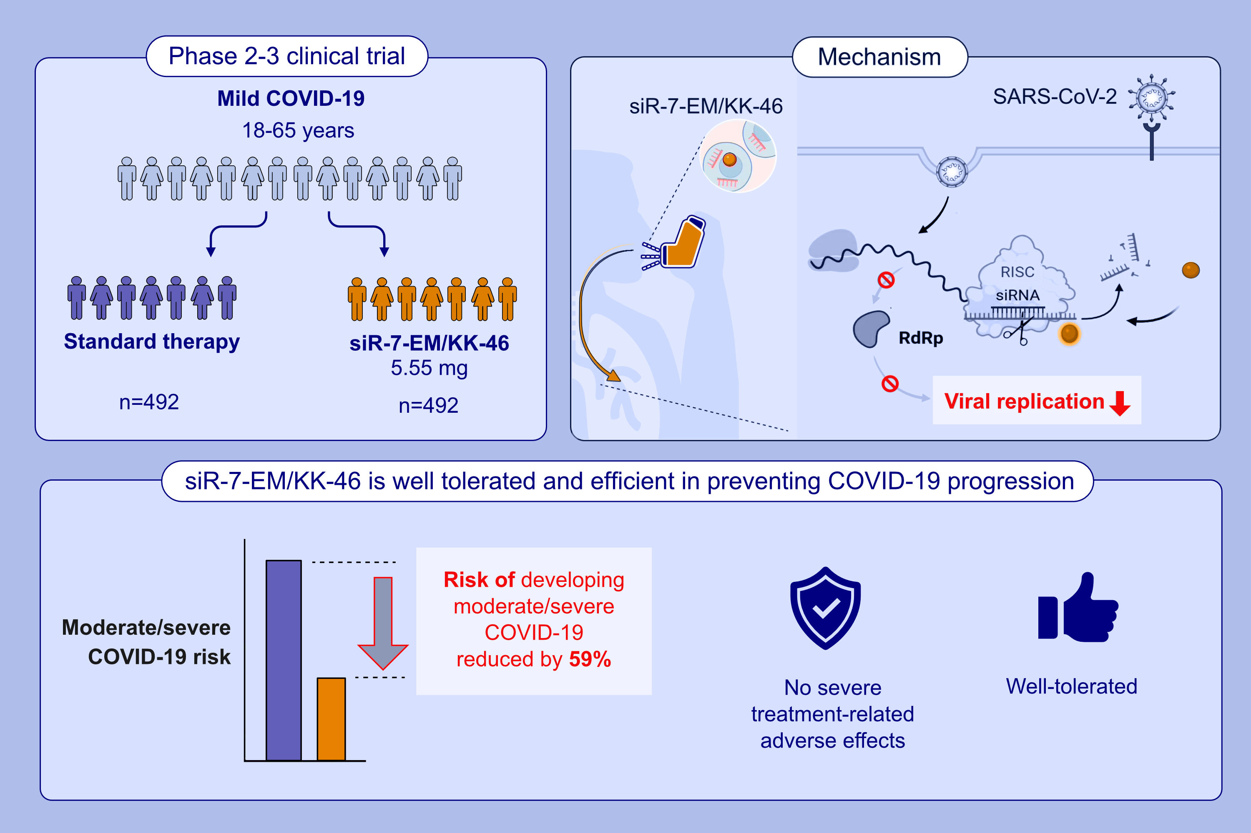
Phase 2-3 Trial: Prevention of the Progression to Moderate and Severe COVID-19 in SARS-CoV-2-Infected Non-Hospitalized Adults With Inhaled siRNA-Based MIR 19
M. Khaitov, A. Nikonova, V. Smirnov, I. Shilovsky, I. Kofiadi, et al.
Allergy. Pages: 2031-2042
https://doi.org/10.1111/all.16515
© 2019 EAACI and John Wiley and Sons A/S. Published by John Wiley and Sons Ltd.
Notes:
HIGHLIGHTS
• siR-7-EM/KK-46 (MIR 19®) is a siRNA-based anti-SARS-CoV-2 antiviral targeting viral RdRp. •In adult outpatients with mild COVID-19 inhaled 5.55 mg/day of MIR 19® reduces the risk of developing moderate/severe COVID-19 by more than 50% as compared to standard therapy. • MIR 19 ® is effective and well tolerated in non-hospitalized adult patients (18-65 years old). .

