Slide 1
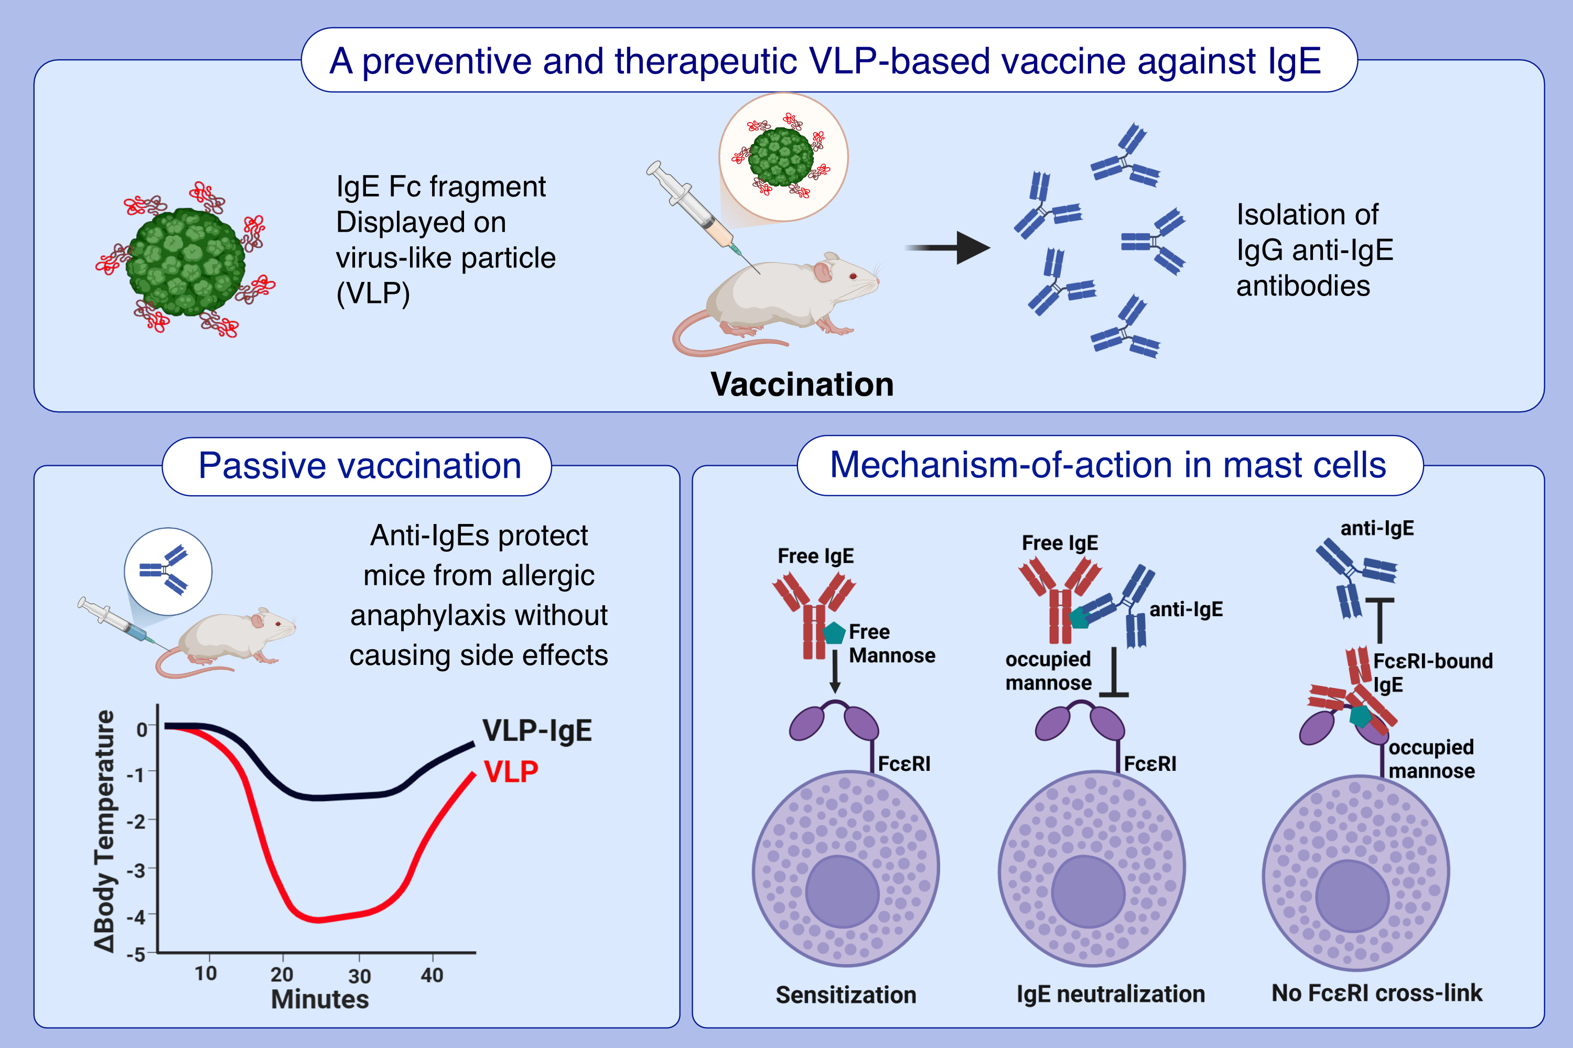
Vaccine-Induced Anti-IgE Antibodies Neutralize Free IgE but Fail to Bind and Activate Mast Cell-Displayed IgE
Zahra Gharailoo, Monique Vogel, Paul Engeroff, Martin F. Bachmann
Allergy. Pages: 1995-2007
https://doi.org/10.1111/all.16530
© 2019 EAACI and John Wiley and Sons A/S. Published by John Wiley and Sons Ltd.
Notes:
HIGHLIGHTS
• We investigated the mechanisms by which a previously established VLP-based anti-IgE vaccine protects from allergic anaphylaxis.
• We show that passively administered vaccine-induced IgGs protect mice from anaphylaxis without side effects. • In mast cells, the IgGs prevent free IgE binding to FcεRI, but fail to bind and activate FcεRI-displayed IgE.
.

