Slide 1
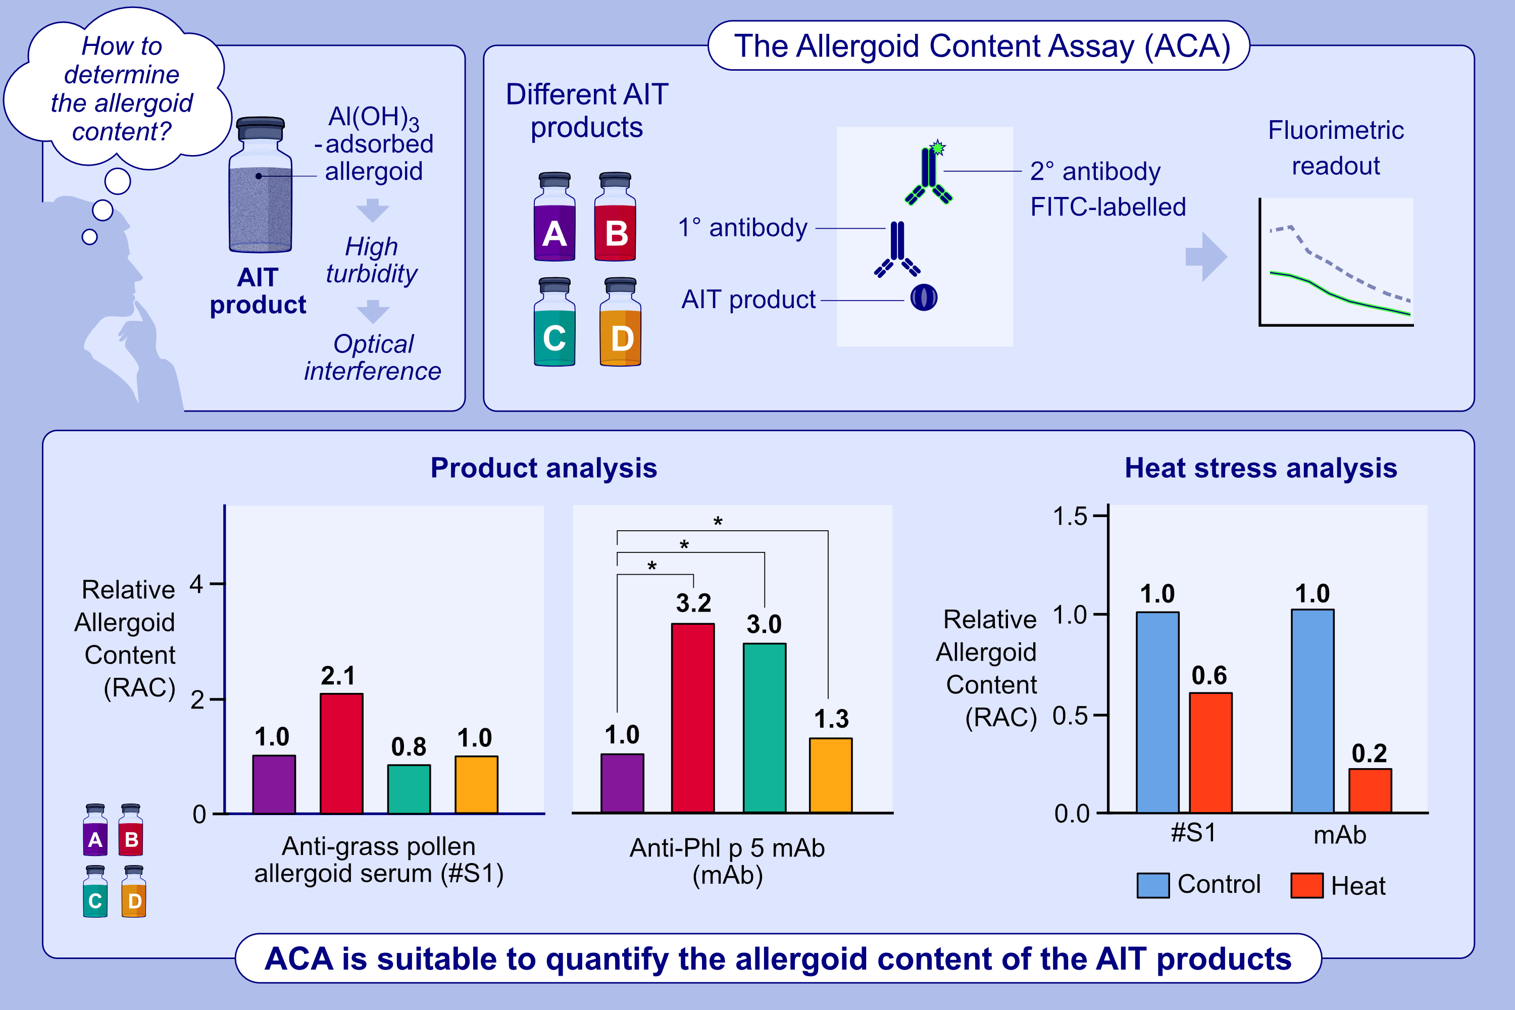
Immunological In Vitro Assay for Quantification of Adjuvanted Allergoids
S. Schlünder, J. Echternach, D. Bartel, V. Mahler, M. D. Mühlebach, et al.
Allergy. Pages: 2008-2017
https://doi.org/10.1111/all.16543
© 2019 EAACI and John Wiley and Sons A/S. Published by John Wiley and Sons Ltd.
Notes:
HIGHLIGHTS
• An assay was developed to measure the allergoid content in adjuvanted grass allergoid AIT drug product (AIT-DPs) at the finished product level. • Both polyclonal rabbit sera or a mouse anti-Phl p 5 mAb can be used, allowing differential product analysis. • All four tested grass pollen AIT-DPs of different manufacturers could be quantified using a defined reference demonstrating broad applicability of the assay. .

