Slide 1
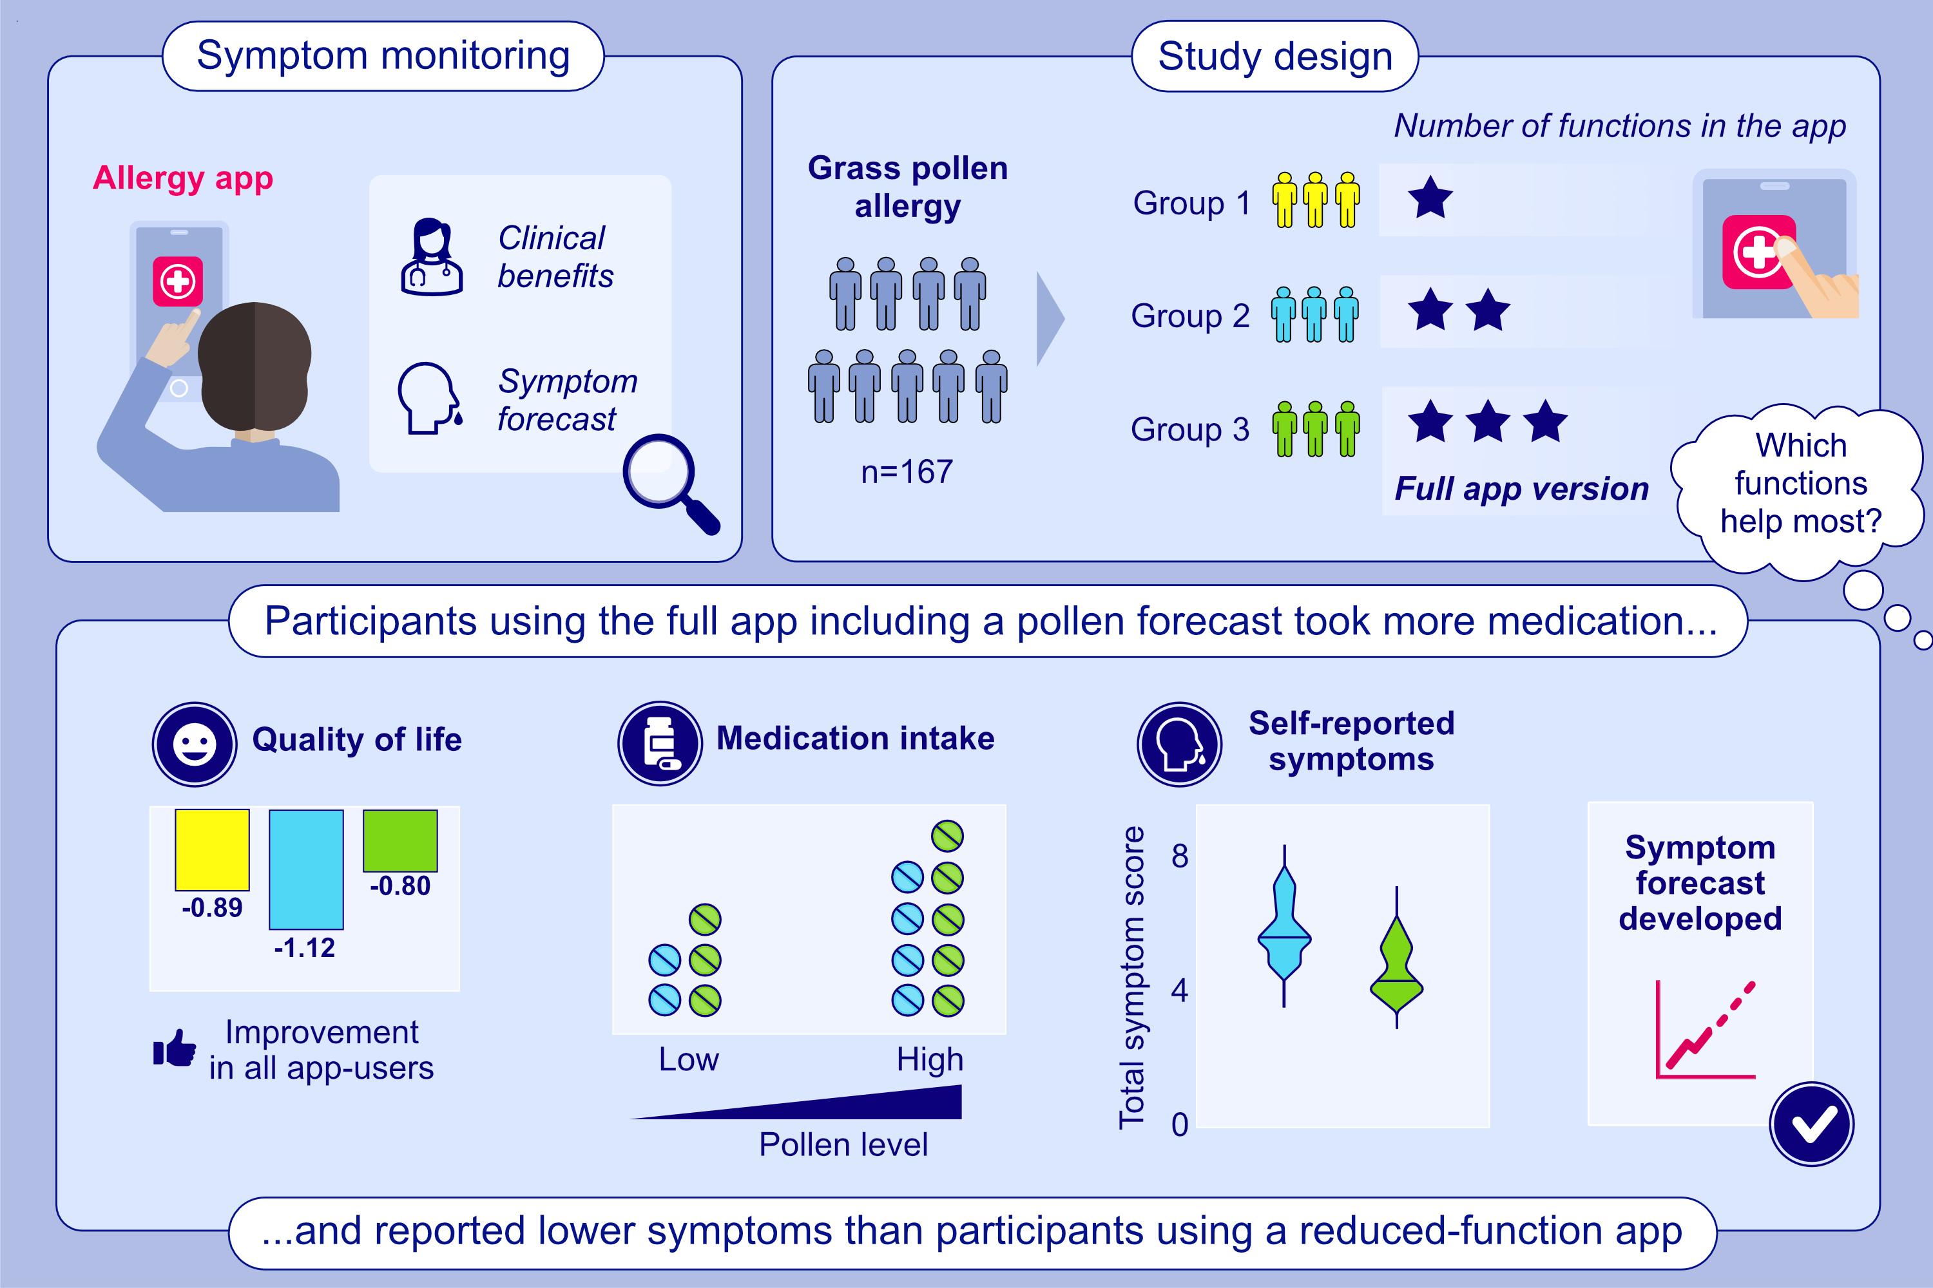
Clinical Benefits of a Randomized Allergy App Intervention in Grass Pollen Sufferers: A Controlled Trial
Caroline Holzmann, Johannes Karg, Matthias Reiger, Rajiv Kharbal, Paola Romano, et al.
Allergy. Pages: 1945-1955
https://doi.org/10.1111/all.16558
© 2019 EAACI and John Wiley and Sons A/S. Published by John Wiley and Sons Ltd.
Notes:
HIGHLIGHTS
• Different functions of an allergy app were tested for clinical benefit in a randomized, controlled trial in patients with grass pollen allergy. • Participants with pollen forecast function took more medication and had less symptoms than participants without pollen forecast. • A symptom forecast was developed based on the study data. .

