Slide 1
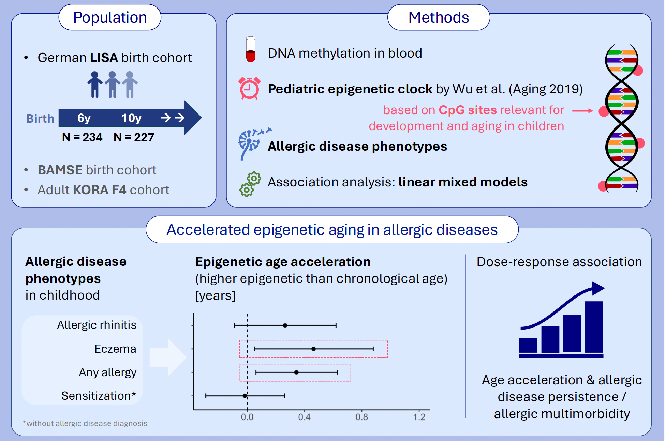
Childhood Asthma and Allergy Are Related to Accelerated Epigenetic Aging
Miriam Leskien, Elisabeth Thiering, Zhebin Yu, Anke Huels, Yueli Yao, et al.
Allergy. Pages: 1912-1922
https://doi.org/10.1111/all.16583
© 2019 EAACI and John Wiley and Sons A/S. Published by John Wiley and Sons Ltd.
Notes:
HIGHLIGHTS
• We used a pediatric epigenetic clock to assess epigenetic age in children from a German birth cohort.
• Accelerated epigenetic aging was found to be related to the presence of allergic diseases like asthma, rhinitis or eczema, but not to non-symptomatic aeroallergen sensitization.
• This was supported by an epigenetic age acceleration gradient in response to allergic disease persistence and allergic multimorbidity.
.

