Slide 1
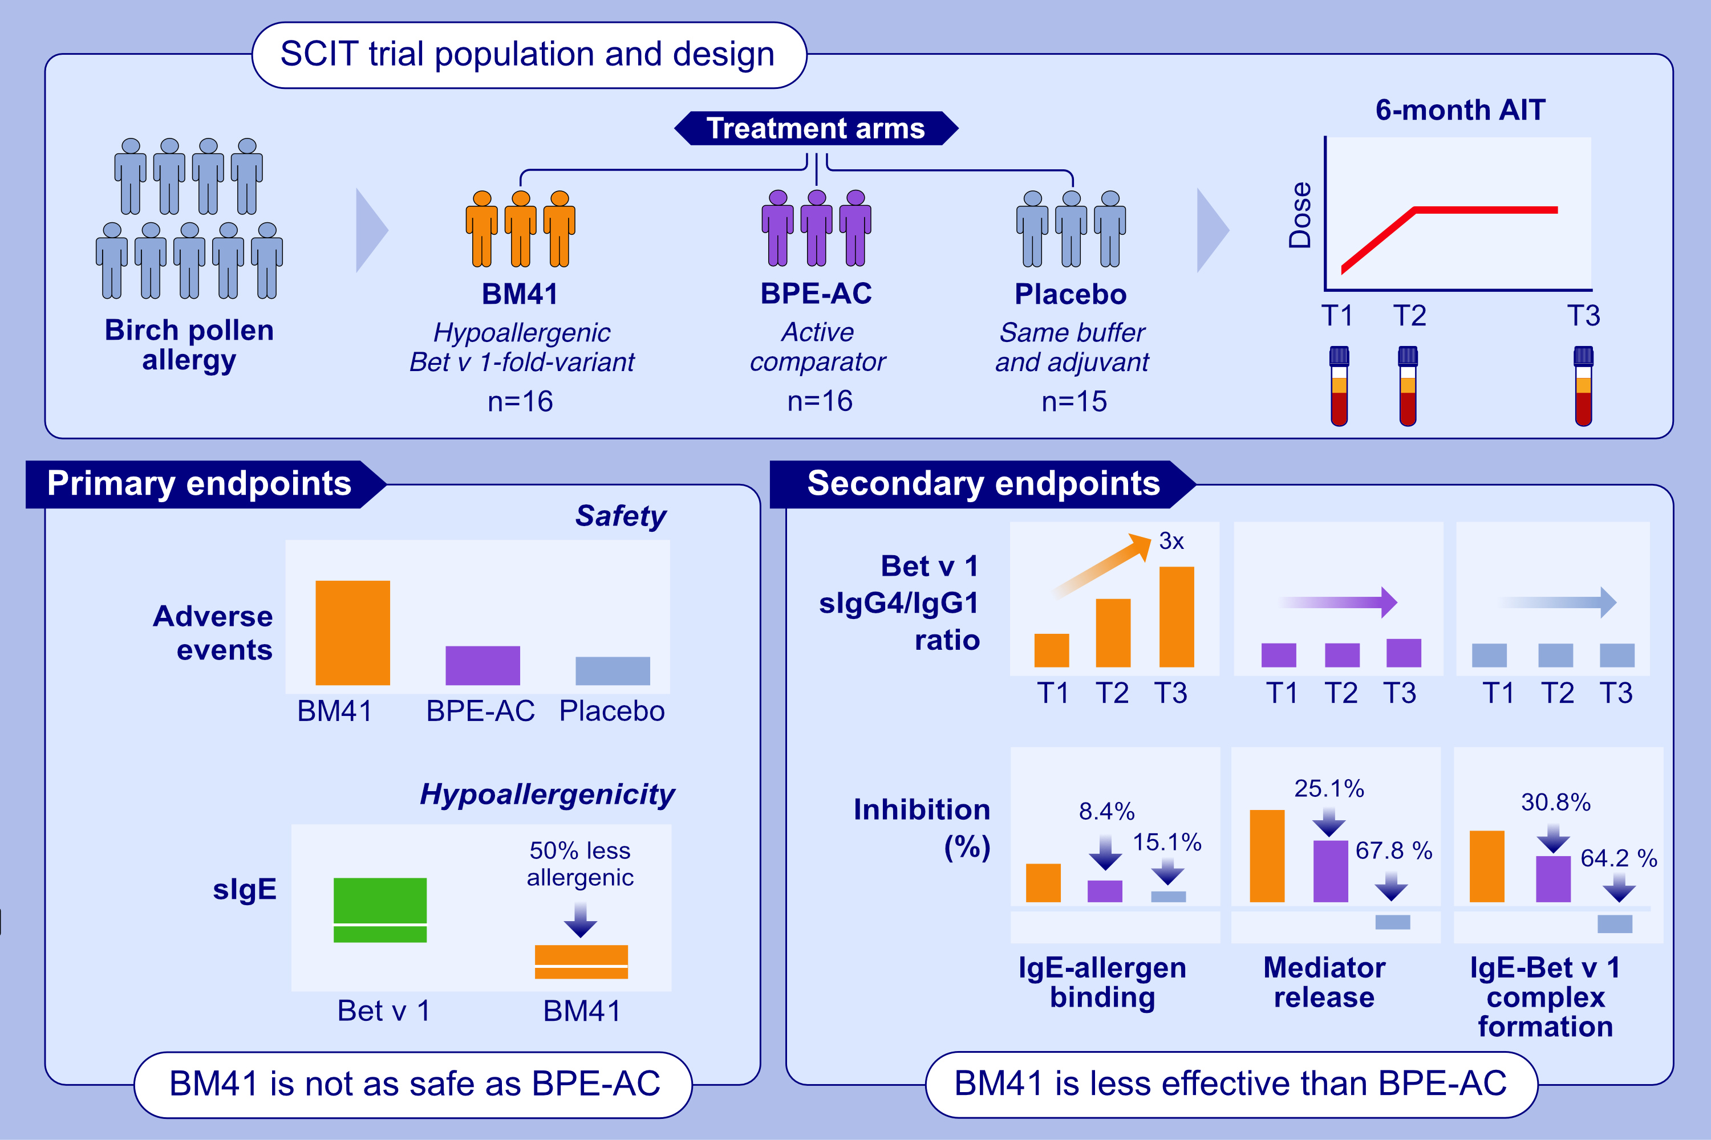
SCIT With Hypoallergenic Bet v 1 Compared to Conventional Extract: Poorer Blocking Antibody Capacity Dominated by IgG1 Instead of IgG4
Lorenz Aglas, Line Kring Tannert, Serge A. Versteeg, Scott A. Smith, Ewa A. Bartko, et al.
Allergy. issue; Pages: 2018-2030
https://doi.org/10.1111/all.16606
© 2019 EAACI and John Wiley and Sons A/S. Published by John Wiley and Sons Ltd.
Notes:
HIGHLIGHTS
• A 6-month randomized, double-blind, placebo-controlled first-in-human clinical trial was conducted in birch pollen allergic patients comparing the Bet v 1-fold-variant BM41 with a licensed birch pollen extract-based treatment, as active comparator, and placebo.
• Despite SPT-confirmed hypo-allergenicity (~50% compared to natural Bet v 1), more adverse events occurred in response to BM41. • In BPE-AC, the sIgG4/sIgG1 ratio tripled over time whereas for BM41 it stagnated.
• BM41 induced efficient serum inhibitory activity for sIgE compared to placebo but was 12-32% less efficient than BPE-AC .

