Slide 1
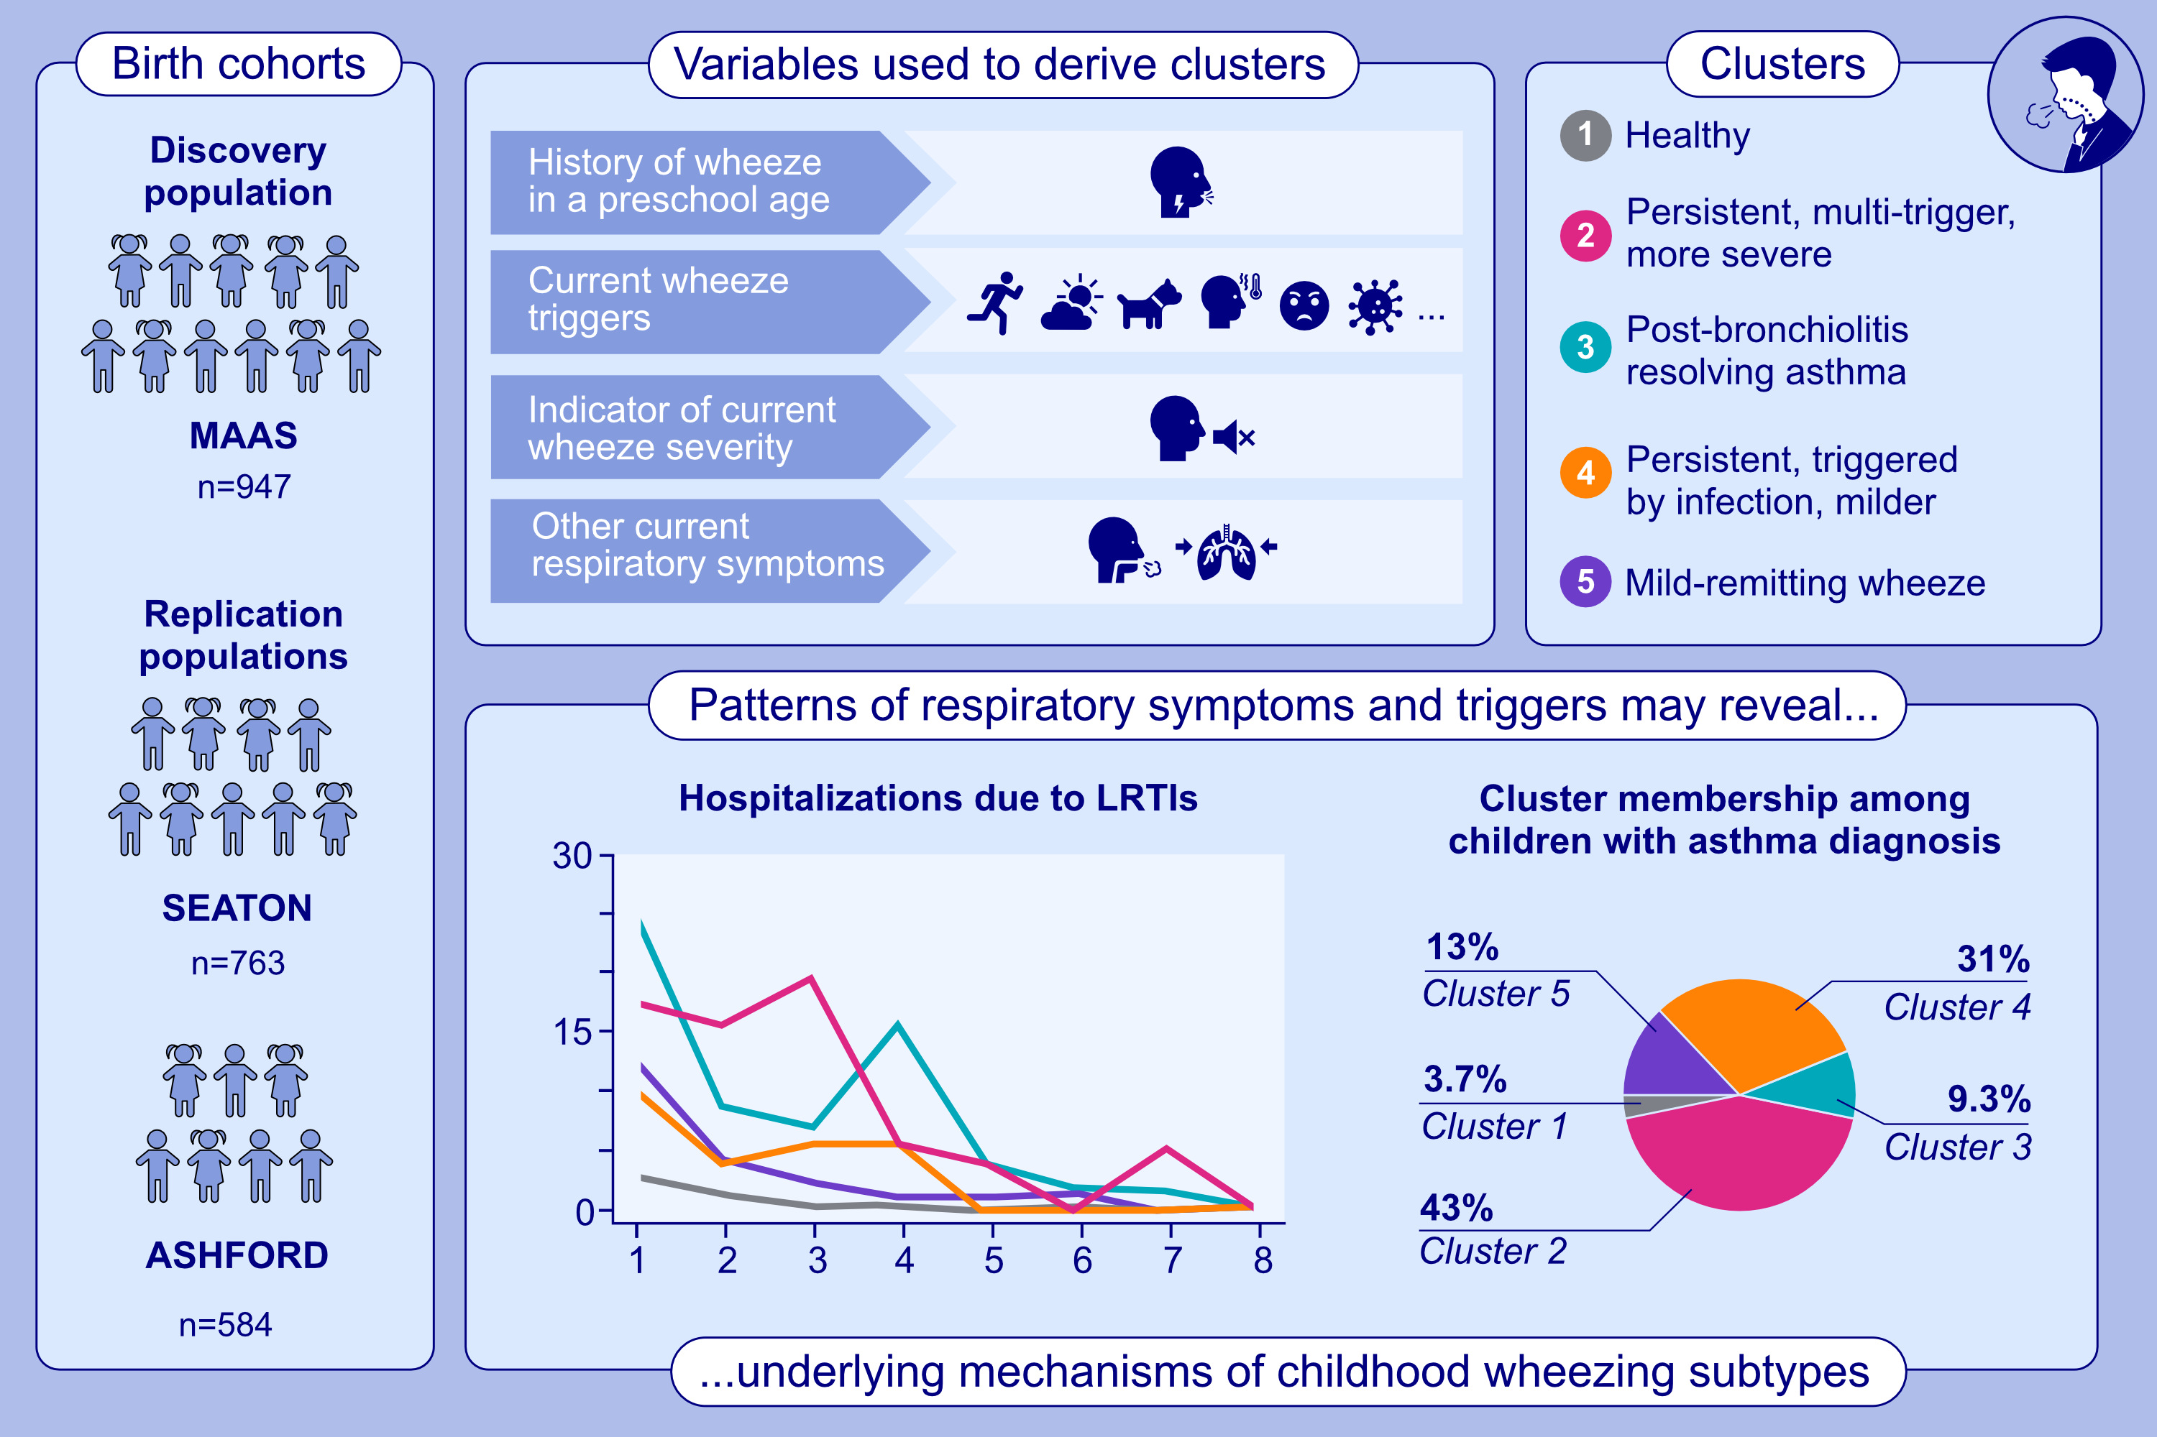
Patterns of Respiratory Symptoms and Asthma Diagnosis in School-Age Children: Three Birth Cohorts
Alex Cucco, Angela Simpson, Sadia Haider, Clare Murray, Stephen Turner, et al.
Allergy. issue; pages:1923-1934
https://doi.org/10.1111/all.16617
© 2019 EAACI and John Wiley and Sons A/S. Published by John Wiley and Sons Ltd.
Notes:
HIGHLIGHTS
• We performed guided multi-domain clustering of symptoms and triggers in school-age children across three birth cohorts. • Using 15 variables, five clusters were identified. Two clusters showed a high prevalence of asthma with persistent symptoms.
• Questions on shortness of breath and chest tightness upon awakening were key to identifying “Post-bronchiolitis resolving asthma”. .

