Slide 1
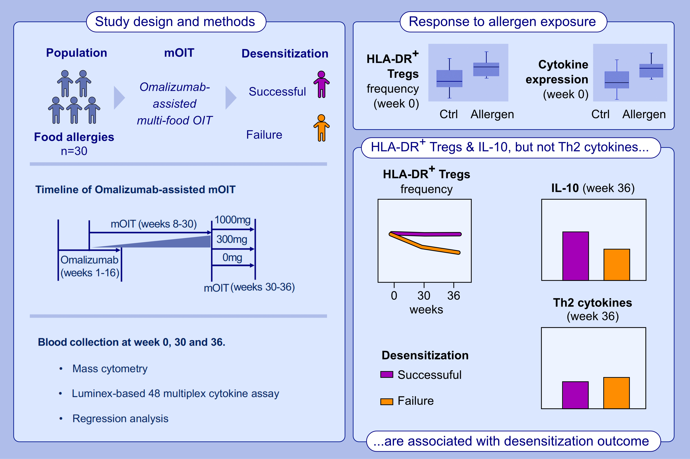
HLA-DR+ regulatory T cells and IL-10 are associated with success or failure of desensitization outcomes
Xiaoying Zhou, Diane Dunham, Sayantani B. Sindher, Andrew Long, Andrea Fernandes, et al.
Allergy. 2025;Pages: 762-774
https://doi.org/10.1111/all.16311
© 2019 EAACI and John Wiley and Sons A/S. Published by John Wiley and Sons Ltd.
Notes:
HIGHLIGHTS
• HLA-DR+ Treg cells, Th2 cytokines and IL-10 cytokine are responsive to allergen exposure.
• The allergen-responsive HLA-DR+ Treg cells and IL-10 cytokine are associated with desensitization outcome (success or failure of desensitization).
• The allergen responsive Th2 cytokines did not show significant differences between participants with success versus failure of desensitization, although omalizumab-assisted mOIT significantly reduced Th2 cytokine production.
• .

