Slide 1
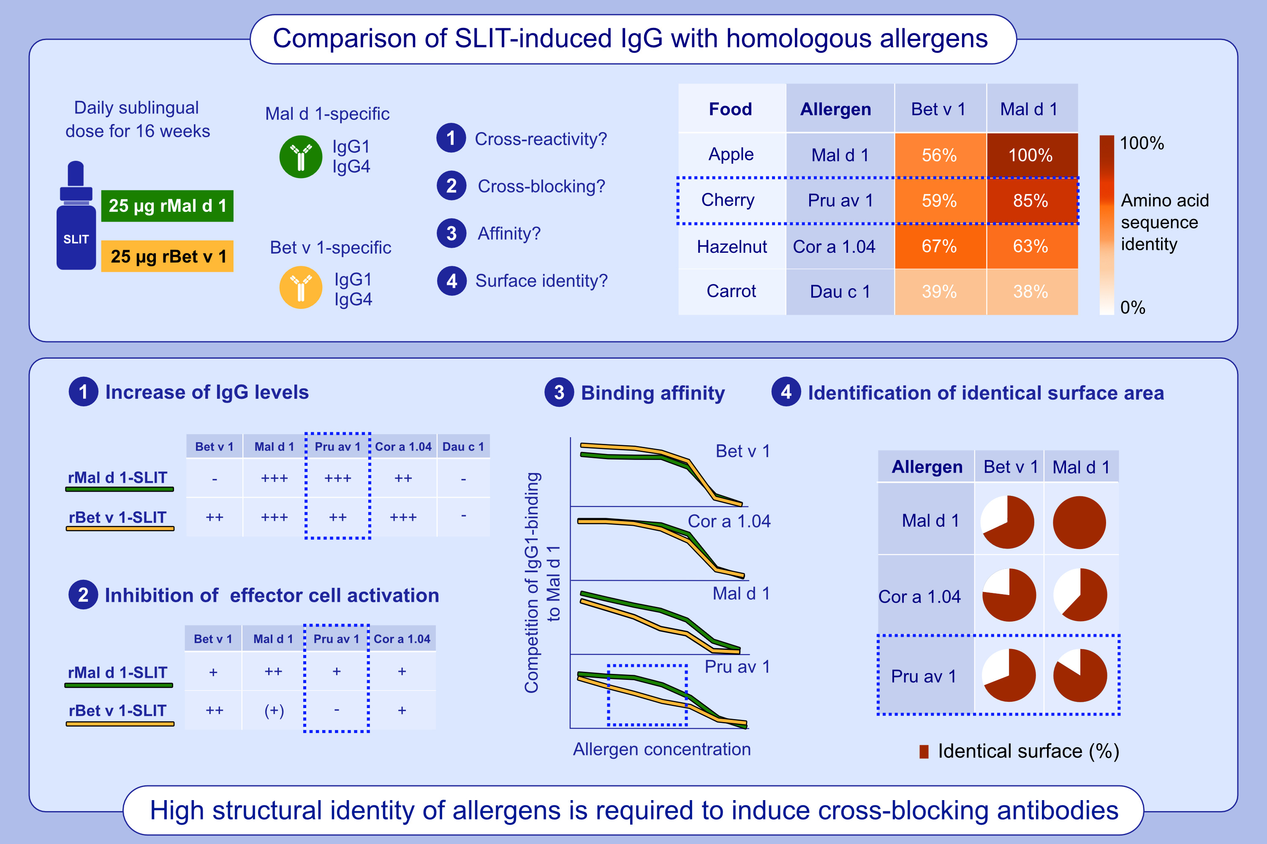
Cross-protection of allergen immunotherapy-induced antibodies to related allergens requires a high degree of structural identity
Hilal Demir, Christian Radauer, Maria R. Strobl, Stephan Scheurer, Tamar Kinaciyan, et al.
Allergy. 2025; Pages: 785-794
https://doi.org/10.1111/all.16323
© 2019 EAACI and John Wiley and Sons A/S. Published by John Wiley and Sons Ltd.
Notes:
HIGHLIGHTS
• Pru av 1 and Cor a 1.04 served to immunologically characterize IgG induced by SLIT with rMal d 1 or rBet v 1.
• Pru av 1 is more identical to Mal d 1 than to Bet v 1, the identity of Cor a 1.04 to both allergens is comparable.
• Either SLIT induced cross-reactive IgG, only rMal d 1-SLIT-induced IgG blocked IgE-binding to Pru av 1.
• Cross-blocking correlated with stronger binding-force and higher surface identity of allergens.
.

