Slide 1
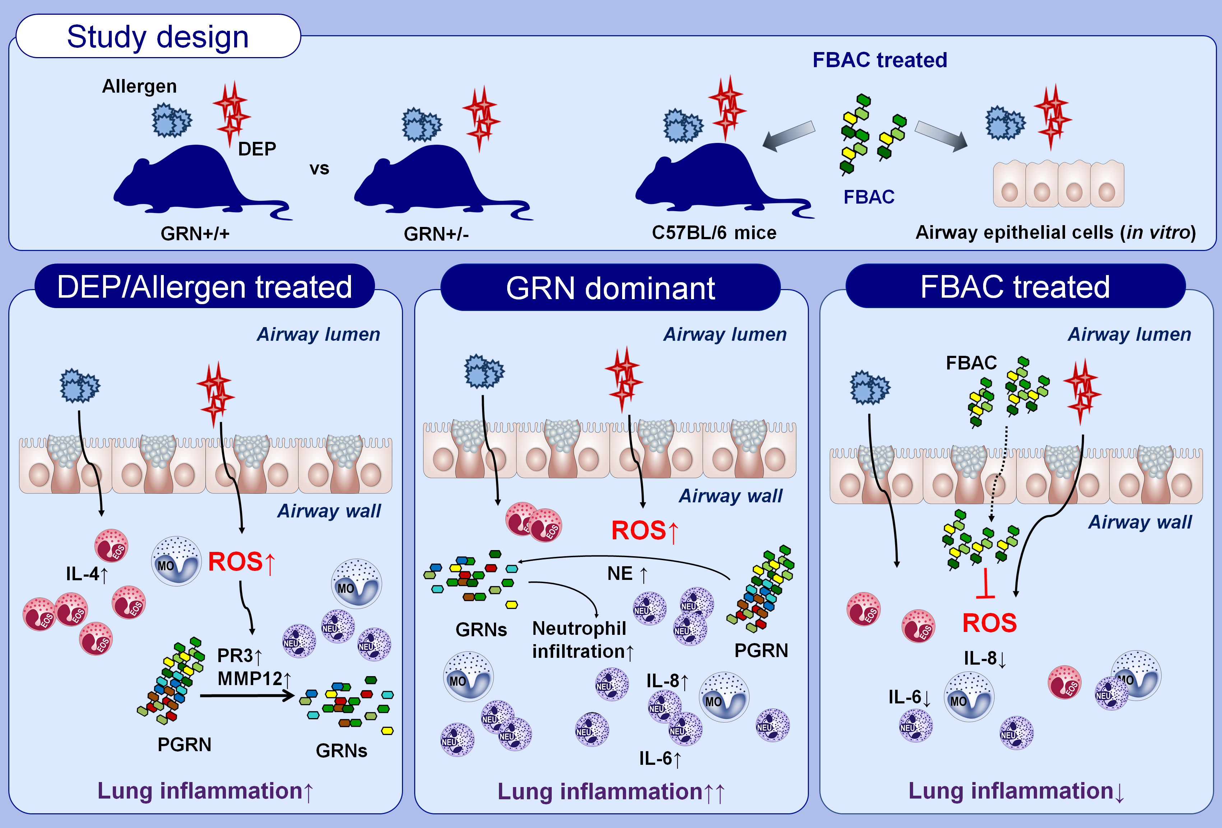
Progranulin derivative attenuates lung neutrophilic infiltration from diesel exhaust particle exposure
A. Ryang Lee, Mini Jeong, Kyomoon Koo, Sin-Jeong Kim, Min Ju Pyo, et al.
Allergy. 2025; Pages: 703-714
https://doi.org/10.1111/all.16362
© 2019 EAACI and John Wiley and Sons A/S. Published by John Wiley and Sons Ltd.
Notes:
HIGHLIGHTS
In a murine model of asthma, DEP treatment exacerbated neutrophil infiltration and allergic airway inflammation by increasing intracellular ROS.
Treatment with a PGRN-derived fragment (FBAC) attenuated the DEP-induced allergic airway inflammation by reducing intracellular ROS.
PGRN-derived fragments may represent a novel therapeutic strategy for asthmatic patients residing in areas with high levels of air pollutants.

