Slide 1
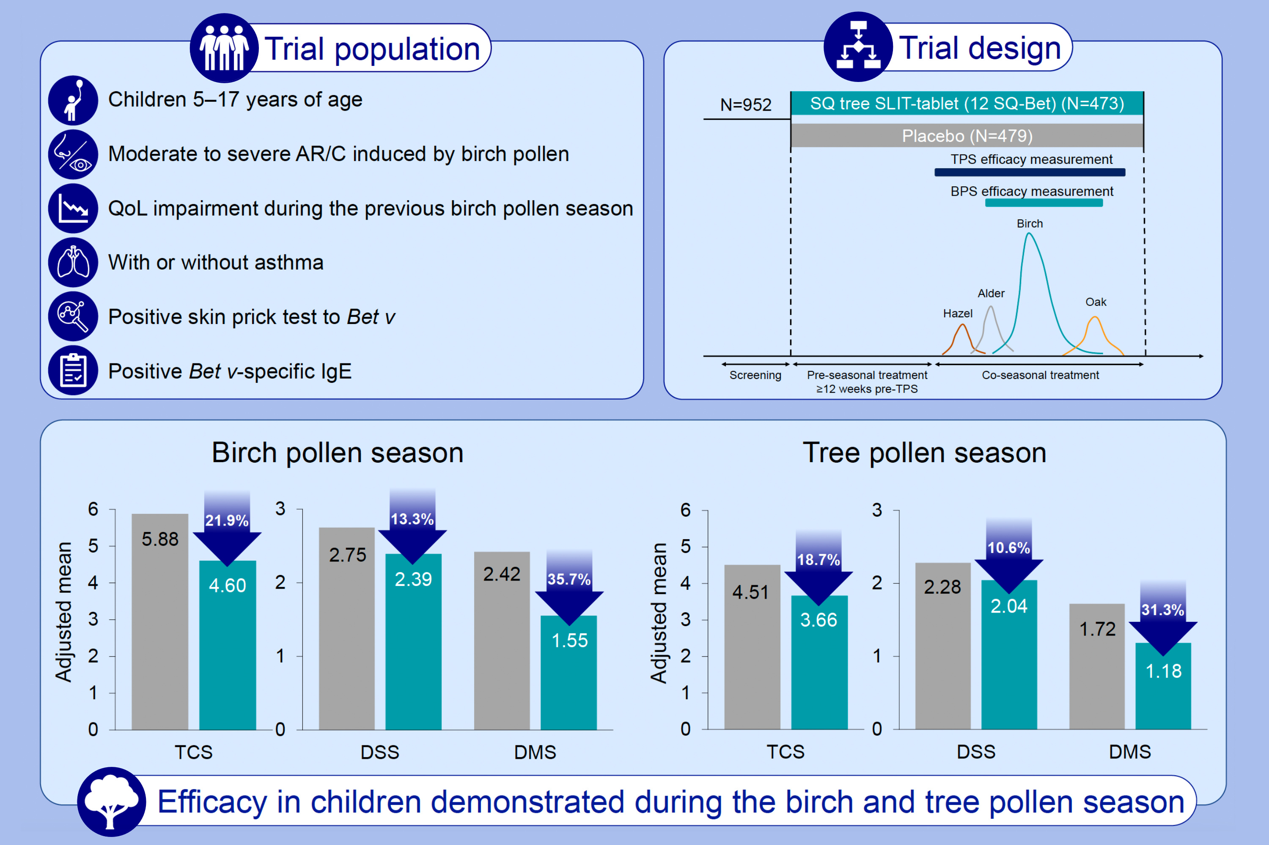
The SQ tree sublingual immunotherapy tablet is effective and well tolerated in children—A pivotal phase III trial
Monika Gappa, Rémi Gagnon, Fritz Horak, Ewa Cichocka-Jarosz, Terrie Dalgaard, et al.
Allergy. 2025; Pages: 795-806
https://doi.org/10.1111/all.16363
© 2019 EAACI and John Wiley and Sons A/S. Published by John Wiley and Sons Ltd.
Notes:
HIGHLIGHTS
• Phase III efficacy and safety trial of SQ tree SLIT-tablet vs placebo in 952 children (5-17 years) with birch pollen induced AR/C (birch homologous group).
• SQ tree SLIT-tablet demonstrated a statistically significant and clinically relevant treatment effect with a reduction in the combined symptom and medication score during both birch and tree pollen seasons.
• Treatment was generally well-tolerated.
.

