Slide 1
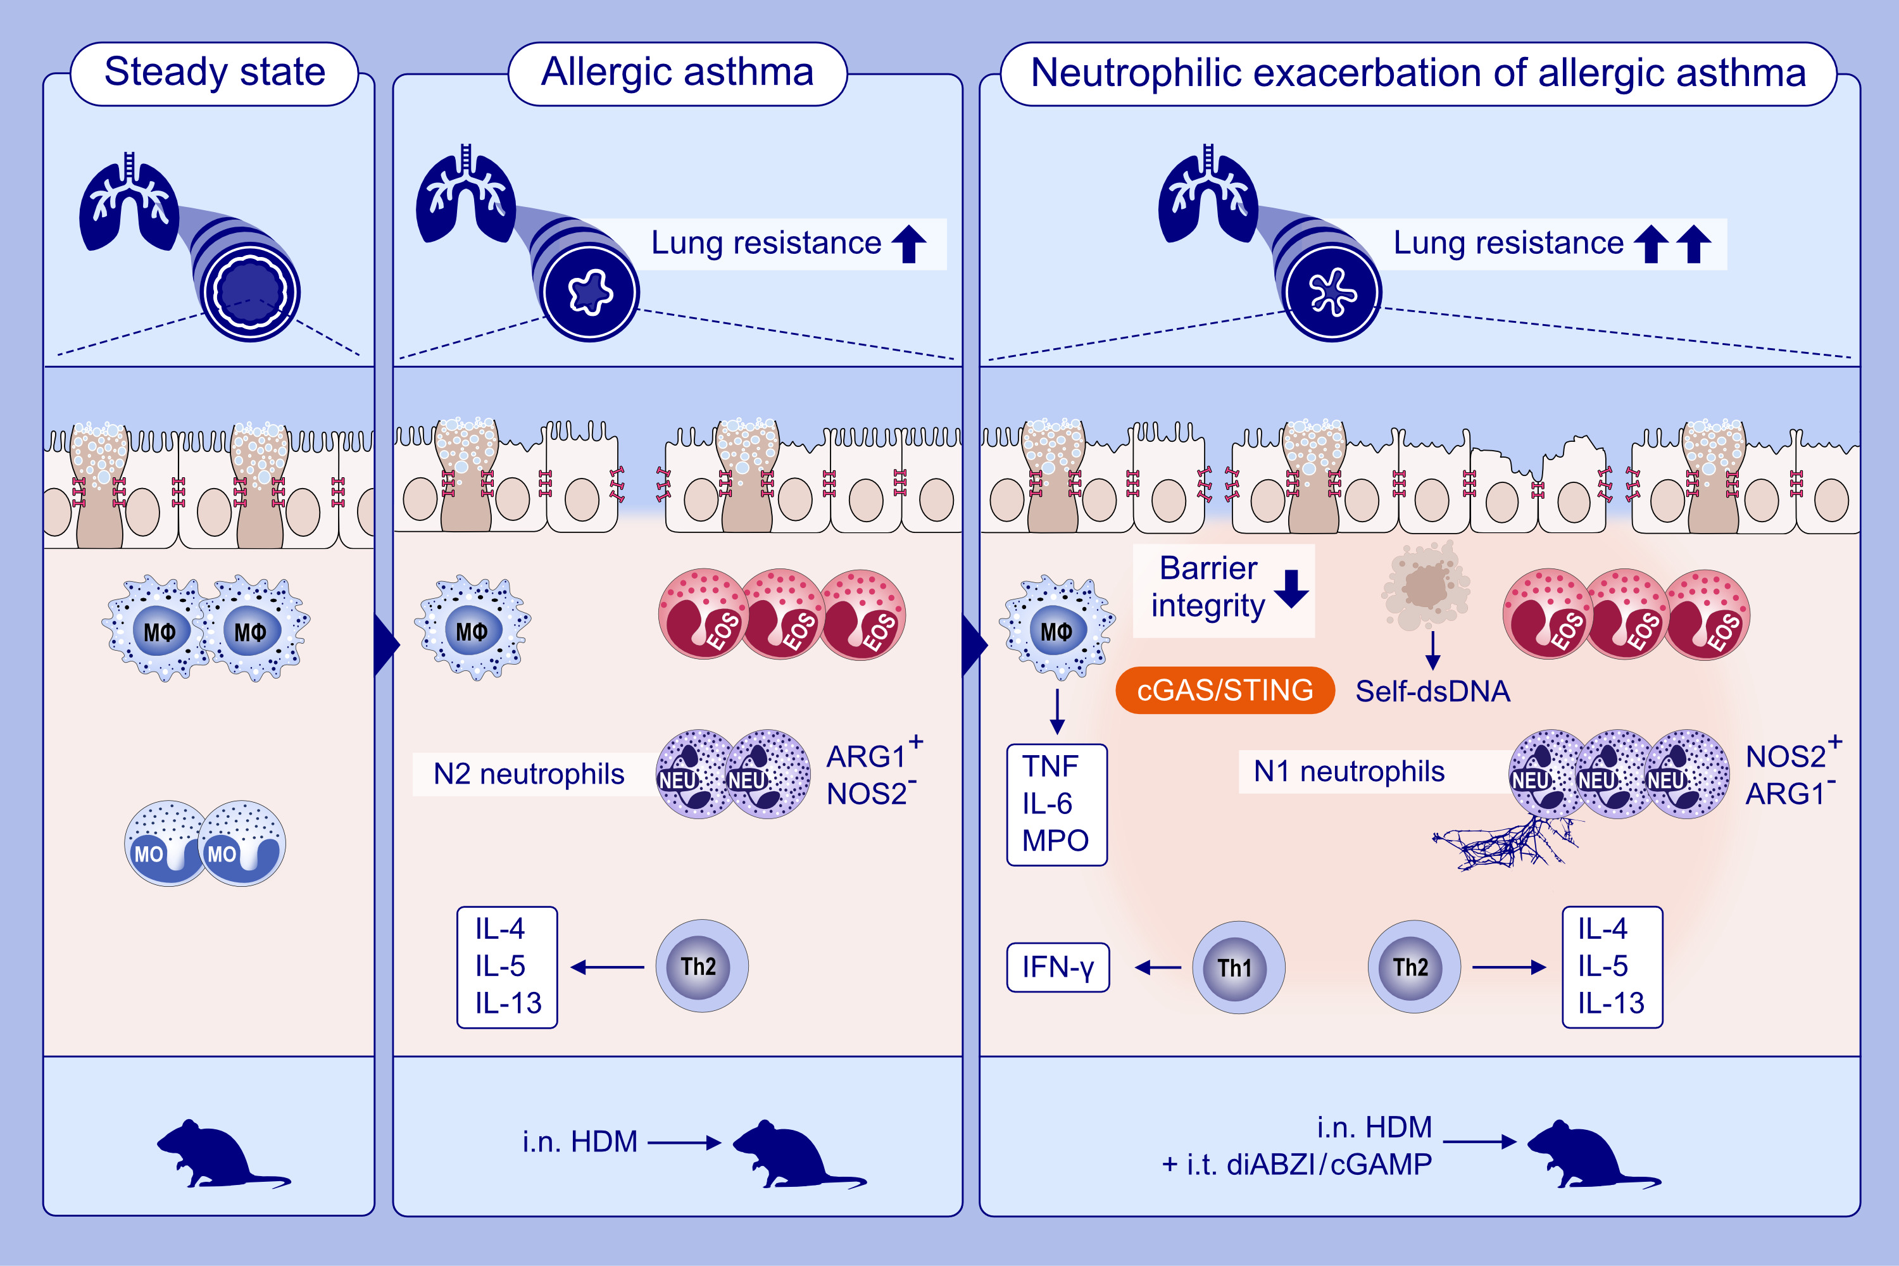
STING-dependent induction of neutrophilic asthma exacerbation in response to house dust mite
Yasmine Messaoud-Nacer, Elodie Culerier, Stéphanie Rose, Isabelle Maillet, Rania Boussad, et al.
Allergy. 2025; Pages: 715-737
https://doi.org/10.1111/all.16369
© 2019 EAACI and John Wiley and Sons A/S. Published by John Wiley and Sons Ltd.
Notes:
HIGHLIGHTS
• This study investigates whether STING-induced neutrophilic lung inflammation mimics severe asthma.
• STING activation during allergic challenge triggers neutrophilic asthma accompanied by a Th1 and pro-inflammatory cytokine in addition to the Th2 cytokines resulting in an epithelial barrier damage, cell death and self-dsDNA release with increased mucus hypersecretion.
• STING agonists induce N2 (ARG1+NOS2-) versus N1 (NOS2+ARG1-) neutrophil polarization and NETs formation.
• .

