Slide 1
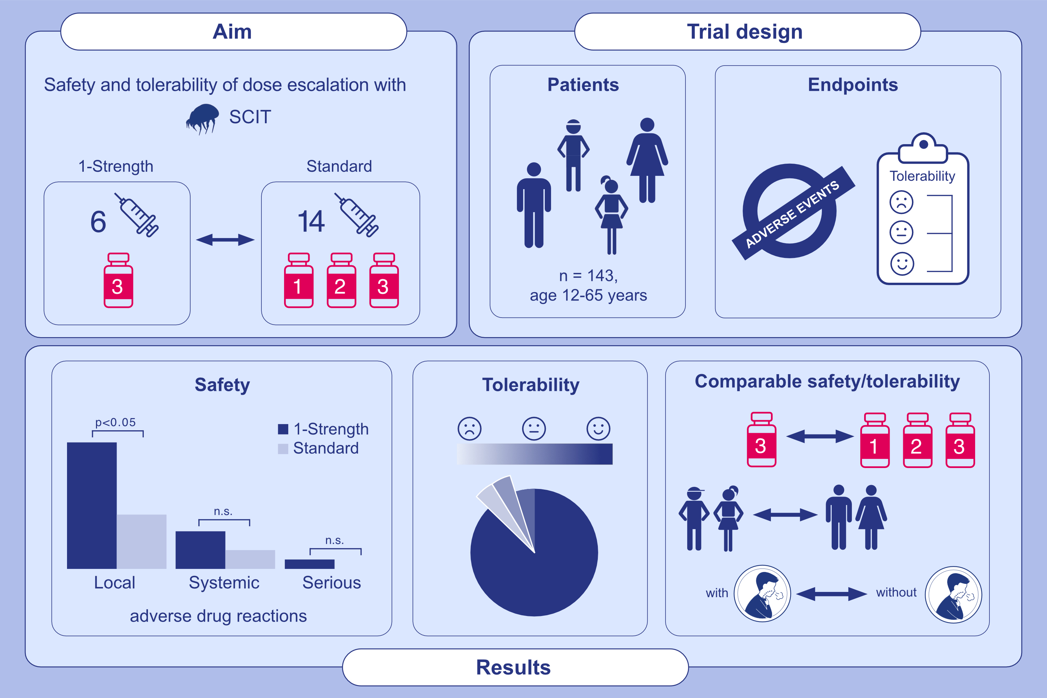
One-strength dose escalation of house dust mite depot product for subcutaneous immunotherapy is safe and tolerable
M. Jutel, C. Vogelberg, K. Duwensee, D. Troyke, L. Klimek et al.
Allergy. 2025; Pages:807-816
https://doi.org/10.1111/all.16370
© 2019 EAACI and John Wiley and Sons A/S. Published by John Wiley and Sons Ltd.
Notes:
HIGHLIGHTS
• This study evaluated safety and tolerability of house dust mite SCIT during dose escalation with a new One-Strength regimen (6 injections, Strength 3) compared to the Standard regimen (14 injections, Strengths 1-3) in adults and adolescents.
• Safety and tolerability were comparable between the two regimens, adults and adolescents, as well as asthmatics and the total population. .

