Slide 1
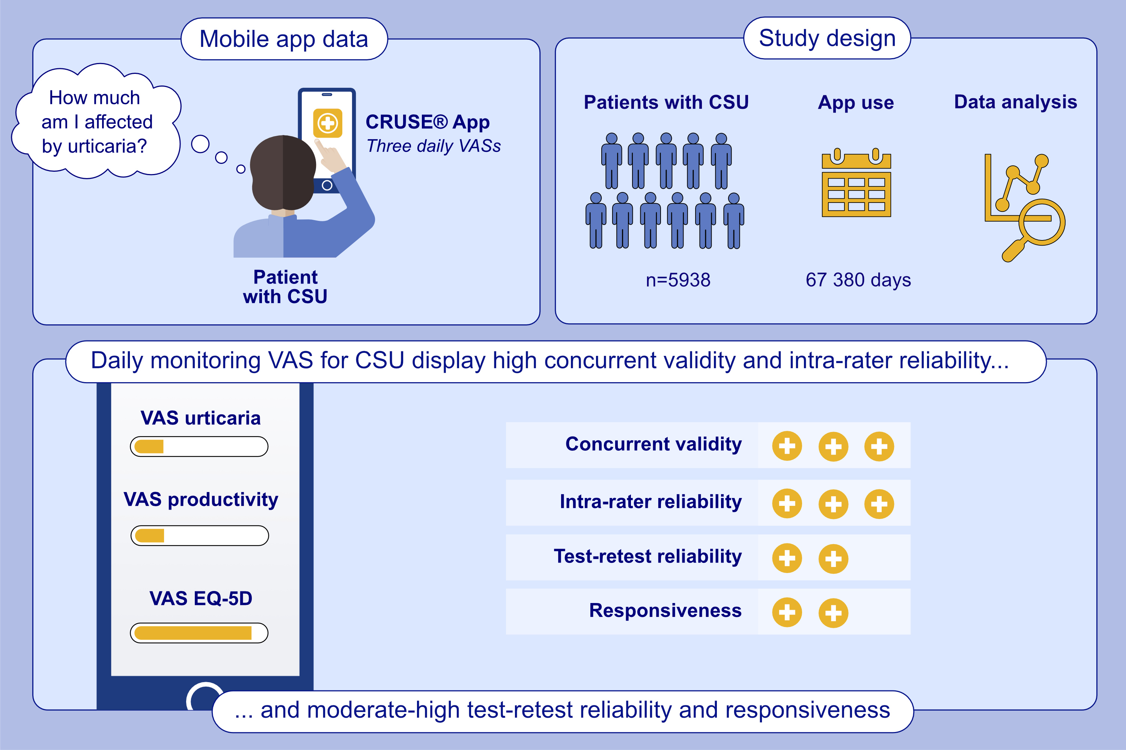
Validity, reliability and responsiveness of digital visual analogue scales for chronic spontaneous urticaria monitoring: A CRUSE® mobile health study
Bernardo Sousa-Pinto, Aiste Ramanauskaite, Sophia Neisinger, Ellen Witte-Händel, Ana M. Gimenez-Arnau, et al.
Allergy. 2025; Pages: 750-761
https://doi.org/10.1111/all.16371
© 2019 EAACI and John Wiley and Sons A/S. Published by John Wiley and Sons Ltd.
Notes:
HIGHLIGHTS
• CRUSE® is a mobile app in which patients with chronic spontaneous urticaria can register their daily symptoms through three VASs.
• This study assesses the concurrent validity, reliability and responsiveness of the three VASs available in the daily monitoring questionnaire of the CRUSE® app.
• The VASs of CRUSE app display high concurrent validity and intra-rater reliability, as well as moderate-high test-retest reliability and responsiveness.
•
.

