Slide 1
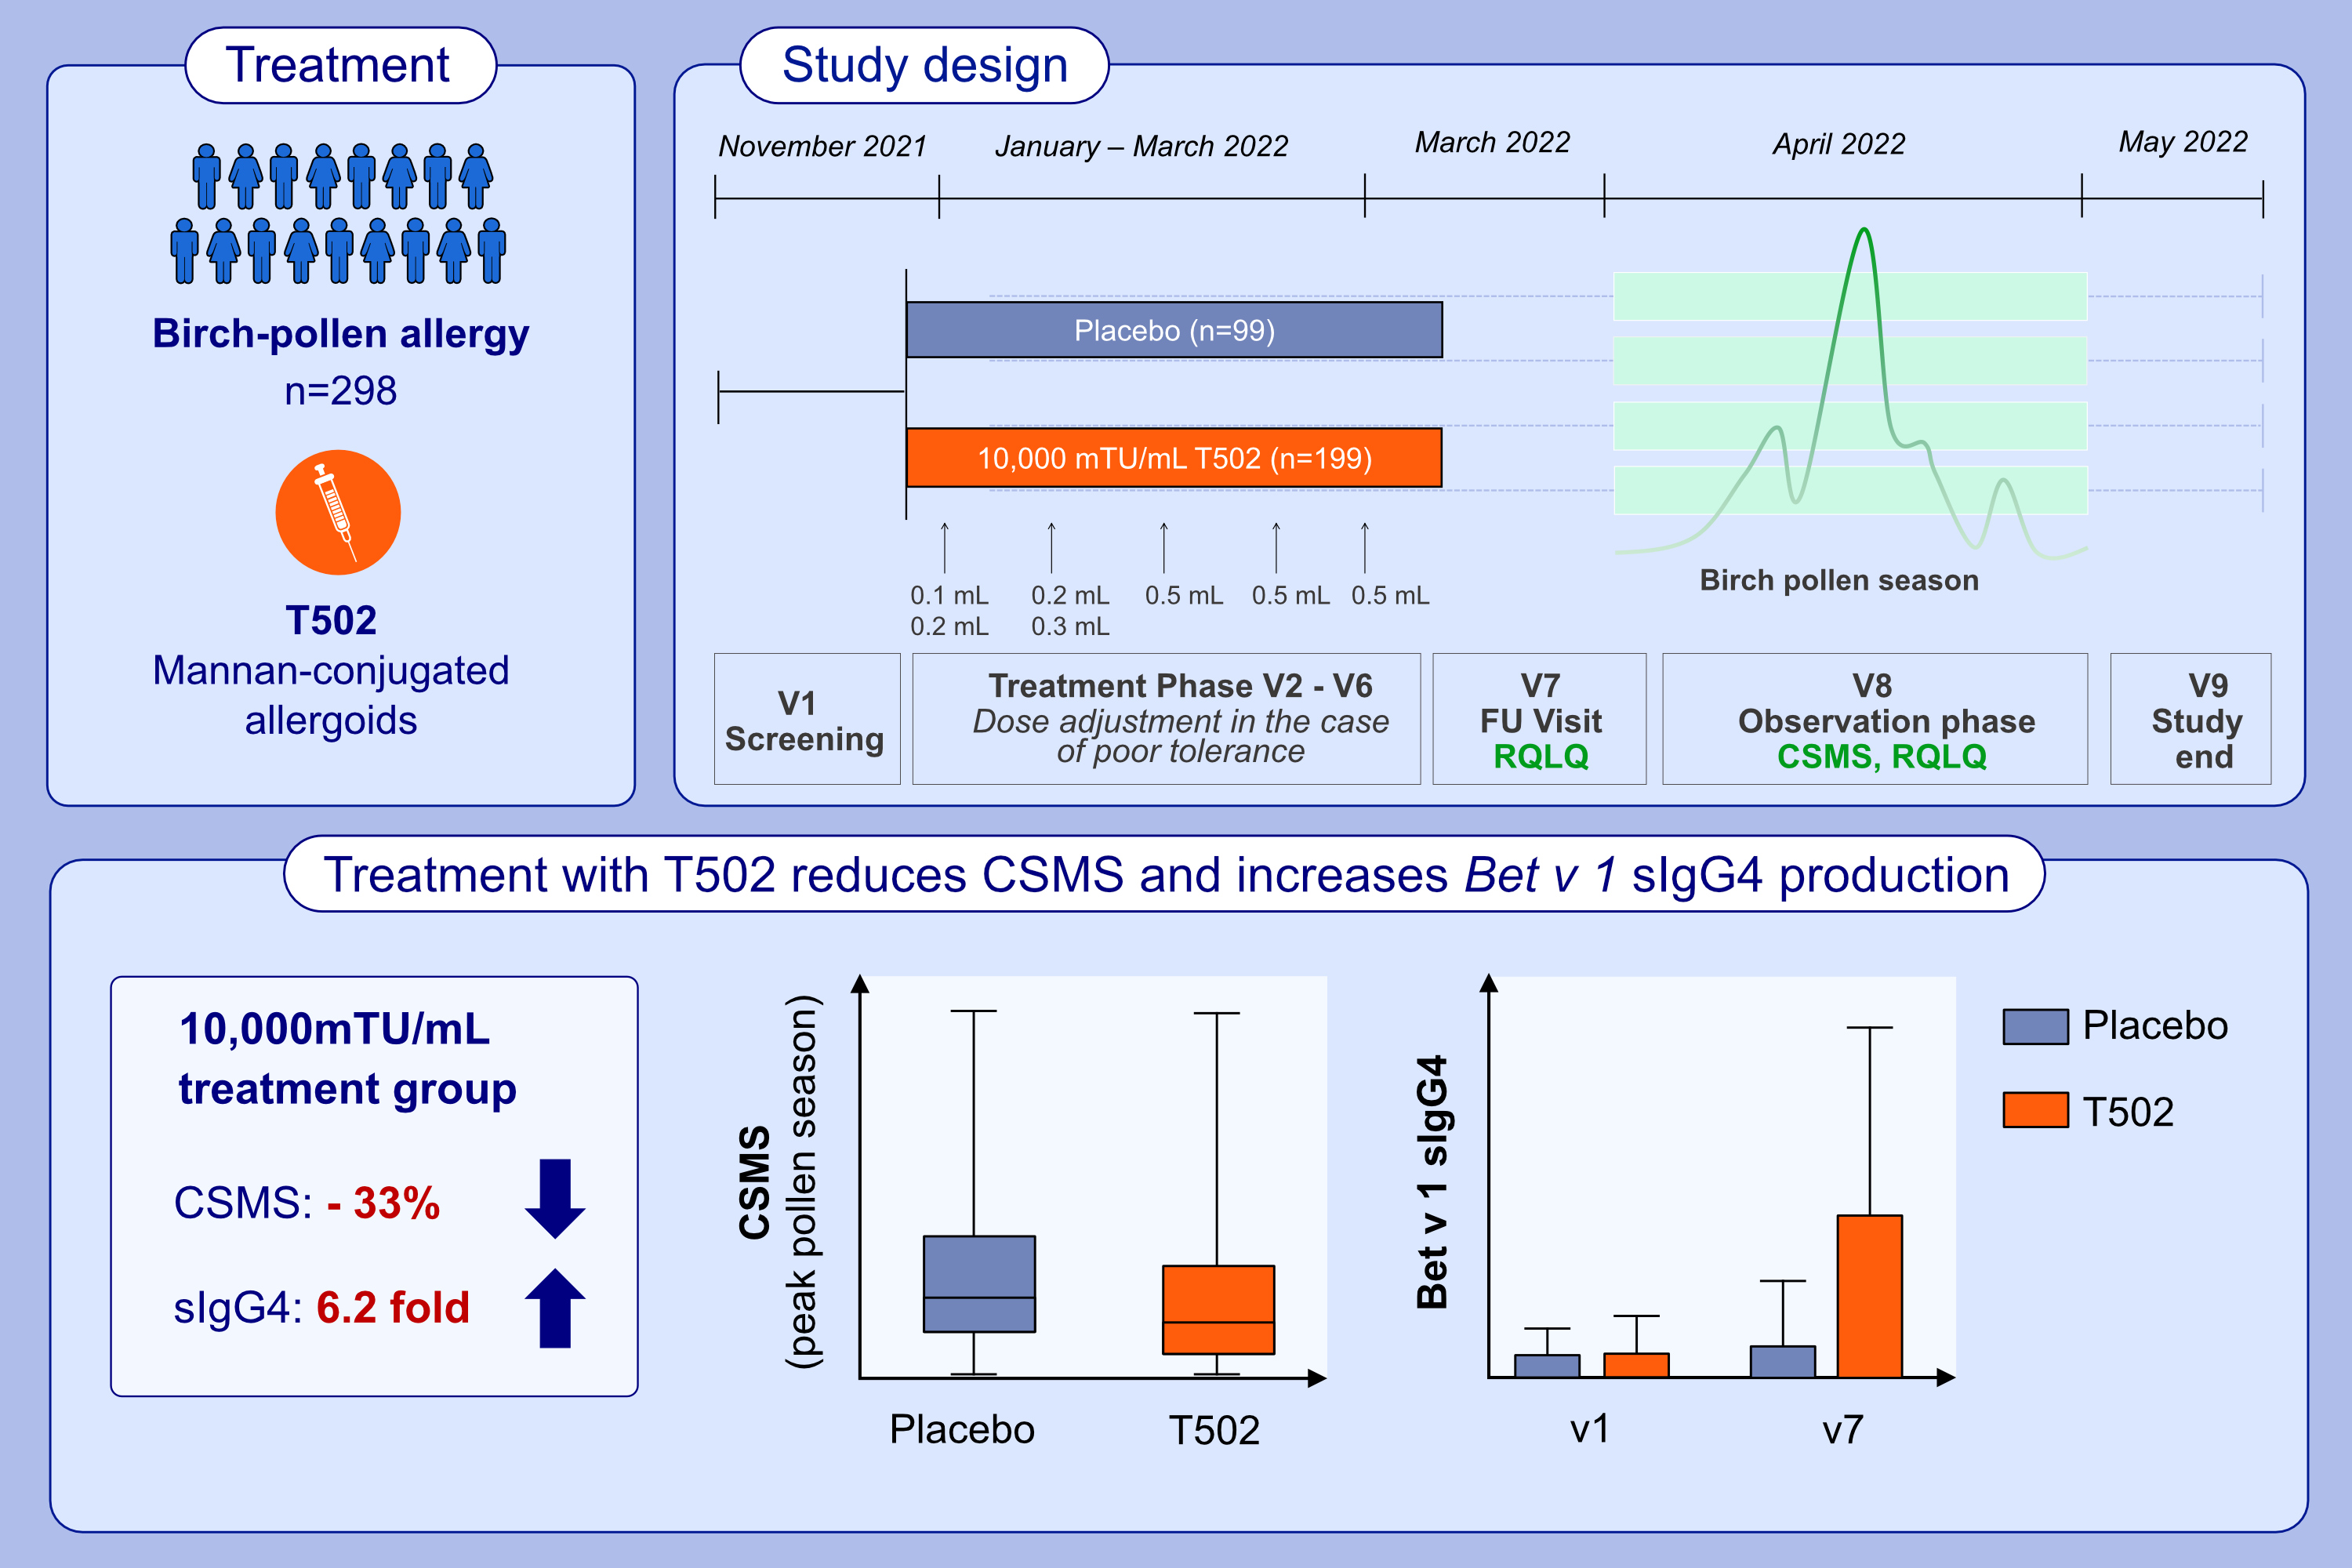
Short-course subcutaneous treatment with birch pollen allergoids greatly improves symptom and medication scores in birch allergy
Ralph Mösges, Esther Raskopf, Ludger Klimek, Oliver Pfaar, Stefan Zielen, et al.
Allergy. 2025; Pages:817-826
https://doi.org/10.1111/all.16387
© 2019 EAACI and John Wiley and Sons A/S. Published by John Wiley and Sons Ltd.
Notes:
HIGHLIGHTS
• This pivotal phase III study investigates subcutaneous immunotherapy with T502 in birch-pollen induced allergic rhinoconjunctivitis.
• 298 birch-pollen allergic adults received short-course treatment of placebo or 10,000 mTU/mL of T502.
• The treatment with mannan-conjugated birch pollen polymerized allergoid resulted in a reduction of CSMS by 33% (median) and a 6.2-fold increased production of Bet v1 specific IgG4 compared to placebo. .

