Slide 1
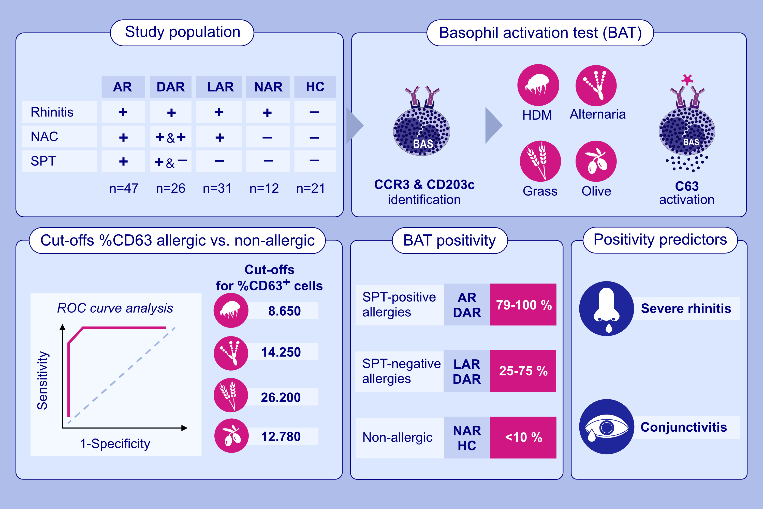
Investigation of the diagnostic accuracy of basophil activation test for allergic phenotypes of rhinitis
Almudena Testera-Montes, Adriana Ariza, Rosa Alba Sola-Martinez, Carlos Jose Aranda, Guillermo Bentabol-Ramos, et al.
Allergy. 2025; Pages:738-749
https://doi.org/10.1111/all.16390
© 2019 EAACI and John Wiley and Sons A/S. Published by John Wiley and Sons Ltd.
Notes:
HIGHLIGHTS
• BAT is an alternative to NAC for the investigation of the clinical relevance of SPT positivities.
• BAT can decrease the number of NAC needed for LAR and DAR diagnosis, but a NAC is still required in case of negative BAT.
• Severe rhinitis and conjunctivitis are predictors of BAT positivity in LAR subjects and allergic patients, respectively.
•
.

