Slide 1
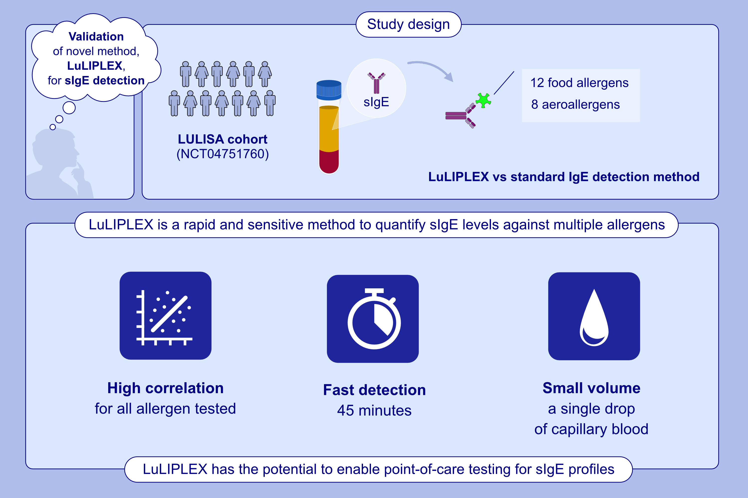
LuLIPLEX: A Fast, Highly Sensitive, and Multiplexed Method for the Detection of IgE Against Major Allergens
Edouard Leveque, Cyprien Pecalvel, Natacha Casanovas, Sophie Goyard, Yves L. Janin, et al.
Allergy. 2025; Pages:849-860
https://doi.org/10.1111/all.16403
© 2019 EAACI and John Wiley and Sons A/S. Published by John Wiley and Sons Ltd.
Notes:
HIGHLIGHTS
• This study aimed to validate a new method, named LuLIPLEX, for multiplexed bioluminescent detection of sIgE against 20 major molecular allergens.
• Head-to-head comparison between LuLIPLEX and standard IgE detection methods showed a high correlation for all allergens tested.
• LuLIPLEX permits simultaneous quantification of IgE against 20 major food and aeroallergens within 45 min using small benchtop luminometers, which could permit point-of-care testing of specific IgE profiles in allergic subjects. .

