Slide 1
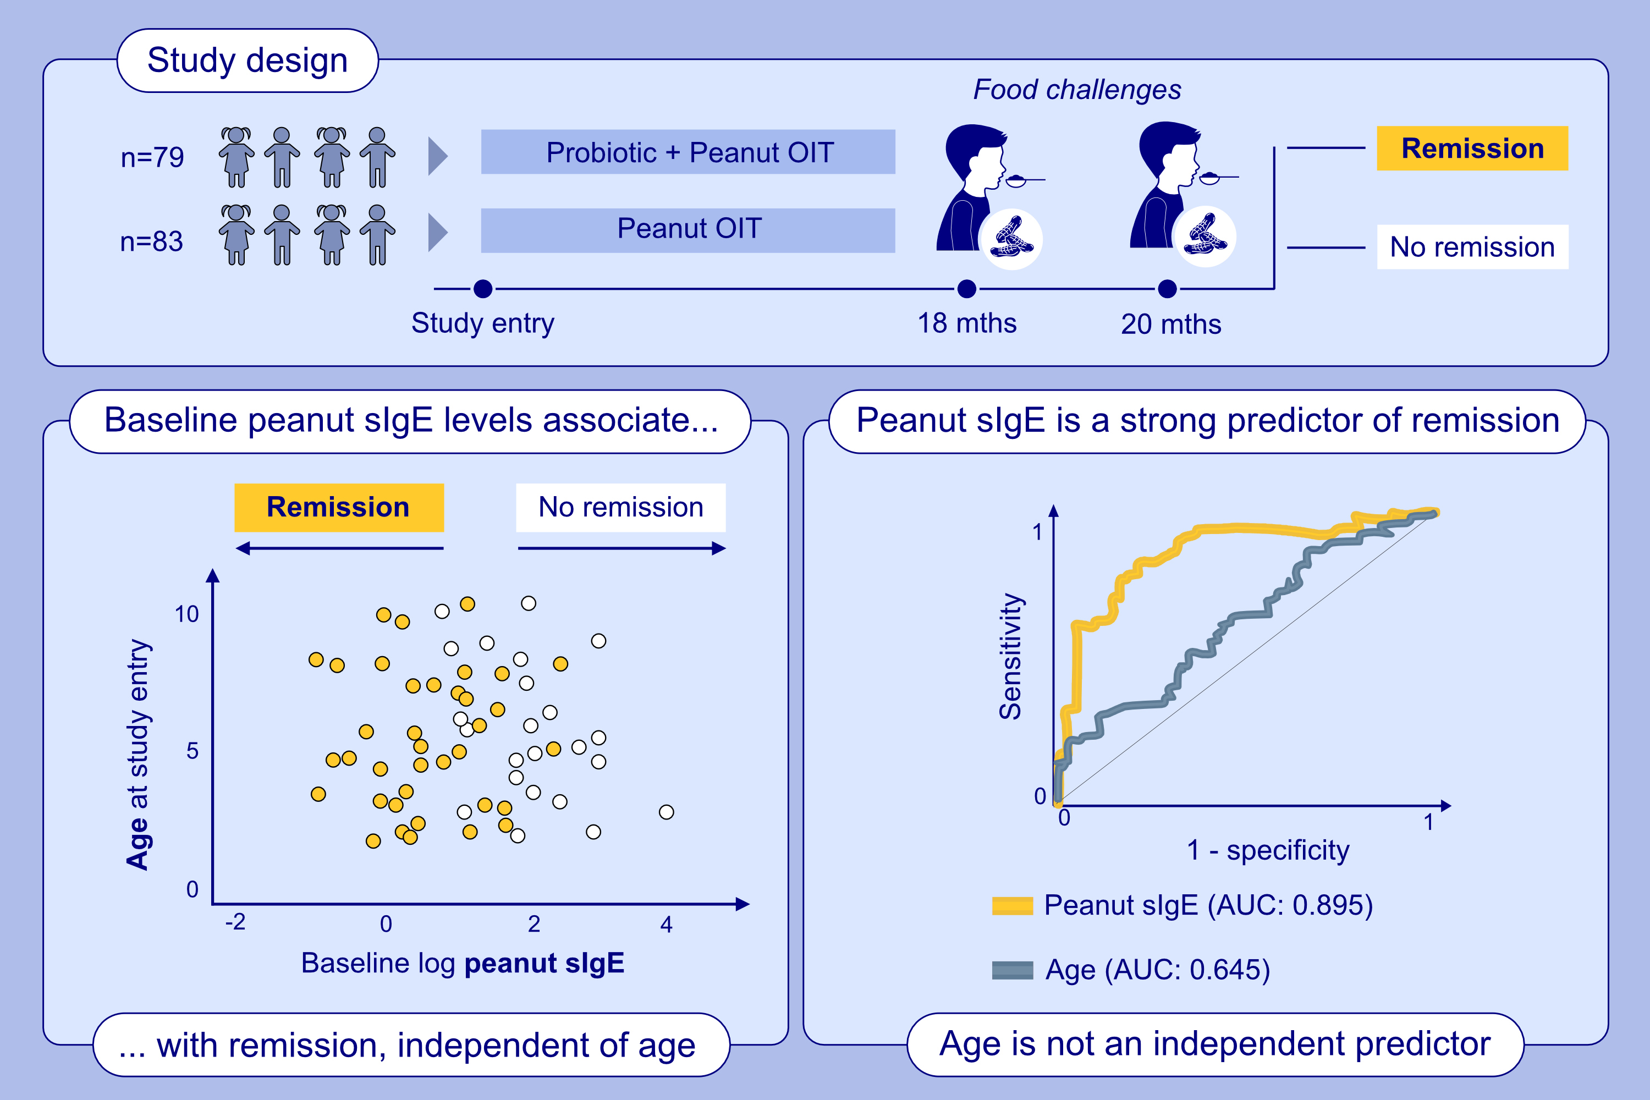
Allergen-Specific IgE is a Stronger Predictor of Remission Following Peanut Oral Immunotherapy Than Age in Children Aged 1–10 Years
Sarah E. Ashley, Melanie Lloyd, Paxton Loke, Francesca Orsini, Adriana C. Lozinsky, et al.
Allergy. 2025; Pages:843-848
https://doi.org/10.1111/all.16451
© 2019 EAACI and John Wiley and Sons A/S. Published by John Wiley and Sons Ltd.
Notes:
HIGHLIGHTS
• This study examines relationships between peanut sIgE and age at baseline and remission, in children aged 1-10 who completed 18 months of OIT in the PPOIT-003 RCT.
• Peanut sIgE at baseline predicts remission but age does not.
• The association between age and remission is driven by lower peanut sIgE at younger ages.
.

