Slide 1
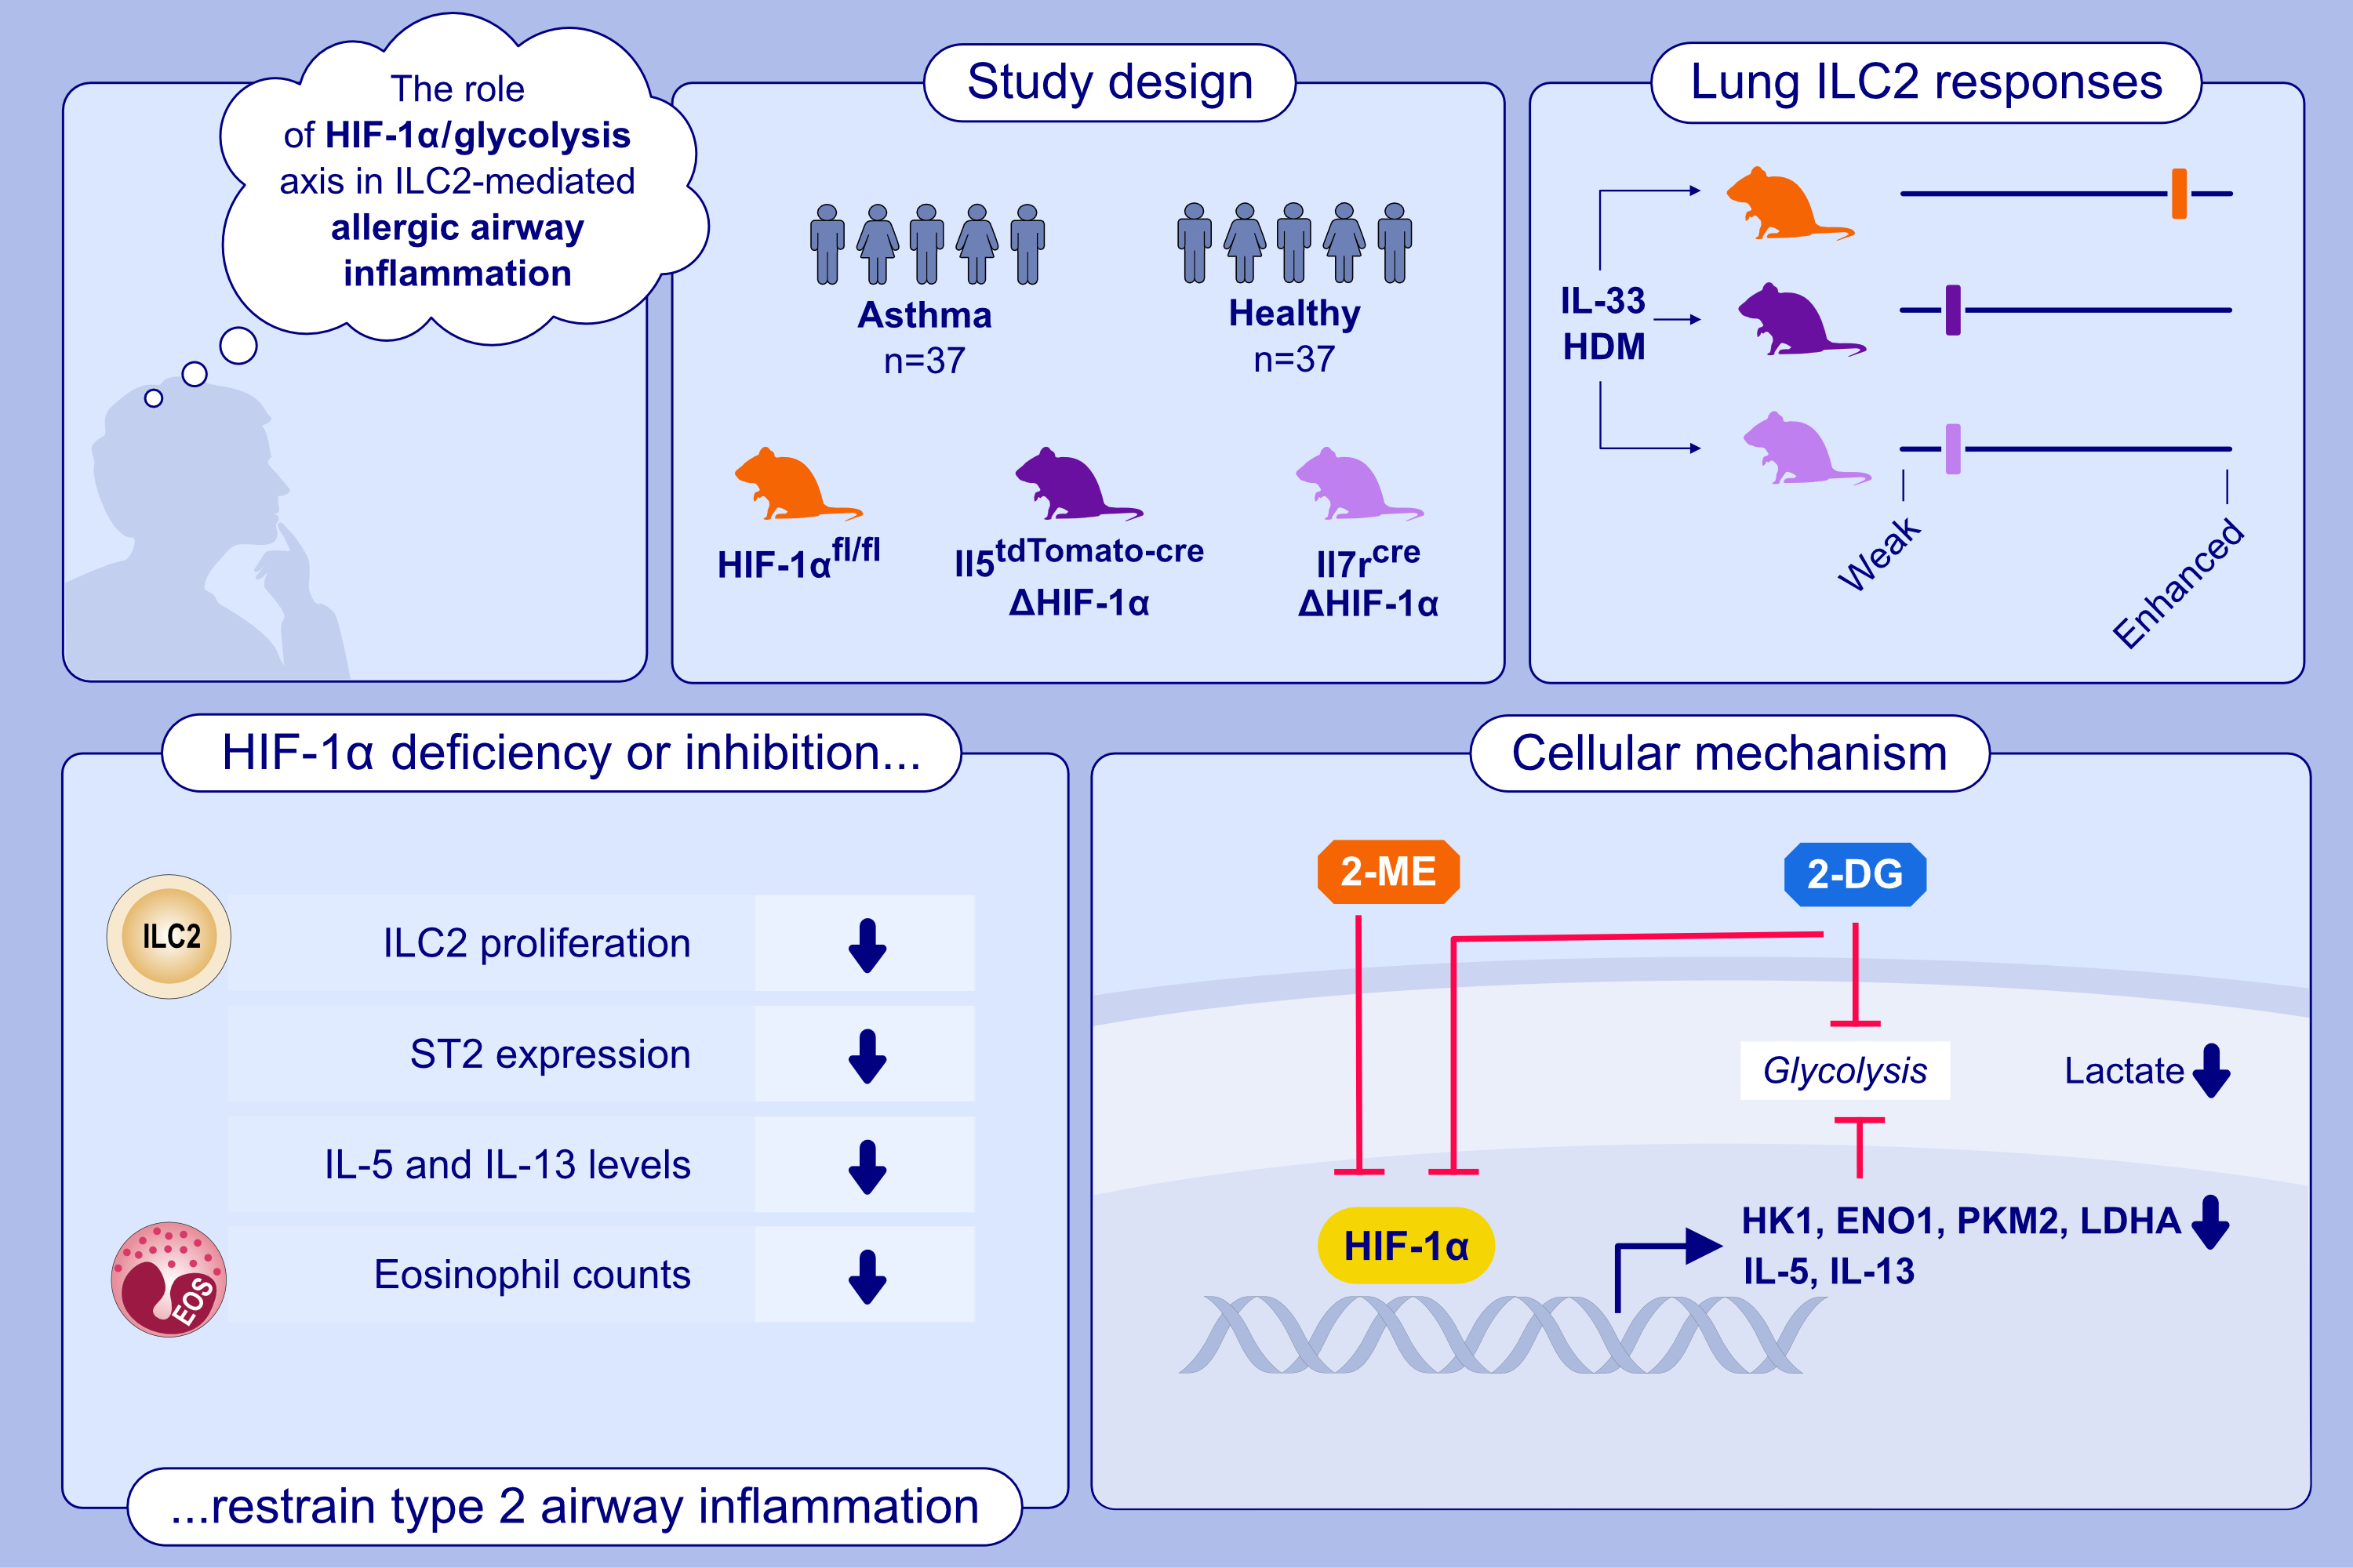
Blocking the HIF-1α/glycolysis axis inhibits allergic airway inflammation by reducing ILC2 metabolism and function
Xiaogang Zhang, Jingping Liu, Xinyao Li, Guilang Zheng, Tianci Wang, et al.
Allergy. 2025; Pages:1309-1334
https://doi.org/10.1111/all.16361
© 2019 EAACI and John Wiley and Sons A/S. Published by John Wiley and Sons Ltd.
Notes:
HIGHLIGHTS
• This study investigates the role of the HIF-1α/glycolysis axis in ILC2-mediated allergic airway inflammation.
• The activation of ILC2s is accompanied by an upregulation in glycolysis and HIF-1α expression in ILC2s.
• The inhibition or deletion of HIF-1α can alleviate allergic airway inflammation by suppressing the transcription of glycolysis-related genes and reducing the function of ILC2s.
.

