Slide 1
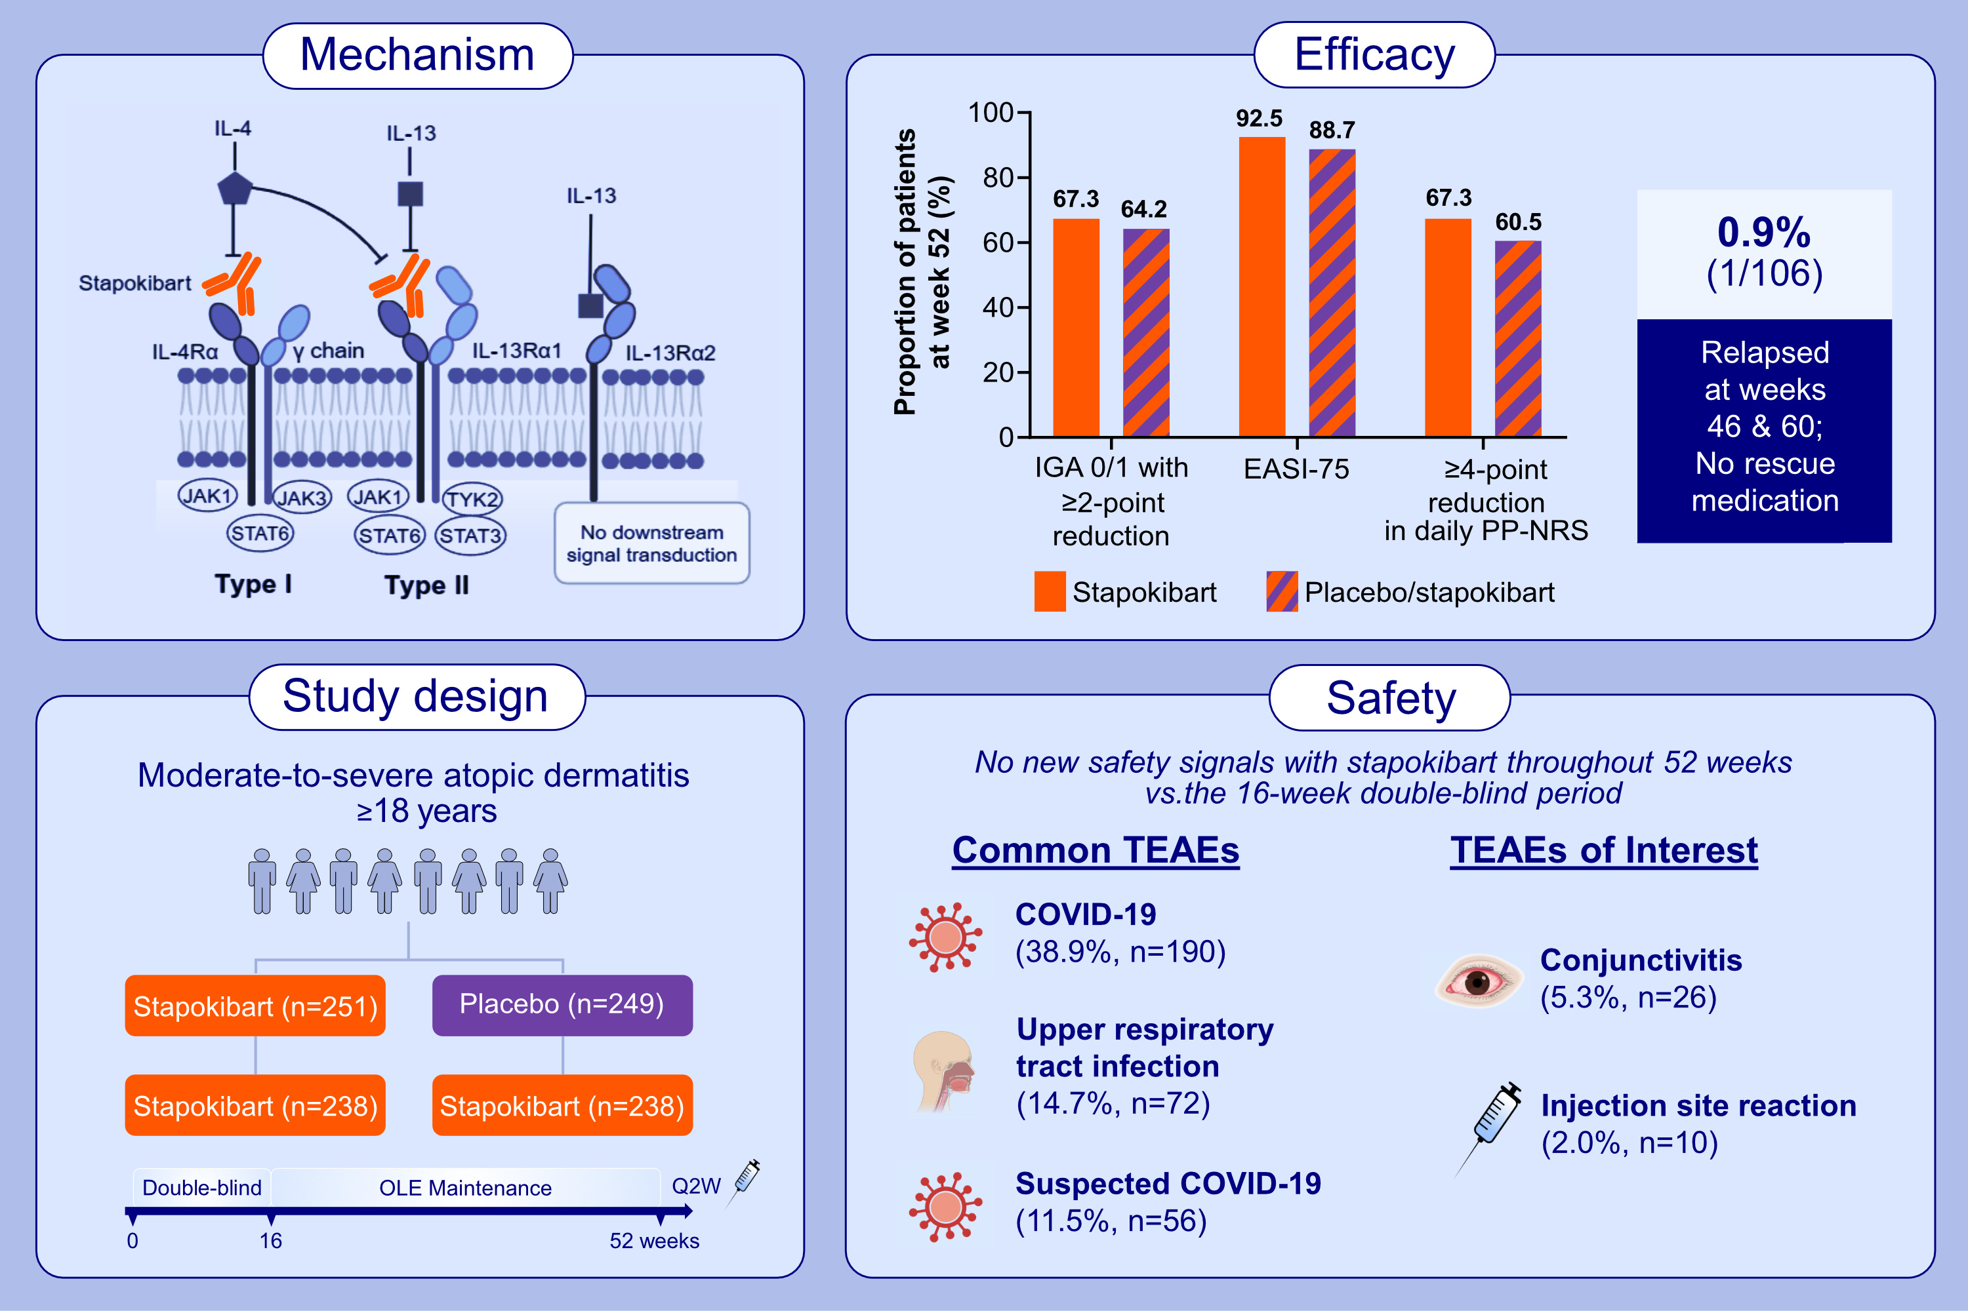
Long-term efficacy and safety of stapokibart for moderate-to-severe atopic dermatitis: 52-week results from a phase 3 trial
Yan Zhao, Litao Zhang, Liming Wu, Bin Yang, Jinyan Wang, et al.
Allergy. 2025;Pages: 1348-1357
https://doi.org/10.1111/all.16368
© 2019 EAACI and John Wiley and Sons A/S. Published by John Wiley and Sons Ltd.
Notes:
HIGHLIGHTS
• Stapokibart, a novel humanized monoclonal antibody against IL-4Rα, has demonstrated promising efficacy and favorable safety in adults with moderate-to-severe AD in a randomized, double-blind, placebo-controlled phase 3 trial.
• Continued stapokibart treatment induced sustained improvements in AD signs and symptoms during the maintenance treatment period.
• No new safety signals with long-term stapokibart treatment up to 52 weeks.
.

