Slide 1
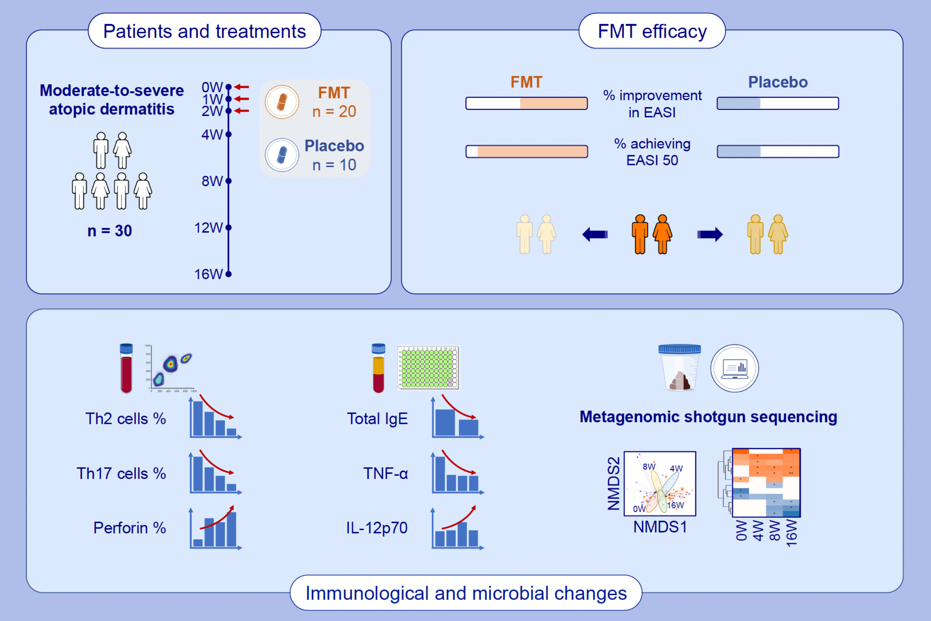
Fecal microbiota transplantation against moderate-to-severe atopic dermatitis: A randomized, double-blind controlled explorer trial
Xiaochun Liu, Yang Luo, Xingyu Chen, Mingyang Wu, Xiaoqiang Xu, et al.
Allergy. 2025; 1377-1388
https://doi.org/10.1111/all.16372
© 2019 EAACI and John Wiley and Sons A/S. Published by John Wiley and Sons Ltd.
Notes:
HIGHLIGHTS
• FMT showed good efficacy and safety for treating patients with moderate-to-severe AD.
• FMT treatment exerted immunomodulatory effects on the frequencies of inflammatory cells and the levels of cytokines associated with AD.
• The composition and functional pathways of gut microbiota from AD patients changed following FMT treatment. .

