Slide 1
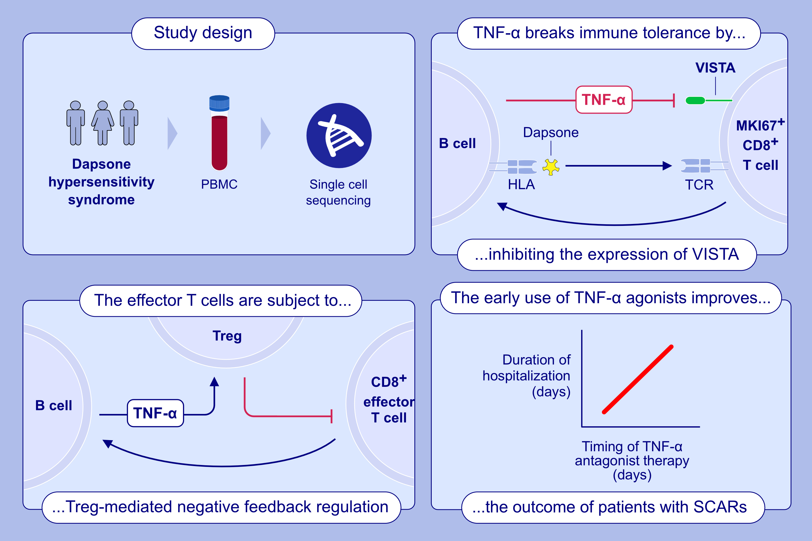
Feedback regulation of VISTA and Treg by TNF-α controls T cell responses in drug allergy
Lele Sun, Qing Zhao, Suiting Ao, Tingting Liu, Zhenzhen Wang, et al.
Allergy. 2025; Pages:17400-1416
https://doi.org/10.1111/all.16393
© 2019 EAACI and John Wiley and Sons A/S. Published by John Wiley and Sons Ltd.
Notes:
HIGHLIGHTS
• TNF-α breaks immune tolerance by regulating the VISTA at early stage of the drug-specific T cell response.
• The response of drug-responsive effector T cells was negative feedback regulated by increasing Treg cells.
• This indicates that Treg agonists, rather than TNF-α antagonists, could be used to treat patients with progressive SCARs. .

