Slide 1
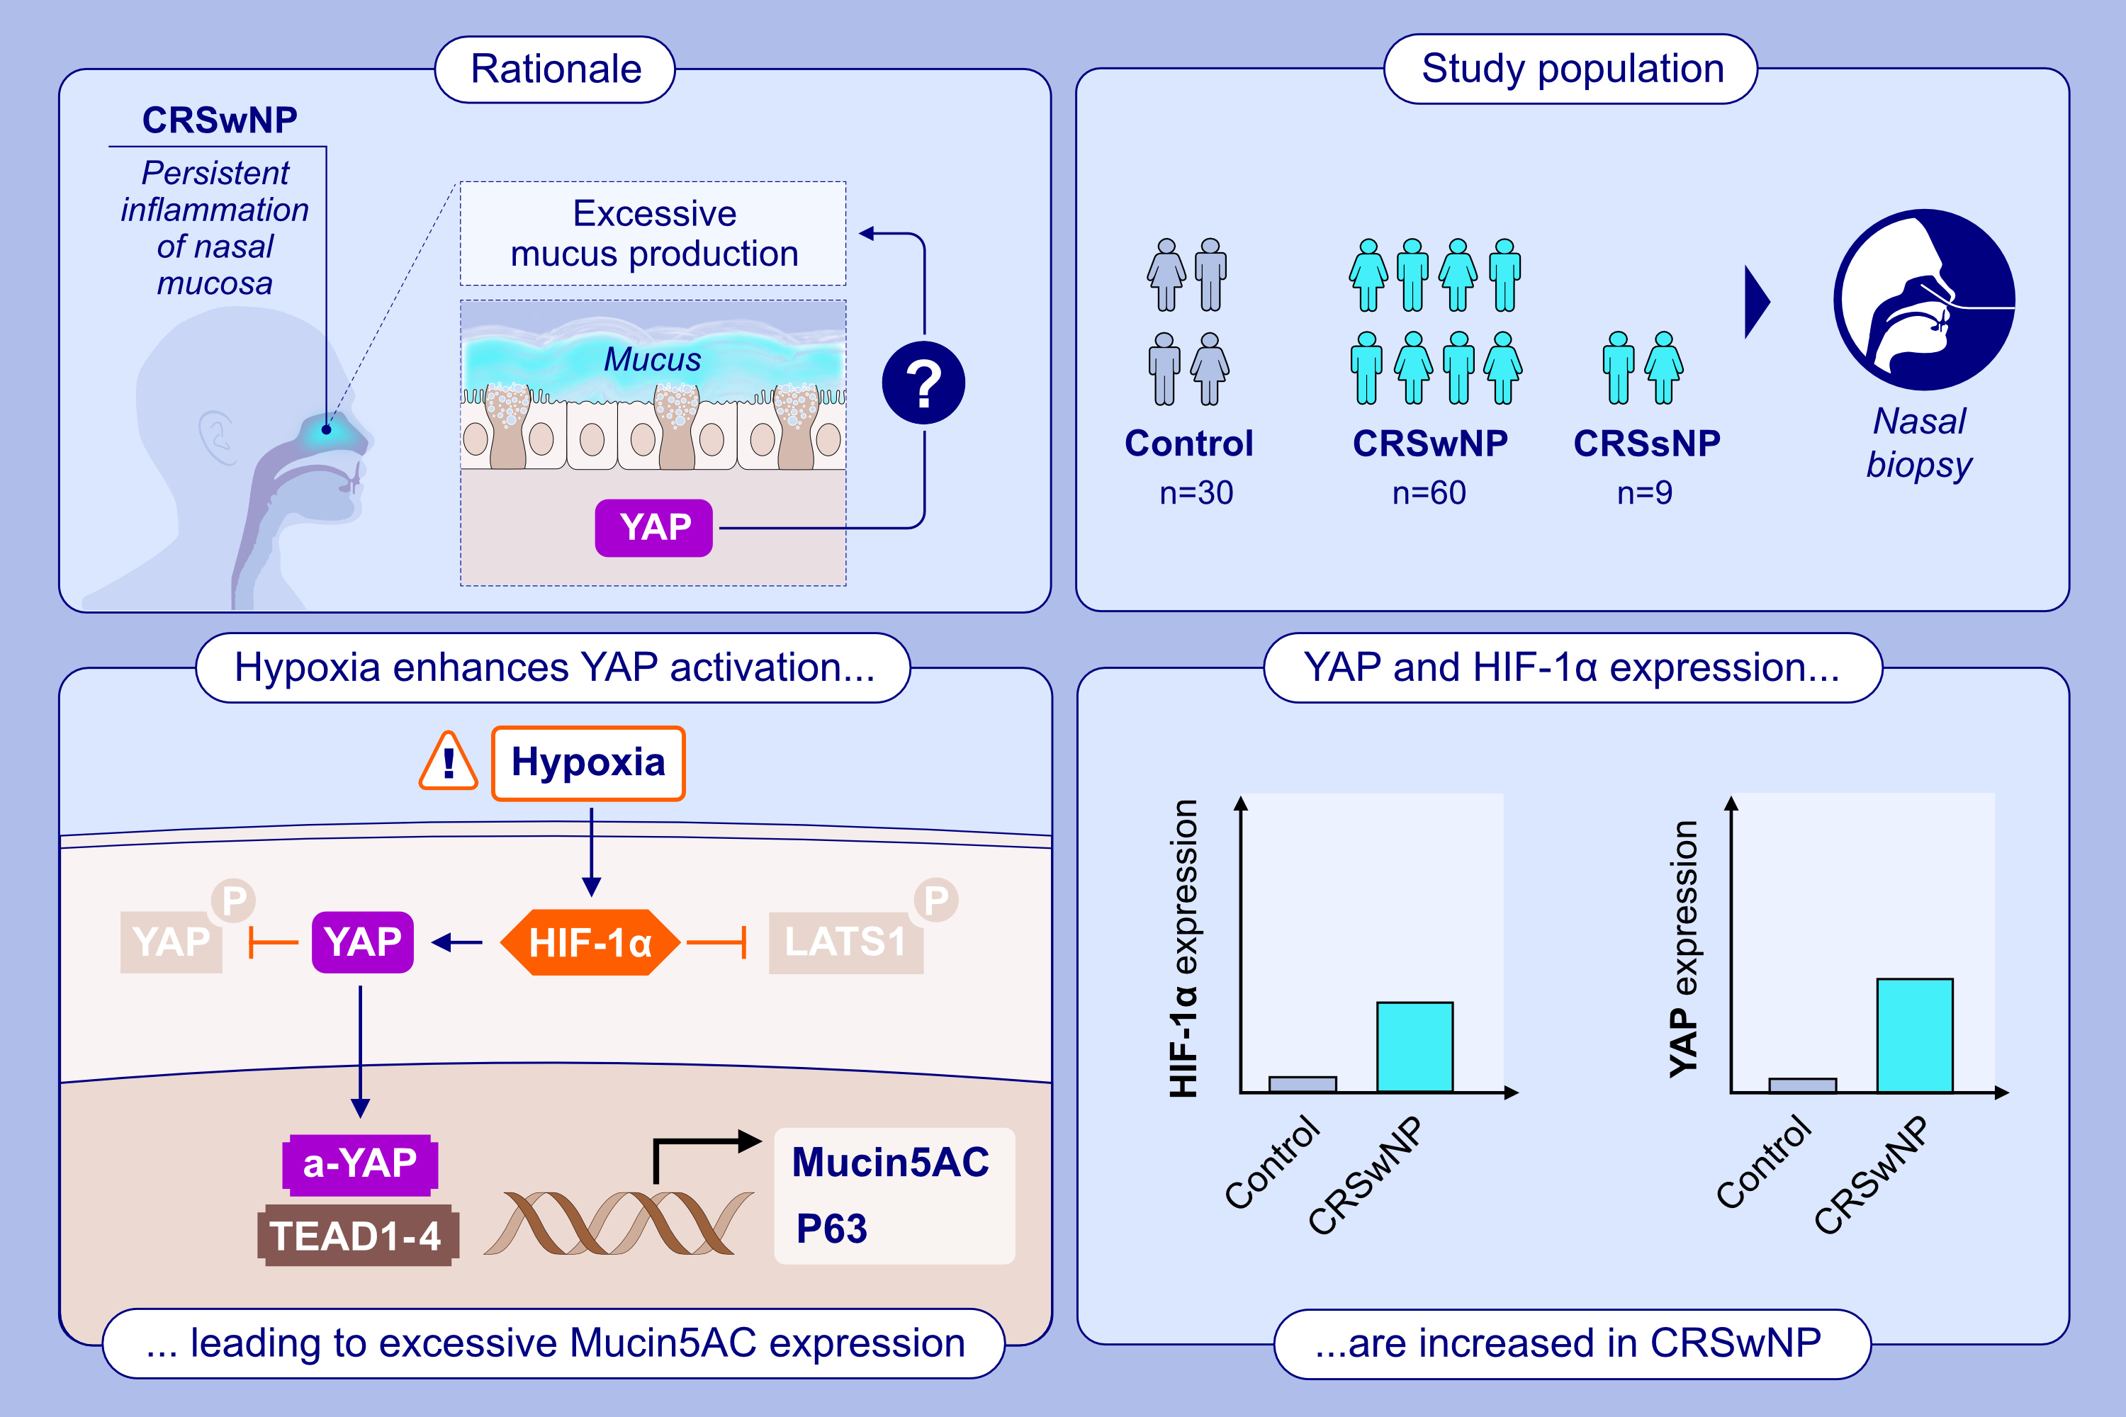
Hypoxia-reduced YAP phosphorylation enhances expression of Mucin5AC in nasal epithelial cells of chronic rhinosinusitis with nasal polyps
Bing Zhong, Jing Liu, Hsiao Hui Ong, Jintao Du, Feng Liu, et al.
Allergy. 2025; Pages:1271-1285
https://doi.org/10.1111/all.16394
© 2019 EAACI and John Wiley and Sons A/S. Published by John Wiley and Sons Ltd.
Notes:
HIGHLIGHTS
• This study investigates the potential role of YAP underlying the mechanism of excessive epithelial Mucin5AC expression in CRSwNP in a hypoxic model.
• YAP and HIF-1α expression levels are significantly elevated in patients with CRSwNP compared to the control group.
• Hypoxia promotes the activation of YAP through HIF-1α, hinders the phosphorylation of LATS1, and inhibits YAP phosphorylation and degradation.
• This pathway leads to increased expression levels of Mucin5AC and P63 and promotes pathological status of CRSwNP.
.

