Slide 1
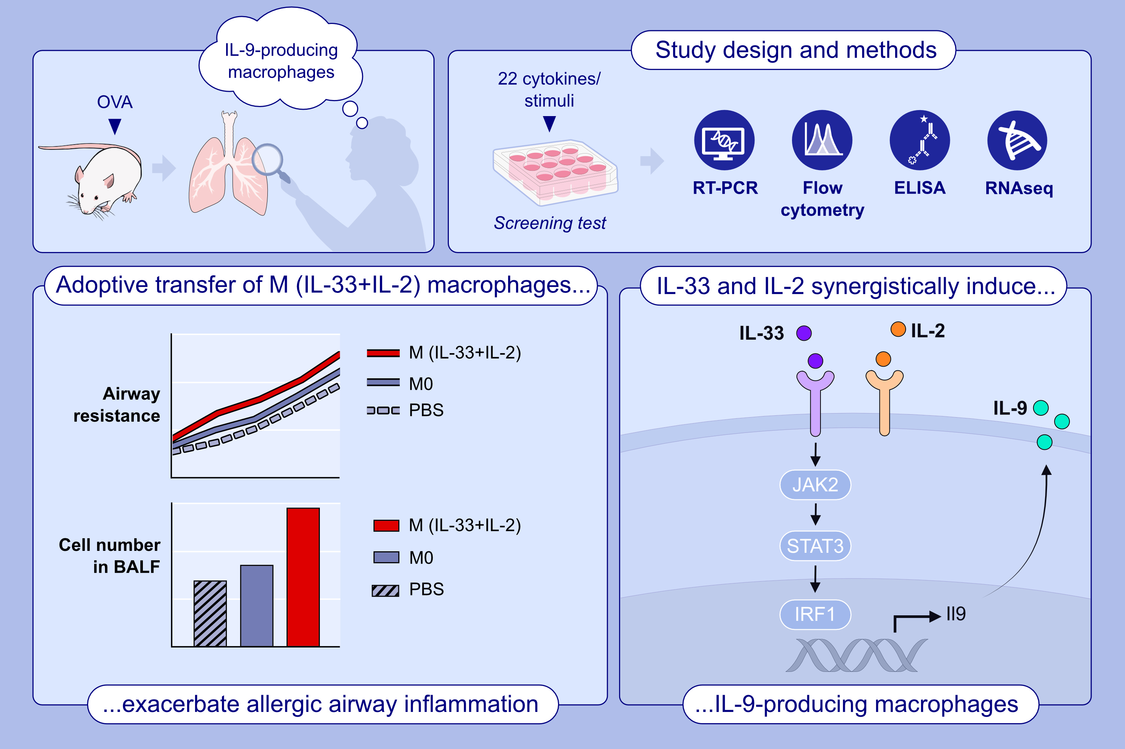
The Presence and Pathogenic Roles of M(IL-33 + IL-2) Macrophages in Allergic Airway Inflammation
Han Guo, Yang Zhao, Zhaoqi Zhang, Yanan Xu, Yifang Chen, et al.
Allergy. 2025; Pages:1298-1308
https://doi.org/10.1111/all.16430
© 2019 EAACI and John Wiley and Sons A/S. Published by John Wiley and Sons Ltd.
Notes:
HIGHLIGHTS
• An IL-9-producing macrophage subset is present during allergic airway inflammation.
• IL-33 and IL-2 collaboratively induce IL-9 production in macrophages, referred to as M(IL-33+IL-2), depending on JAK2-STAT3-IRF1 pathway.
• M(IL-33+IL-2) macrophages has a distinctive gene expression profile and exacerbate OVA-induced allergic airway inflammation. .

