Slide 1
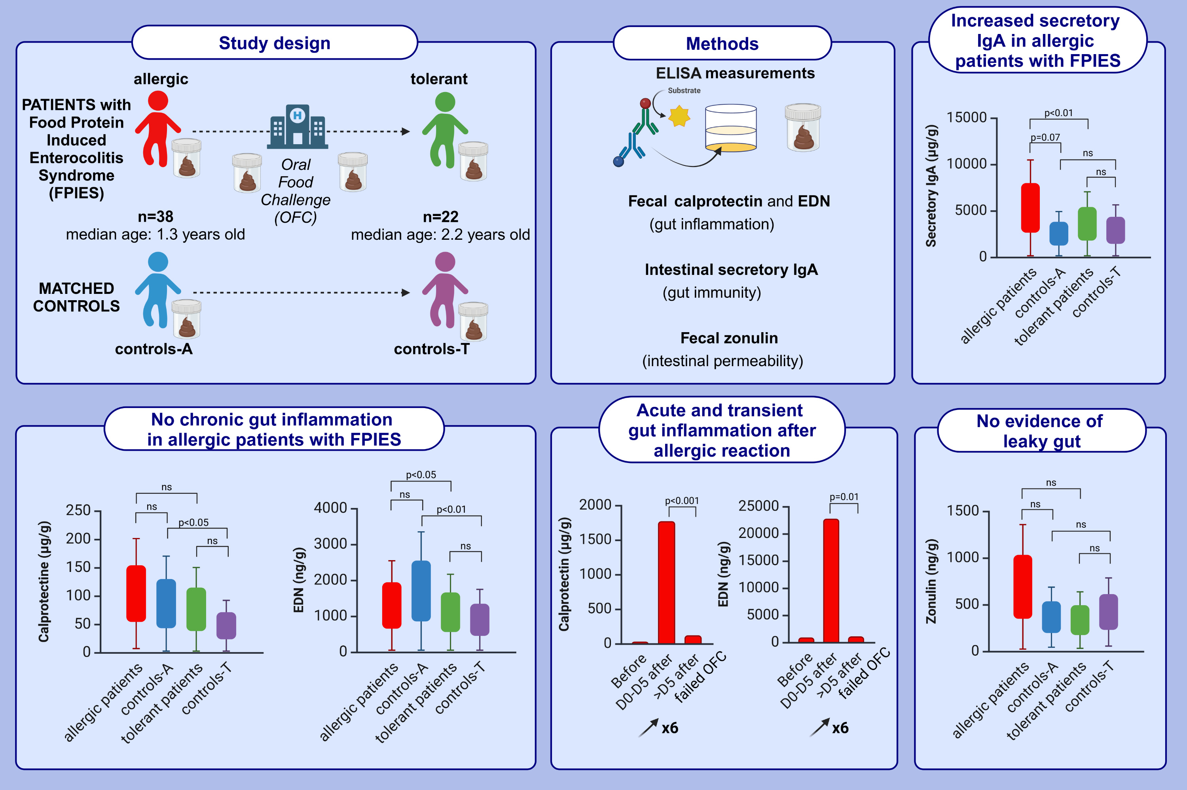
Identification of Gut Biomarkers of FPIES in a Longitudinal Comparative Pediatric Study
A. Lemoine, N. Kapel, I. Nicolis, P. Tounian, A. Bruneau, et al.
Allergy. 2025; Pages:1389-1399
https://doi.org/10.1111/all.16457
© 2019 EAACI and John Wiley and Sons A/S. Published by John Wiley and Sons Ltd.
Notes:
HIGHLIGHTS
• We compared fecal biomarkers related to gut inflammation and immunity in children with FPIES, with resolved FPIES (tolerant), and in matched controls.
• Allergic patients had no measurable gut inflammation (calprotectin, EDN) on elimination diet.
• Inflammation was transitory after an acute allergic reaction.
• We evidenced increased secretory IgA in allergic patients.

