Slide 1
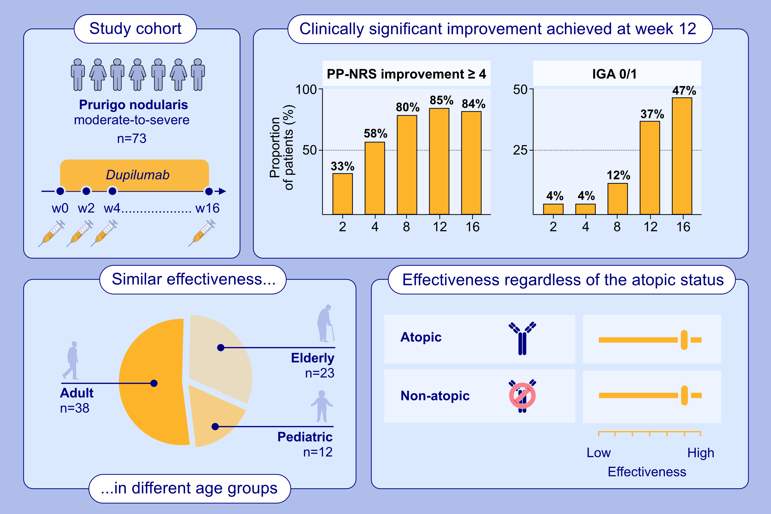
Effectiveness and Safety of Dupilumab for Prurigo Nodularis in China: A Multicentric and Observational Study
Zuotao Zhao, Xiaoting Song, Yuanyuan Shang, Lijuan Liu, Rui Zheng, et al.
Allergy. 2025; Pages:1428-1435
https://doi.org/10.1111/all.16478
© 2019 EAACI and John Wiley and Sons A/S. Published by John Wiley and Sons Ltd.
Notes:
HIGHLIGHTS
• This multicentric and observational real-world study demonstrates that dupilumab is effective in improving the signs and symptoms in Chinese patients with prurigo nodularis.
• Effectiveness of dupilumab in prurigo nodularis is consistent regardless of age and atopic status.
• The safety profile of dupilumab is favorable. .

