Slide 1
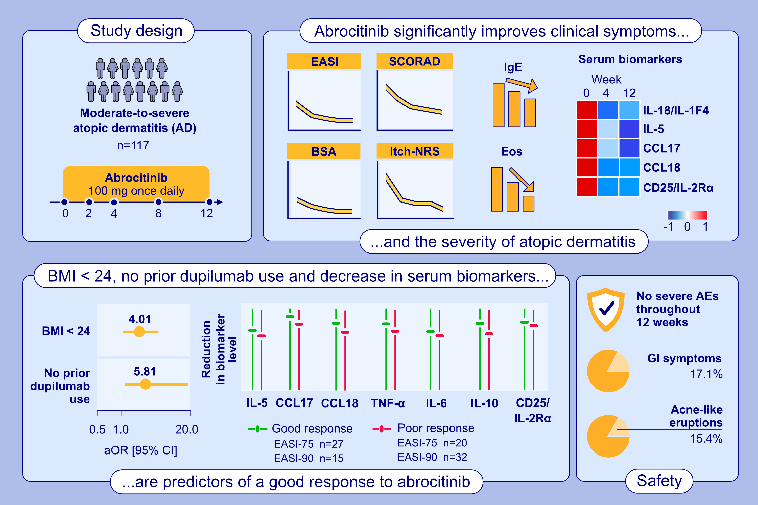
Real-World Efficacy and Safety of Abrocitinib in Chinese Atopic Dermatitis Patients: A Single-Center Prospective Study
Zheng Li, Yu Wang, Yuemeng Wu, Huibin Yin, Shangshang Wang, et al.
Allergy. 2025; Pages:1417-1427
https://doi.org/10.1111/all.16495
© 2019 EAACI and John Wiley and Sons A/S. Published by John Wiley and Sons Ltd.
Notes:
HIGHLIGHTS
• Abrocitinib exhibited a rapid and potent therapeutic effect on AD, with a well-tolerated safety profile.
• Blood eosinophil counts, serum IgE, and Th1/Th2/Treg-related cytokines significantly decreased.
• BMI < 24, no prior dupilumab treatment, and significantly greater reductions in serum IL-5, CCL17, CCL18, TNF-α, IL-6, IL-10, and CD25/IL-2Rα were identified as predictive factors of good response to abroctinib.
.

