Slide 1
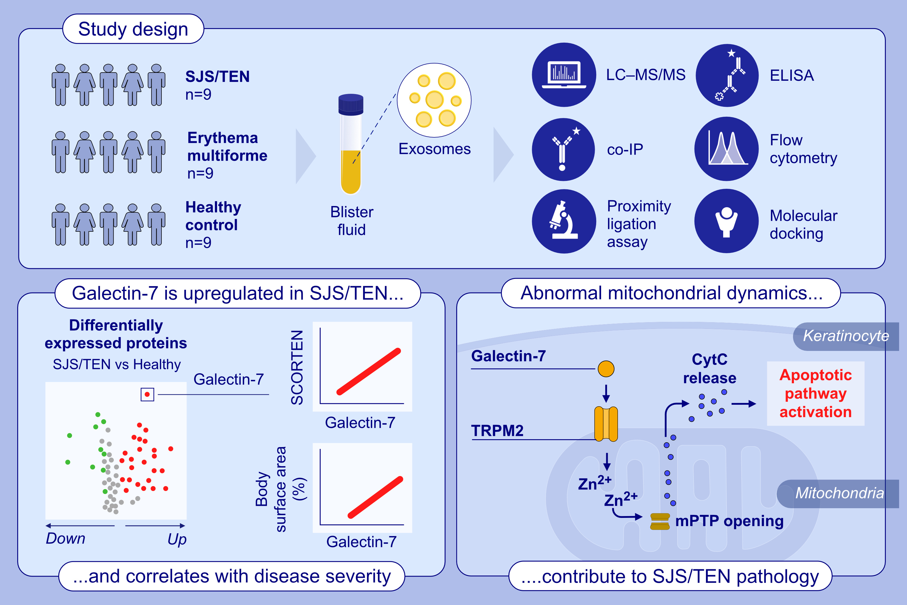
Targeting the Galectin-7/TRPM2/Zn2+/DRP-1 Signaling Pathway: A Potential Therapeutic Intervention in the Pathogenesis of SJS/TEN
Chen Zhang, BingYu Pang, YiXin Luo, Zipeng Cao, Pei Qiao, et al.
Allergy. 2025;Pages:1358-1376
https://doi.org/10.1111/all.16510
© 2019 EAACI and John Wiley and Sons A/S. Published by John Wiley and Sons Ltd.
Notes:
HIGHLIGHTS
• This study investigates the role of mitochondrial fission in keratinocyte apoptosis in blister fluid-derived exosomes from patients with SJS/TEN, erythema multiforme and in healthy individuals.
• Galectin-7 is upregulated in exosomes of patients with SJS/TEN and shows correlation with disease severity.
• Exosomal Galectin-7 enters keratinocyte, binds to TRPM2 in mitochondria and induces increase in mitochondrial Zn2+, which leads to keratinocyte fission and mPTP opening, subsequently promotes cytochrome c release and caspase activation, leading to keratinocyte apoptosis in SJS/TEN patients. .

