Slide 1
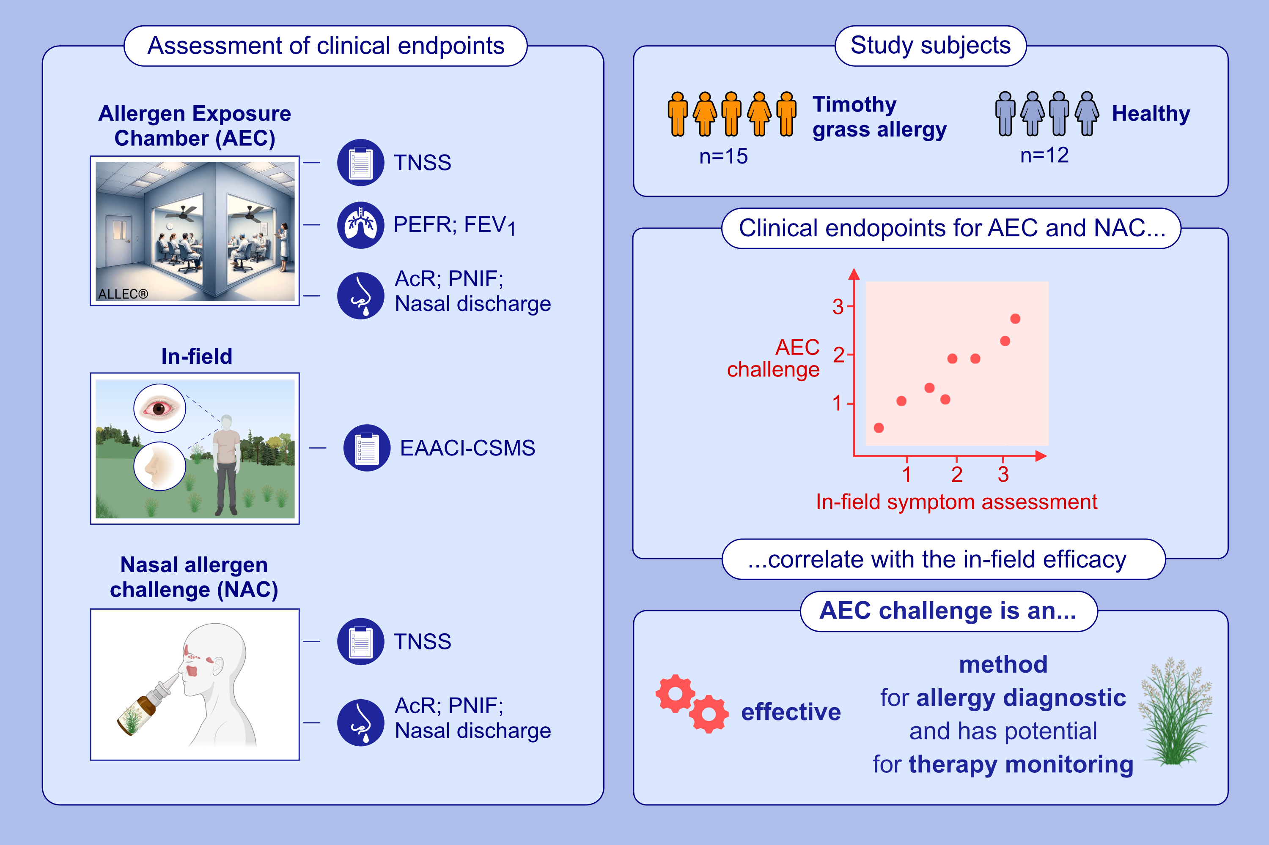
Comparative Evaluation of an Allergen Exposure Chamber and Nasal Allergen Challenge Versus In-Field Symptom Assessment in Patients With Allergic Rhinitis Triggered by Timothy Grass Pollen
Magdalena Zemelka-Wiacek, Anna Kosowska, Oliver Pfaar, Ioana Agache, Krzysztof Kujawa, et al.
Allergy. 2025; Pages:1286-1297
https://doi.org/10.1111/all.16518
© 2019 EAACI and John Wiley and Sons A/S. Published by John Wiley and Sons Ltd.
Notes:
HIGHLIGHTS
• This study validated AEC and NAC allergen provocation-derived symptom severity against natural exposure during the timothy grass pollen season in allergic rhinitis patients.
• Both, AEC and NAC tests can be effectively applied for symptom severity assessment in allergy diagnostics.
• The data may support AEC as a reliable method for monitoring the effects of different therapies, including AIT.
.

