Slide 1
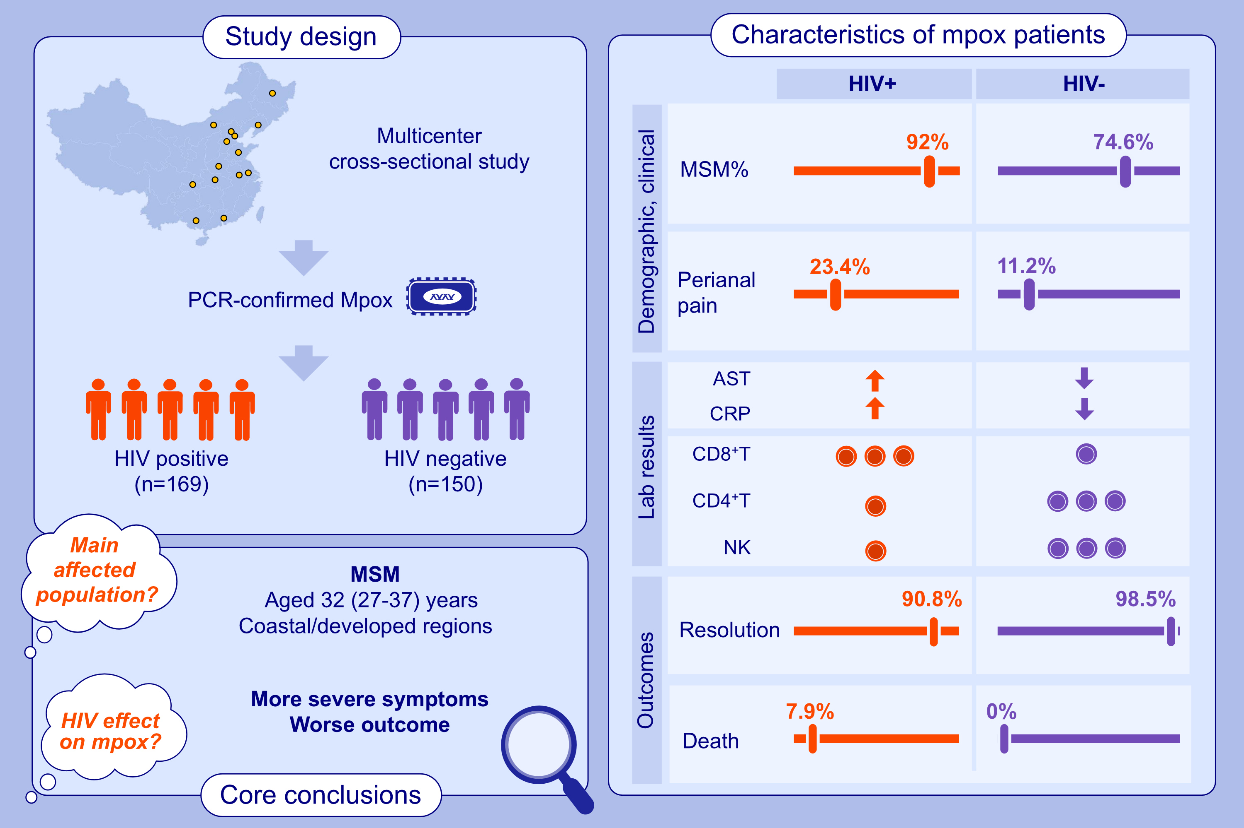
Clinical, Epidemiological, Virological Characteristics and Outcomes of 286 Patients Infected With Monkeypox Virus in China
Hankun Hu, Yang Zheng, Lianguo Ruan, Yamin Liu, Yeqing Tong, et al.
Allergy. 2025; Pages:1436-1451
https://doi.org/10.1111/all.16540
© 2019 EAACI and John Wiley and Sons A/S. Published by John Wiley and Sons Ltd.
Notes:
HIGHLIGHTS
• Men who have sex with men (MSM), with median age of 32 (27-37) years, from China’s coastal or developed regions, are the “main mpox-affected” population.
• HIV-positive mpox patients showed more severe manifestations, with elevated aspartate transaminase and C-reactive protein levels, reduced CD4+ T and NK (natural killer) cell counts versus HIV-negative mpox patients.
• HIV-positive mpox patients had worse clinical outcomes than HIV-negative mpox patients, with a lower rate of resolution and a higher rate of death.
.

