Slide 1
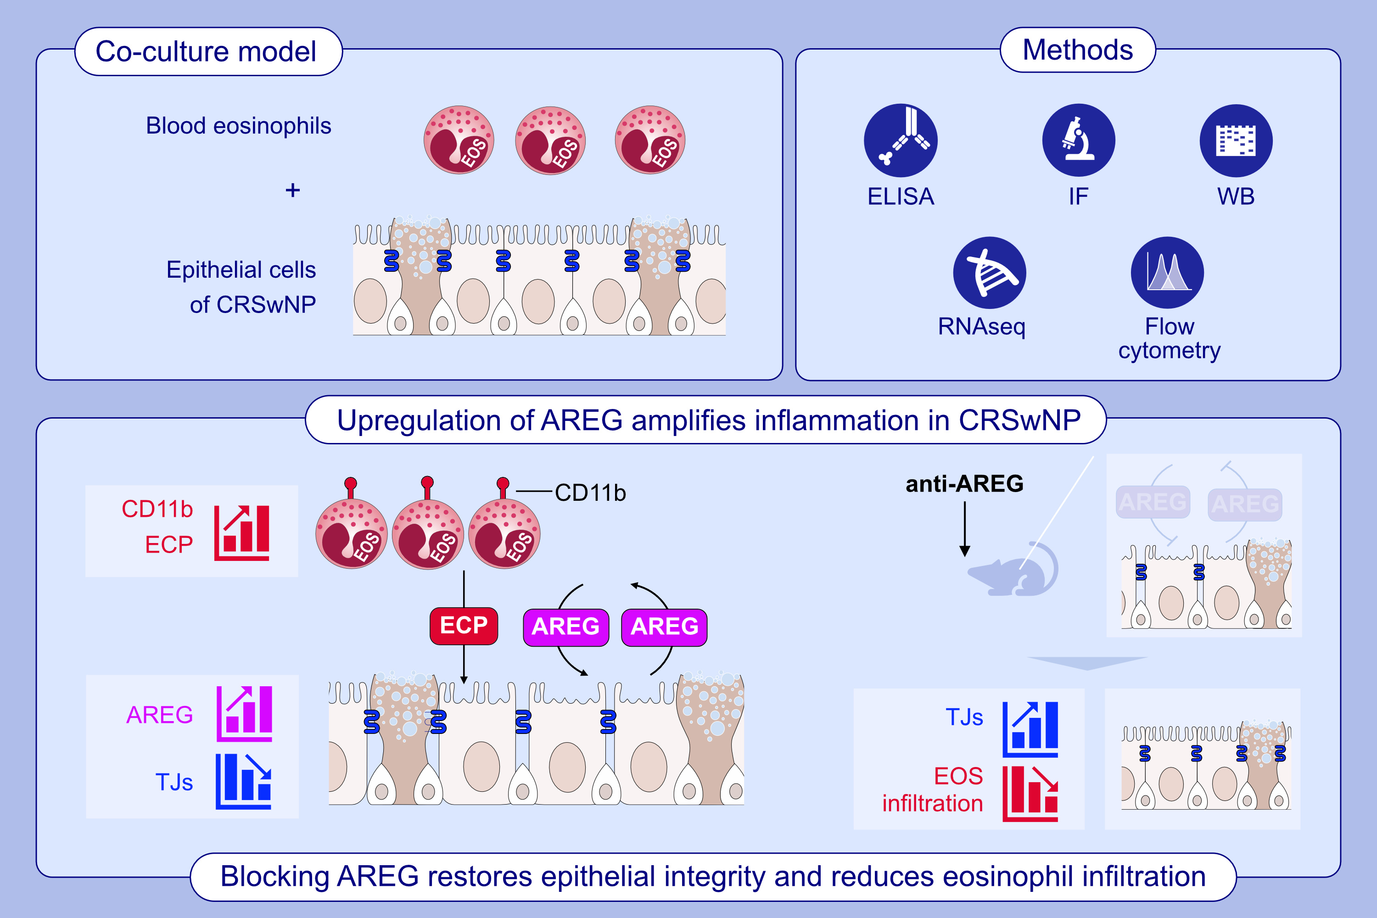
Amphiregulin Mediates Epithelial Cell–Eosinophil Interactions and Amplifies Inflammation in Chronic Rhinosinusitis With Nasal Polyps
Limin Zhao, Shujian Zhang, Yuling Zhang, Yingyue Liu, Yushi Guo, et al.
Allergy. 2025; Pages:1335-1347
https://doi.org/10.1111/all.16582
© 2019 EAACI and John Wiley and Sons A/S. Published by John Wiley and Sons Ltd.
Notes:
HIGHLIGHTS
• This study investigates eosinophil recruitment and function near the epithelium in CRSwNP.
• AREG, upregulated in severe CRSwNP, mediated epithelial-eosinophils interactions, disrupting tight junctions and activating eosinophils.
• Blocking AREG in a murine model restored epithelial integrity and reduced eosinophil infiltration, highlighting its therapeutic potential. .

