Slide 1
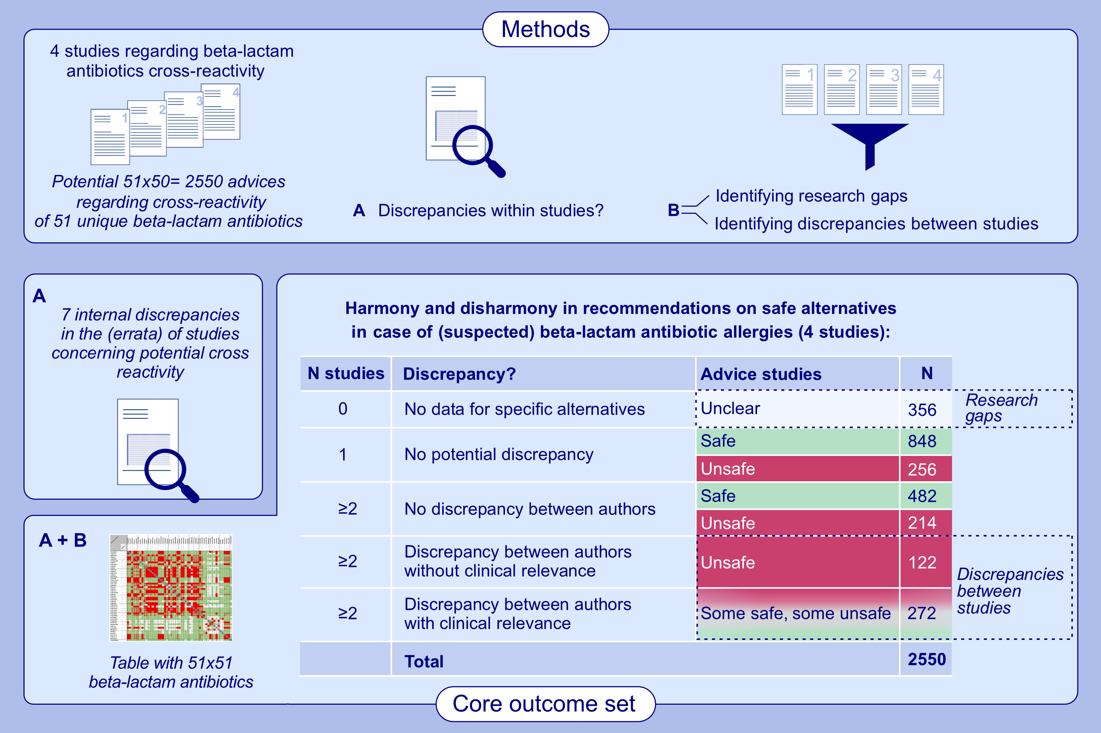
Discrepancies in Beta-Lactam Antibiotics Cross-Reactivity: Implications for Clinical Practice
Evelien Maria Hutten, Maja Bulatović Ćalasan, Jason Anthony Trubiano, Rick Gert-Jan Pleijhuis, Ingrid Terreehorst et al.
Allergy. 2025; pages: 3108-3114
https://doi.org/10.1111/all.16485
© 2019 EAACI and John Wiley and Sons A/S. Published by John Wiley and Sons Ltd.
Notes:
HIGHLIGHTS
• Four studies previously published on beta-lactam antibiotics cross-reactivity were compared head-to-head. These studies covered 51 antibiotics,theoretically leading to 2550 potential recommendations regarding alternatives in case of specific allergies.
• The studies analyzed different sets of beta-lactam antibiotics. Since none of the tables included all 51 antibiotics, data were missing in 356 instances regarding specific alternative recommendations.
•The studies provided conflicting recommendations on safe alternatives for (suspected) beta-lactam antibiotic allergies, occasionally resulting in clinically significant discrepancies in advice.

