Slide 1
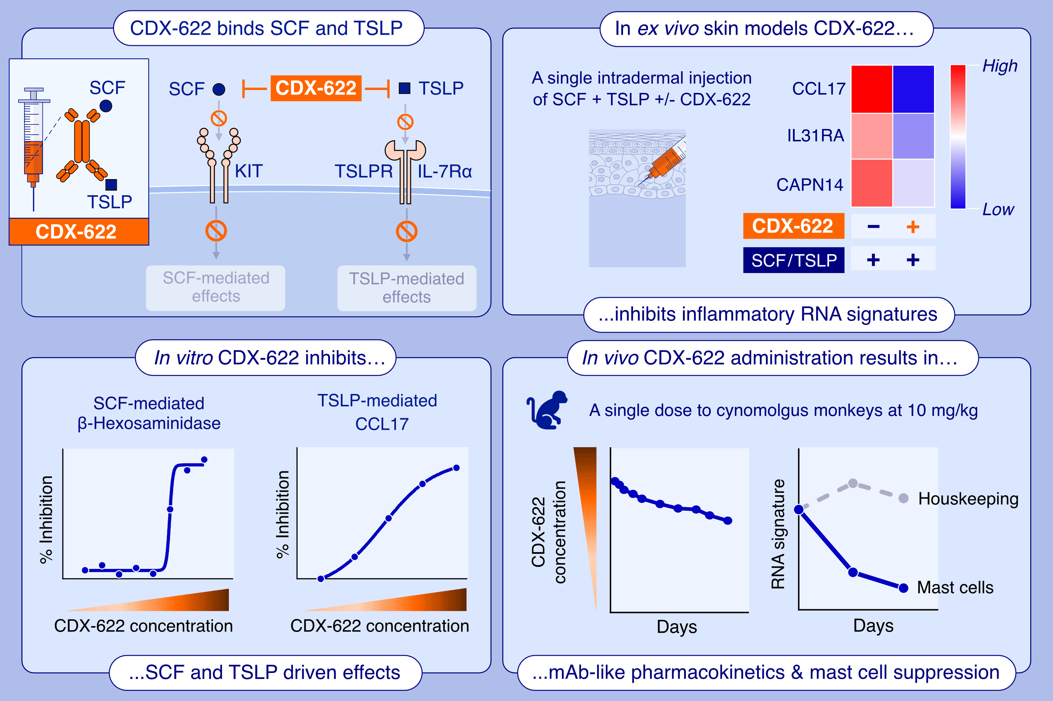
Dual Inhibition of Mast Cells and Thymic Stromal Lymphopoietin Using a Novel Bispecific Antibody, CDX-622
Michael B. Murphy, Laura Vitale, Thomas O'Neill, Deena M. Maurer, Linda Malenchek, et al.
Allergy. 2025; pages: 3115-3126
https://doi.org/10.1111/all.16509
© 2019 EAACI and John Wiley and Sons A/S. Published by John Wiley and Sons Ltd.
Notes:
HIGHLIGHTS
• SCF and TSLP expression are known to drive unique immune responses leading to the onset of allergic and inflammatory diseases.
• Here we describe the characterization of a novel bsAb, CDX-622 that targets SCF and TSLP.
• CDX-622 inhibits MC functions through SCF starvation and Type 2 inflammatory responses via TSLP inhibition. .

