Slide 1
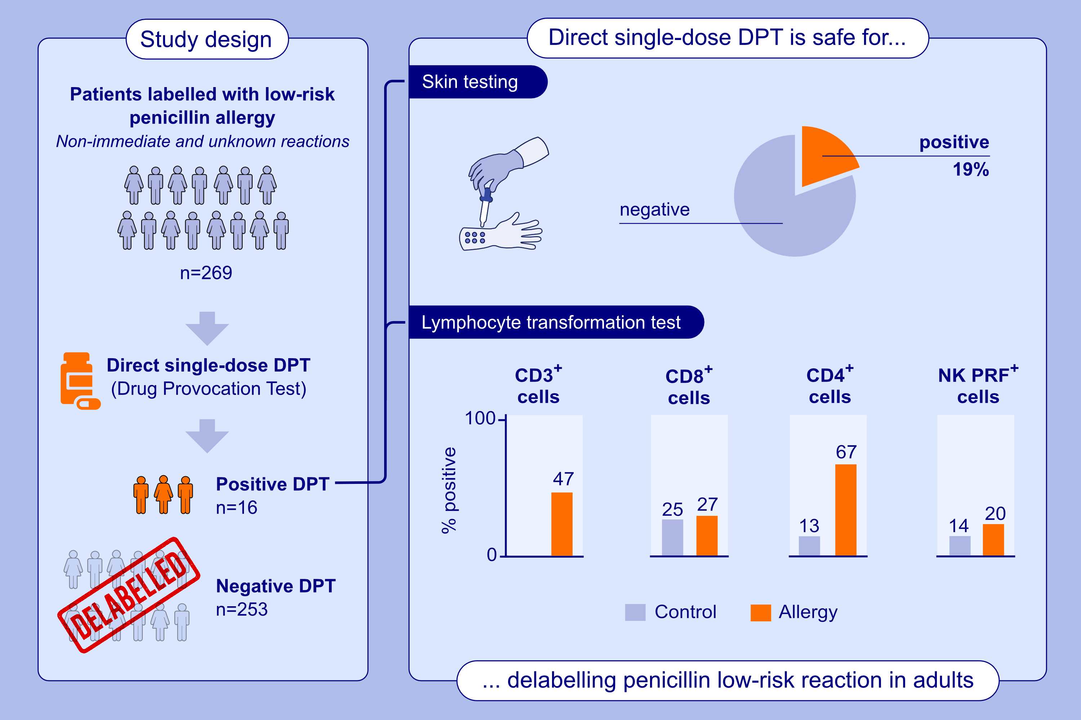
Microenvironment-Driven Mast Cell Plasticity: Insights From Cytokine-Activated Gene Signatures in Skin and Respiratory Diseases
Chiara Tontini, Rajia Bahri, Andrew Higham, Dave Singh, Angela Simpson, et al.
Allergy. 2025;pages:3127-3139
https://doi.org/10.1111/all.16567
© 2019 EAACI and John Wiley and Sons A/S. Published by John Wiley and Sons Ltd.
Notes:
HIGHLIGHTS
We show that direct single-dose provocation test was both safe and effective in delabeling penicillin allergy in low-risk adult patients, including those with mild delayed skin reactions and those with unknown reactions, such as childhood labels and past syncope episodes.
In those who react in the drug provocation test, a T-cell mechanism was confirmed by positive lymphocyte transformation test.
In these cases, the utility of skin tests appears to be minimal.

