Slide 1
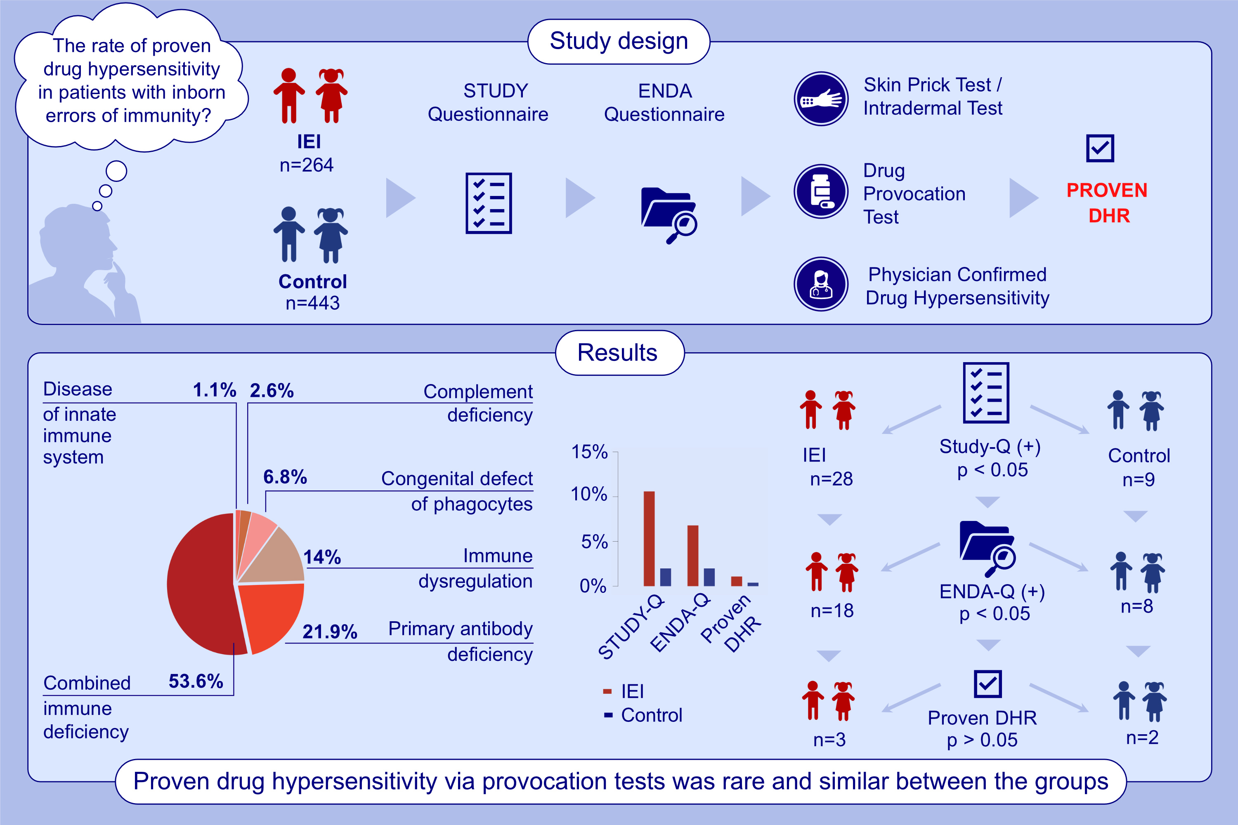
The Discrepancy Between Perceived and Proven Drug Hypersensitivity in a Well-Defined Cohort of Patients With Inborn Errors of Immunity
Sevgi Bilgic-Eltan, Tuba Karakurt, Rozerin Goze Yuksel, Aysu Ilhan Yalaki, Ferit Durankus, et al.
Allergy. 2025; pages: 3140-3150
https://doi.org/10.1111/all.16570
© 2019 EAACI and John Wiley and Sons A/S. Published by John Wiley and Sons Ltd.
Notes:
HIGHLIGHTS
• Self-reported drug allergy was higher in IEI patients than in controls.
• Confirmed hypersensitivity via DPT was rare and similar between groups.
• Despite greater antibiotic use and allergy prevalence in IEI, the low rate of confirmed cases highlights the value of systematic DPT-based evaluation. .

