Slide 1
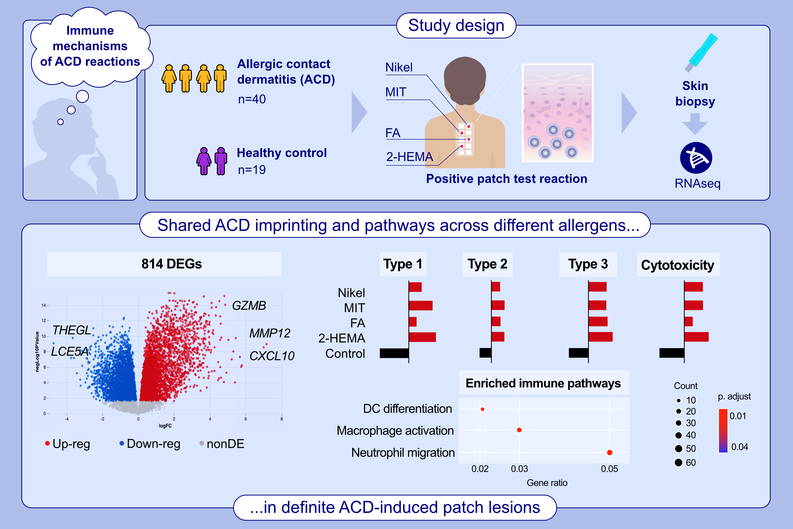
Transcriptomic Analysis of Allergic Patch Test Reactions in Non-Atopic Patients: A Comparative Study Across Multiple Allergens
David Pesqué, Evelyn Andrades, Pau Berenguer-Molins, Júlia Perera-Bel, Miquel Clarós, et al.
Allergy. 2025; pages:3043-3054
https://doi.org/10.1111/all.16642
© 2019 EAACI and John Wiley and Sons A/S. Published by John Wiley and Sons Ltd.
Notes:
HIGHLIGHTS
• This study investigated the immune mechanisms underlying allergic contact dermatitis (ACD) in response to four distinct allergens by using RNA sequencing in a cohort of 40 non-atopic patients and 19 controls.
• A shared ACD imprinting across allergens showed strong innate and adaptive responses, dominated by type 1 immunity but with mixed immune responses, including type 2 immunity.
• Unique allergen-specific genes and pathways were identified, though their overall contribution to the immune response appeared to be limited.
• .

