Slide 1
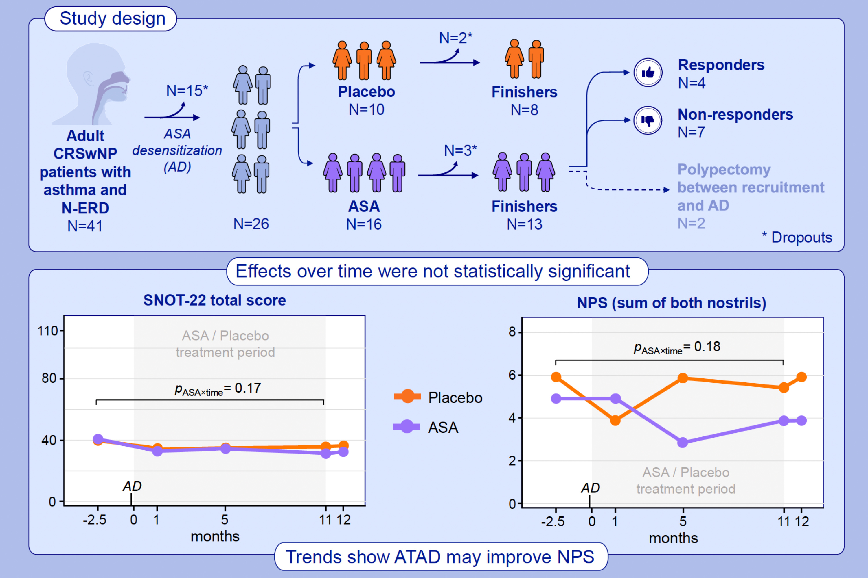
Efficacy of Aspirin Therapy After Desensitization on Chronic Rhinosinusitis With Nasal Polyps Patients With Asthma and Non-steroidal Anti-inflammatory Drug Exacerbated Respiratory Disease —A Randomized Clinical Trial
Alma Helevä, Annina Lyly, Viljami Salmi, Mika Mäkelä, Paula Kauppi, et al.
Allergy. 2025; 3151-3164
https://doi.org/10.1111/all.16679
© 2019 EAACI and John Wiley and Sons A/S. Published by John Wiley and Sons Ltd.
Notes:
HIGHLIGHTS
This randomized double-blind clinical trial investigated the impact of aspirin therapy after desensitization in patients with CRSwNP, asthma, and N-ERD.
Various clinical outcomes were assessed, including health-related quality of life (with the SNOT-22 questionnaire) and the severity of nasal polyposis (with the NPS).
ATAD may not be significantly better than placebo for achieving clinical improvements for the majority of adult CRSwNP patients with asthma and N-ERD.

