Slide 1
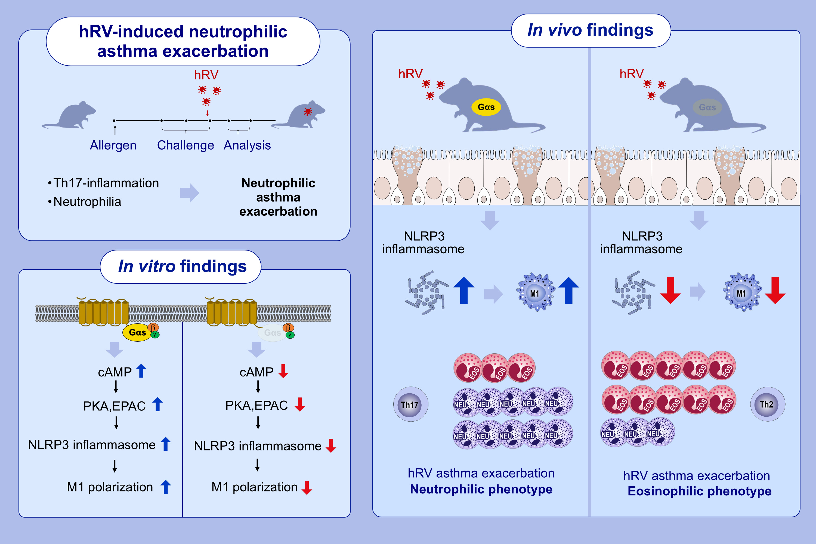
Myeloid cAMP Reduction Shifts Rhinovirus-Induced Airway Inflammation From Neutrophilic to Eosinophilic by Suppressing M1-Interstitial Macrophages
Seong Ok Park, Erdenebileg Uyangaa, Hyo Jin Kim, Hee Won Byeon, Jin Young Choi, et al.
Allergy. 2025; pages:3055-3076
https://doi.org/10.1111/all.70018
© 2019 EAACI and John Wiley and Sons A/S. Published by John Wiley and Sons Ltd.
Notes:
HIGHLIGHTS
• Myeloid Gαs ablation shifts hRV-exacerbated asthma from neutrophil to eosinophil dominance.
• Loss of myeloid Gs suppresses M1 polarization of interstitial macrophage during eosinophilic airway inflammation.
• Gs-deficient macrophages exhibit impaired NLRP3 inflammasome activation and M1 polarization through PKA and EPAC pathways.
• Artificial cAMP-treated macrophages reverse eosinophilic to neutrophilic inflammation in the absence of myeloid Gs following hRV infection.
.

