Slide 1
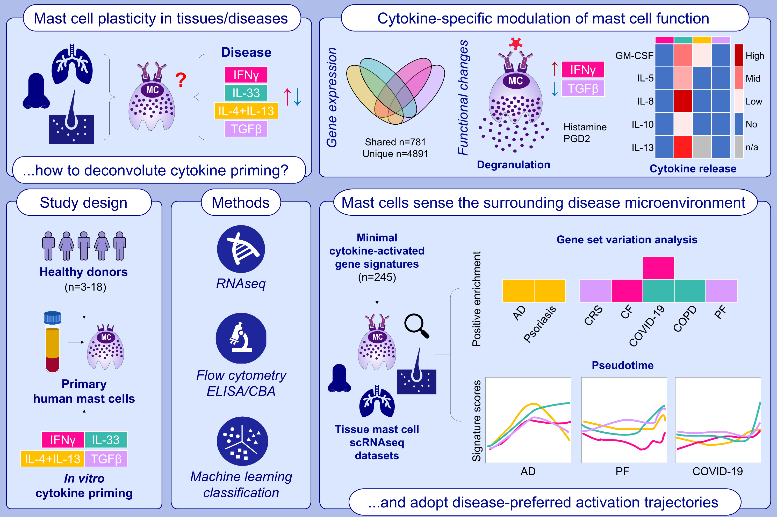
Microenvironment-Driven Mast Cell Plasticity: Insights From Cytokine-Activated Gene Signatures in Skin and Respiratory Diseases
Chiara Tontini, Rajia Bahri, Andrew Higham, Dave Singh, Angela Simpson, et al.
Allergy. 2025; pages: 3077-3094
https://doi.org/10.1111/all.70052
© 2019 EAACI and John Wiley and Sons A/S. Published by John Wiley and Sons Ltd.
Notes:
HIGHLIGHTS
• Primary peripheral blood-derived human mast cells exposed to IFNγ, IL-33, IL-4+IL-13, or TGFβ develop distinct transcriptional signatures with unique functional changes including degranulation and cytokine/chemokine release.
• Machine learning-defined minimal cytokine-activated signatures (245 genes) successfully detect cytokine-primed mast cells in diseased tissues using gene set variation analysis.
• Single-cell pseudotime analysis reveals tissue mast cells exist along activation continua rather than discrete populations, with disease-specific trajectories.
.

