Slide 1
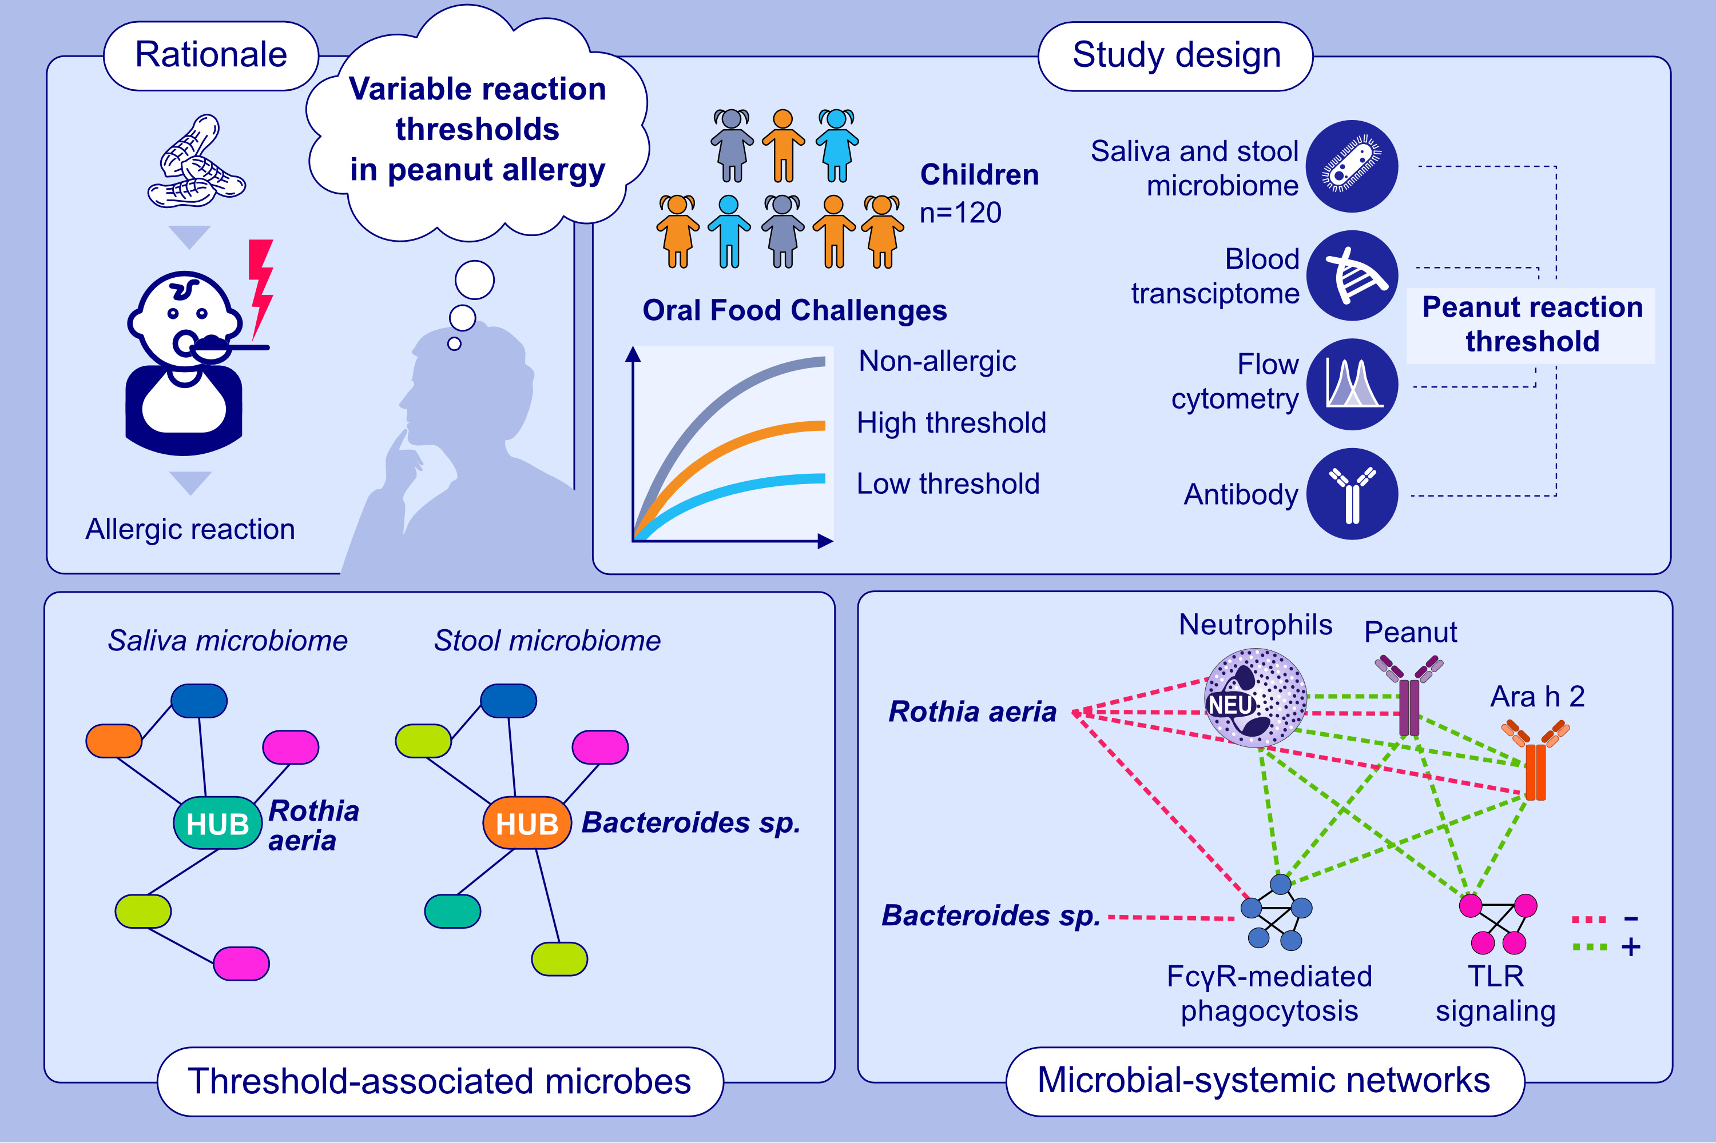
Oral and Gut Microbial Hubs Associated With Reaction Threshold Interact With Circulating Immune Factors in Peanut Allergy
Lingdi Zhang, Yoojin Chun, Galina Grishina, Tracy Lo, Kyle Reed, et al.
Allergy. 2025; Early view https://doi.org/10.1111/all.16481
© 2019 EAACI and John Wiley and Sons A/S. Published by John Wiley and Sons Ltd.
Notes:
HIGHLIGHTS
• This multi-omic study of 120 children addressed the hypothesis that reaction threshold in peanut allergy is associated with cross-talk between the oral and gut microbiomes and systemic circulating factors.
• Microbiome network analyses identified Rothia aeria in saliva and Bacteroides sp. in stool as hub microbes associated with reaction threshold.
• Microbial-systemic networks revealed local-systemic cross-talk between the microbial hubs and IgE- and IgG-mediated peanut allergy.

