Slide 1
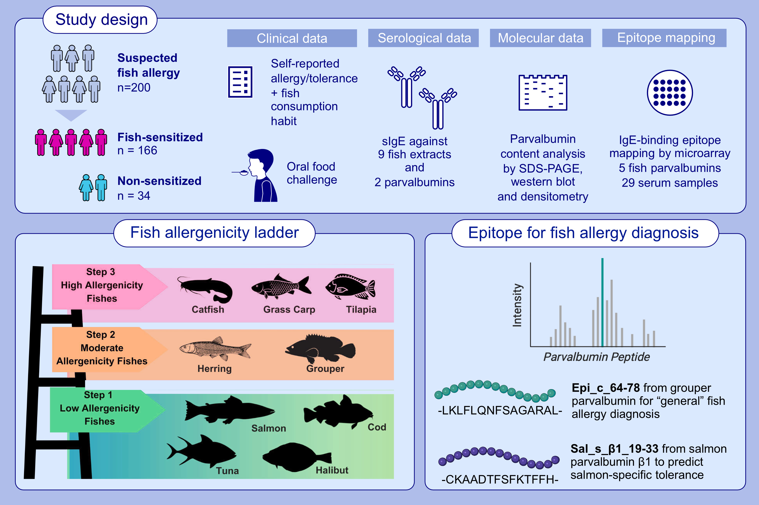
Fish Allergenicity Ladder and Parvalbumin Epitopes for Predicting Clinical Cross-Reactivity and Reintroduction in Chinese Population
Christine Y. Y. Wai, Nicki Y. H. Leung, Agnes S. Y. Leung, Man Fung Tang, Åsa Marknell DeWitt, et al.
Allergy. 2025; Early view https://doi.org/10.1111/all.16562
© 2019 EAACI and John Wiley and Sons A/S. Published by John Wiley and Sons Ltd.
Notes:
HIGHLIGHTS
• Clinical history including self-reported history and oral food challenge outcome, and sIgE sensitization profile of 200 subjects with suspected fish allergy were analyzed to construct a 3-step fish allergenicity ladder. • The allergenicity ladder was positively linked to the relative parvalbumin content of fish muscle but not differences in the IgE reactivity of different fish parvalbumins. • Epitope mapping with sera of 28 fish allergic and tolerant subjects diagnosed by DBPCFC against five fish parvalbumins led to the discovery of one epitope from grouper parvalbumin for predicting general fish allergy and one epitope from salmon parvalbumin for predicting specific fish tolerance that cannot be achieved by sIgE to fish extracts or parvalbumins. .

