Slide 1
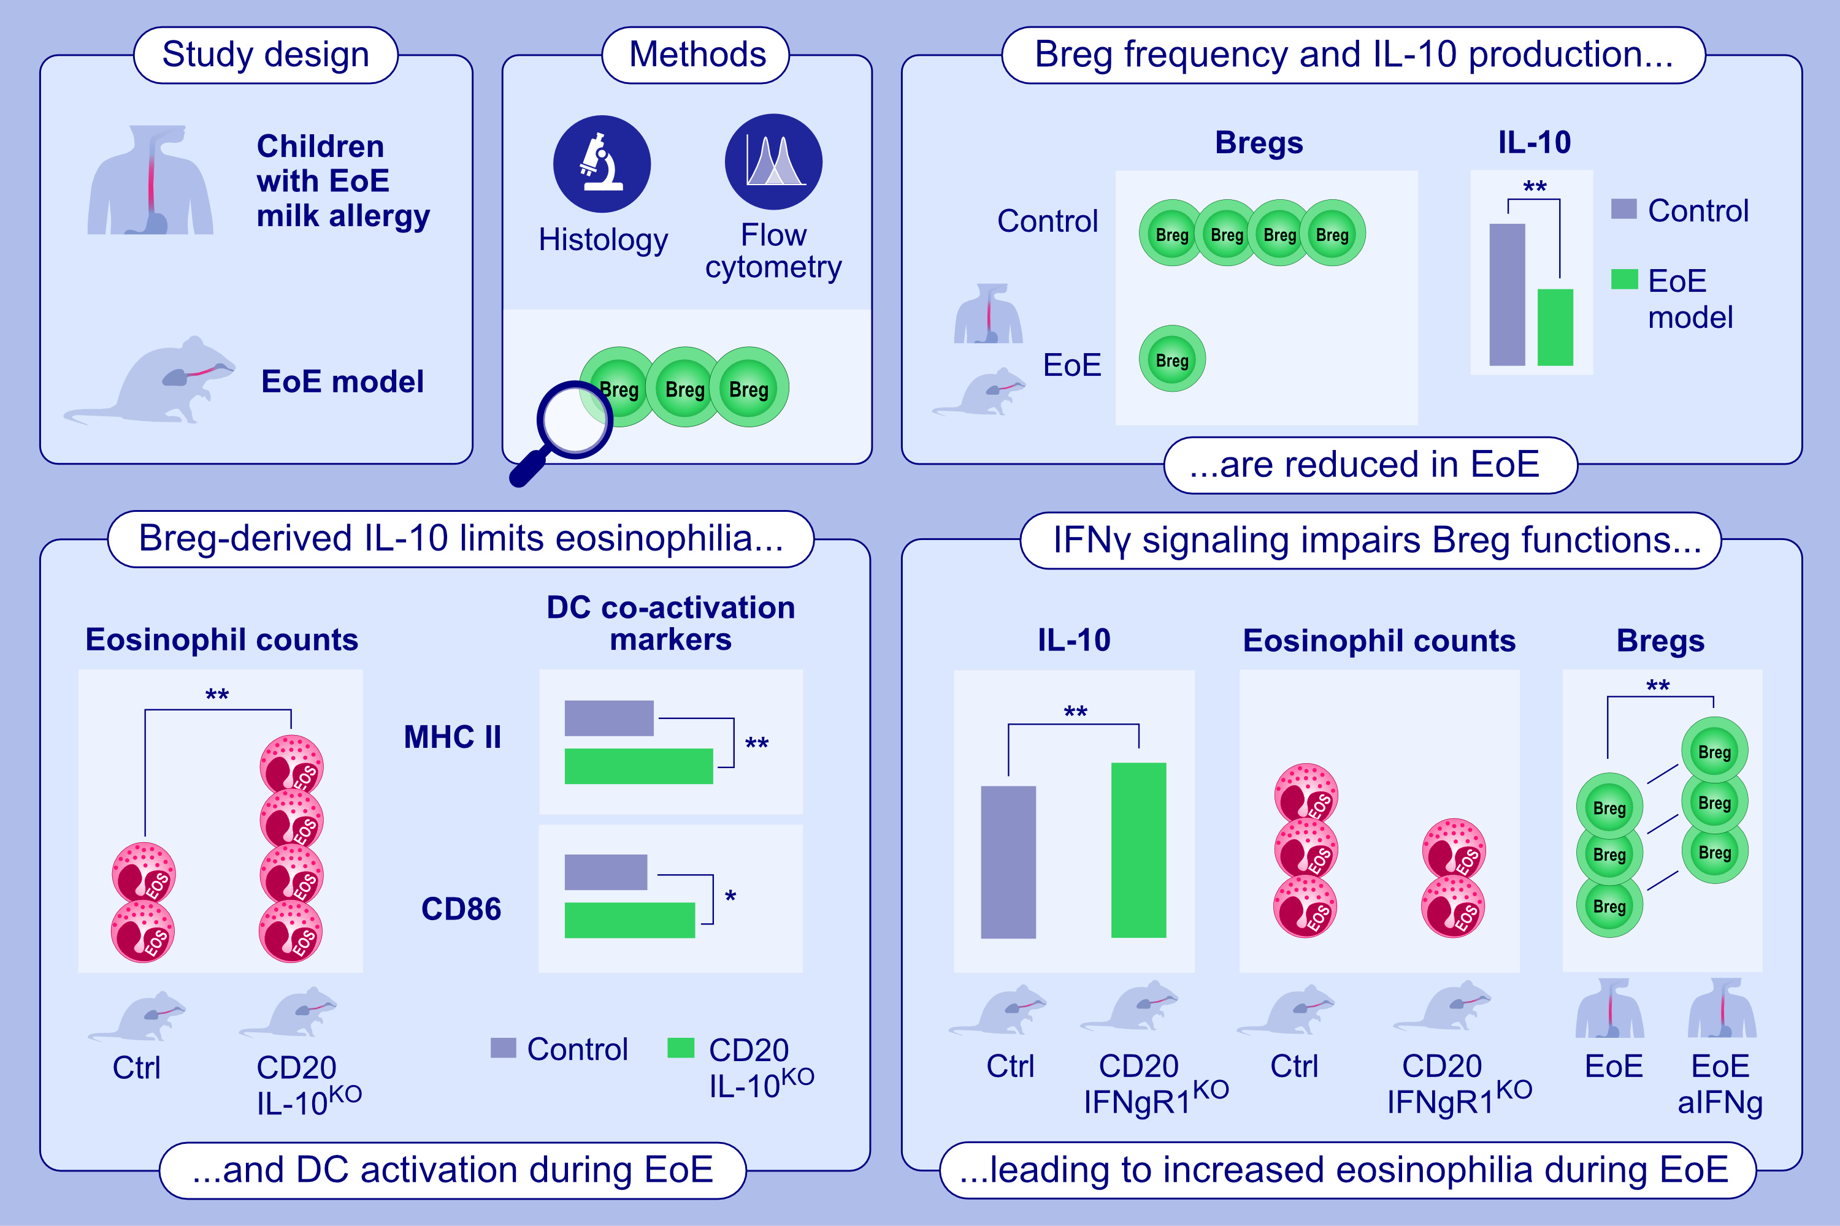
IFNγ Signaling Impairs Regulatory B Cell Function Resulting in Worse Control of Esophageal Food Allergy
Rachel L. Clement, Julie Dilollo, Eric M. Rodríguez-López, Cleandre M. Guerrier, David A. Hill et al.
Allergy. 2025; Early view https://doi.org/10.1111/all.16594
© 2019 EAACI and John Wiley and Sons A/S. Published by John Wiley and Sons Ltd.
Notes:
HIGHLIGHTS
• We used patient samples and a murine model to understand the contribution of Bregs to EoE immunopathology.
• We find that Breg-derived IL-10 is important for controlling EoE, but that Breg expansion and function are impaired in this condition.
• We identify IFN-γ as a key negative regulator of Breg function in mice and patients with EoE.

