Slide 1
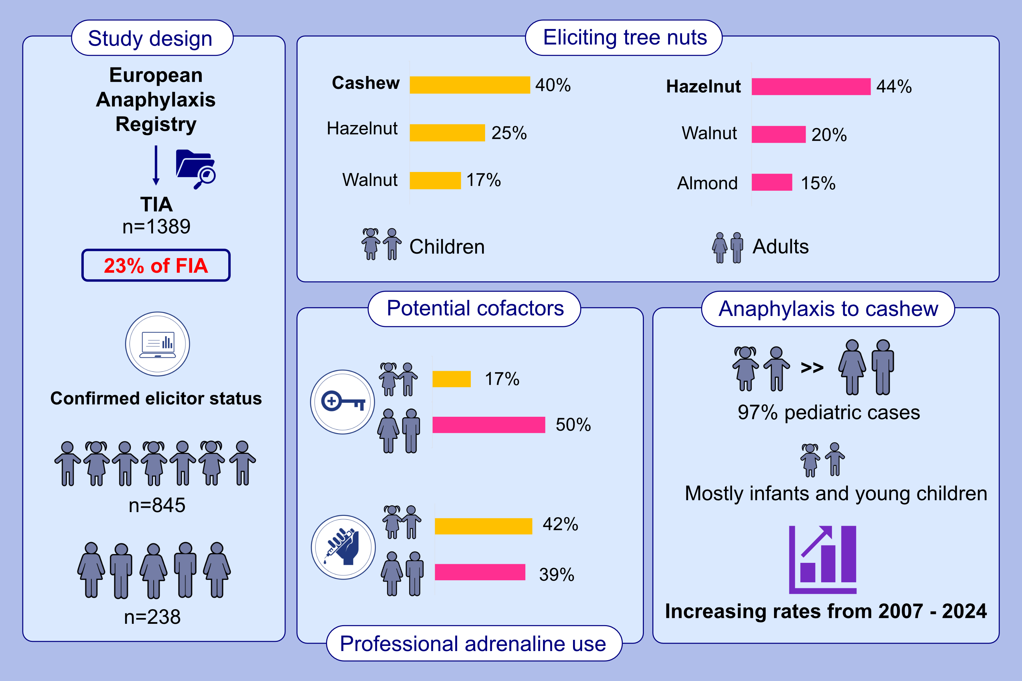
A Growing Concern for Cashew and an Unexpected Risk From Almonds: Data From the Anaphylaxis Registry
Veronika Höfer, Sabine Dölle-Bierke, Dominique Sabouraud-Leclerc, Amandine Divaret-Chauveau, Alice Köhli, et al.
Allergy. 2025; Early view https://doi.org/10.1111/all.16619
© 2019 EAACI and John Wiley and Sons A/S. Published by John Wiley and Sons Ltd.
Notes:
HIGHLIGHTS
• Tree nut-induced anaphylaxis constitutes 23% of food-induced anaphylaxis among the anaphylaxis registry. • Confirmed elicitors differed between children (n = 845) and adults (n = 238): cashew, hazelnut and walnut were most frequent among children, while hazelnut, walnut and almond were most frequent among adults. • Cashew-induced anaphylaxis increased from 2007 – 2024 among children but rarely affects adults (n = 11).

