Slide 1
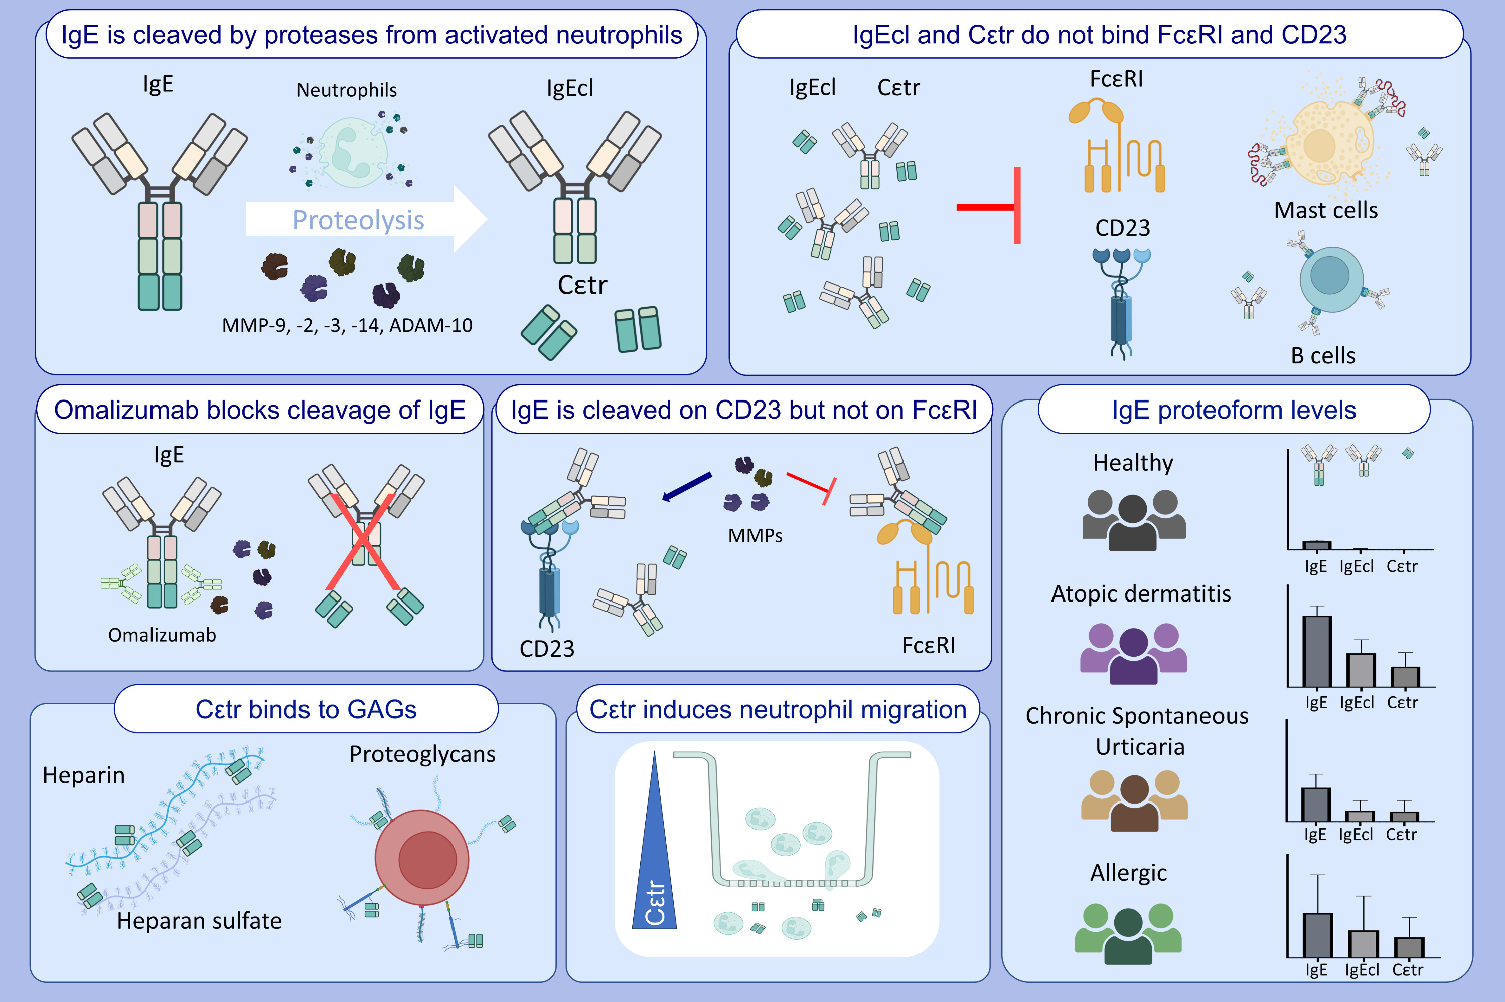
An Inflammation-Associated Control Mechanism of Allergy by Proteolysis of IgE
Estefania Ugarte-Berzal, Erik Martens, Rafaela Vaz Sousa Pereira, Dries Wets, Eva Ganseman, et al.
Allergy. 2025; Early view https://doi.org/10.1111/all.16622
© 2019 EAACI and John Wiley and Sons A/S. Published by John Wiley and Sons Ltd.
Notes:
HIGHLIGHTS
• This study evaluates proteolysis of IgE within the contexts of acute inflammations in vitro and in patient samples and the biological effects of resulting IgE proteoforms. • Omalizumab prevents cleavage of IgE by granulocyte derived proteases into two IgE proteoforms: IgEcl (150 kDa) and Cεtr fragment (13kDa).
• IgEcl and Cεtr fragments with abolished IgE receptor interaction were detected in plasma samples from patients with atopic dermatitis, chronic spontaneous urticaria and allergy.

