Slide 1
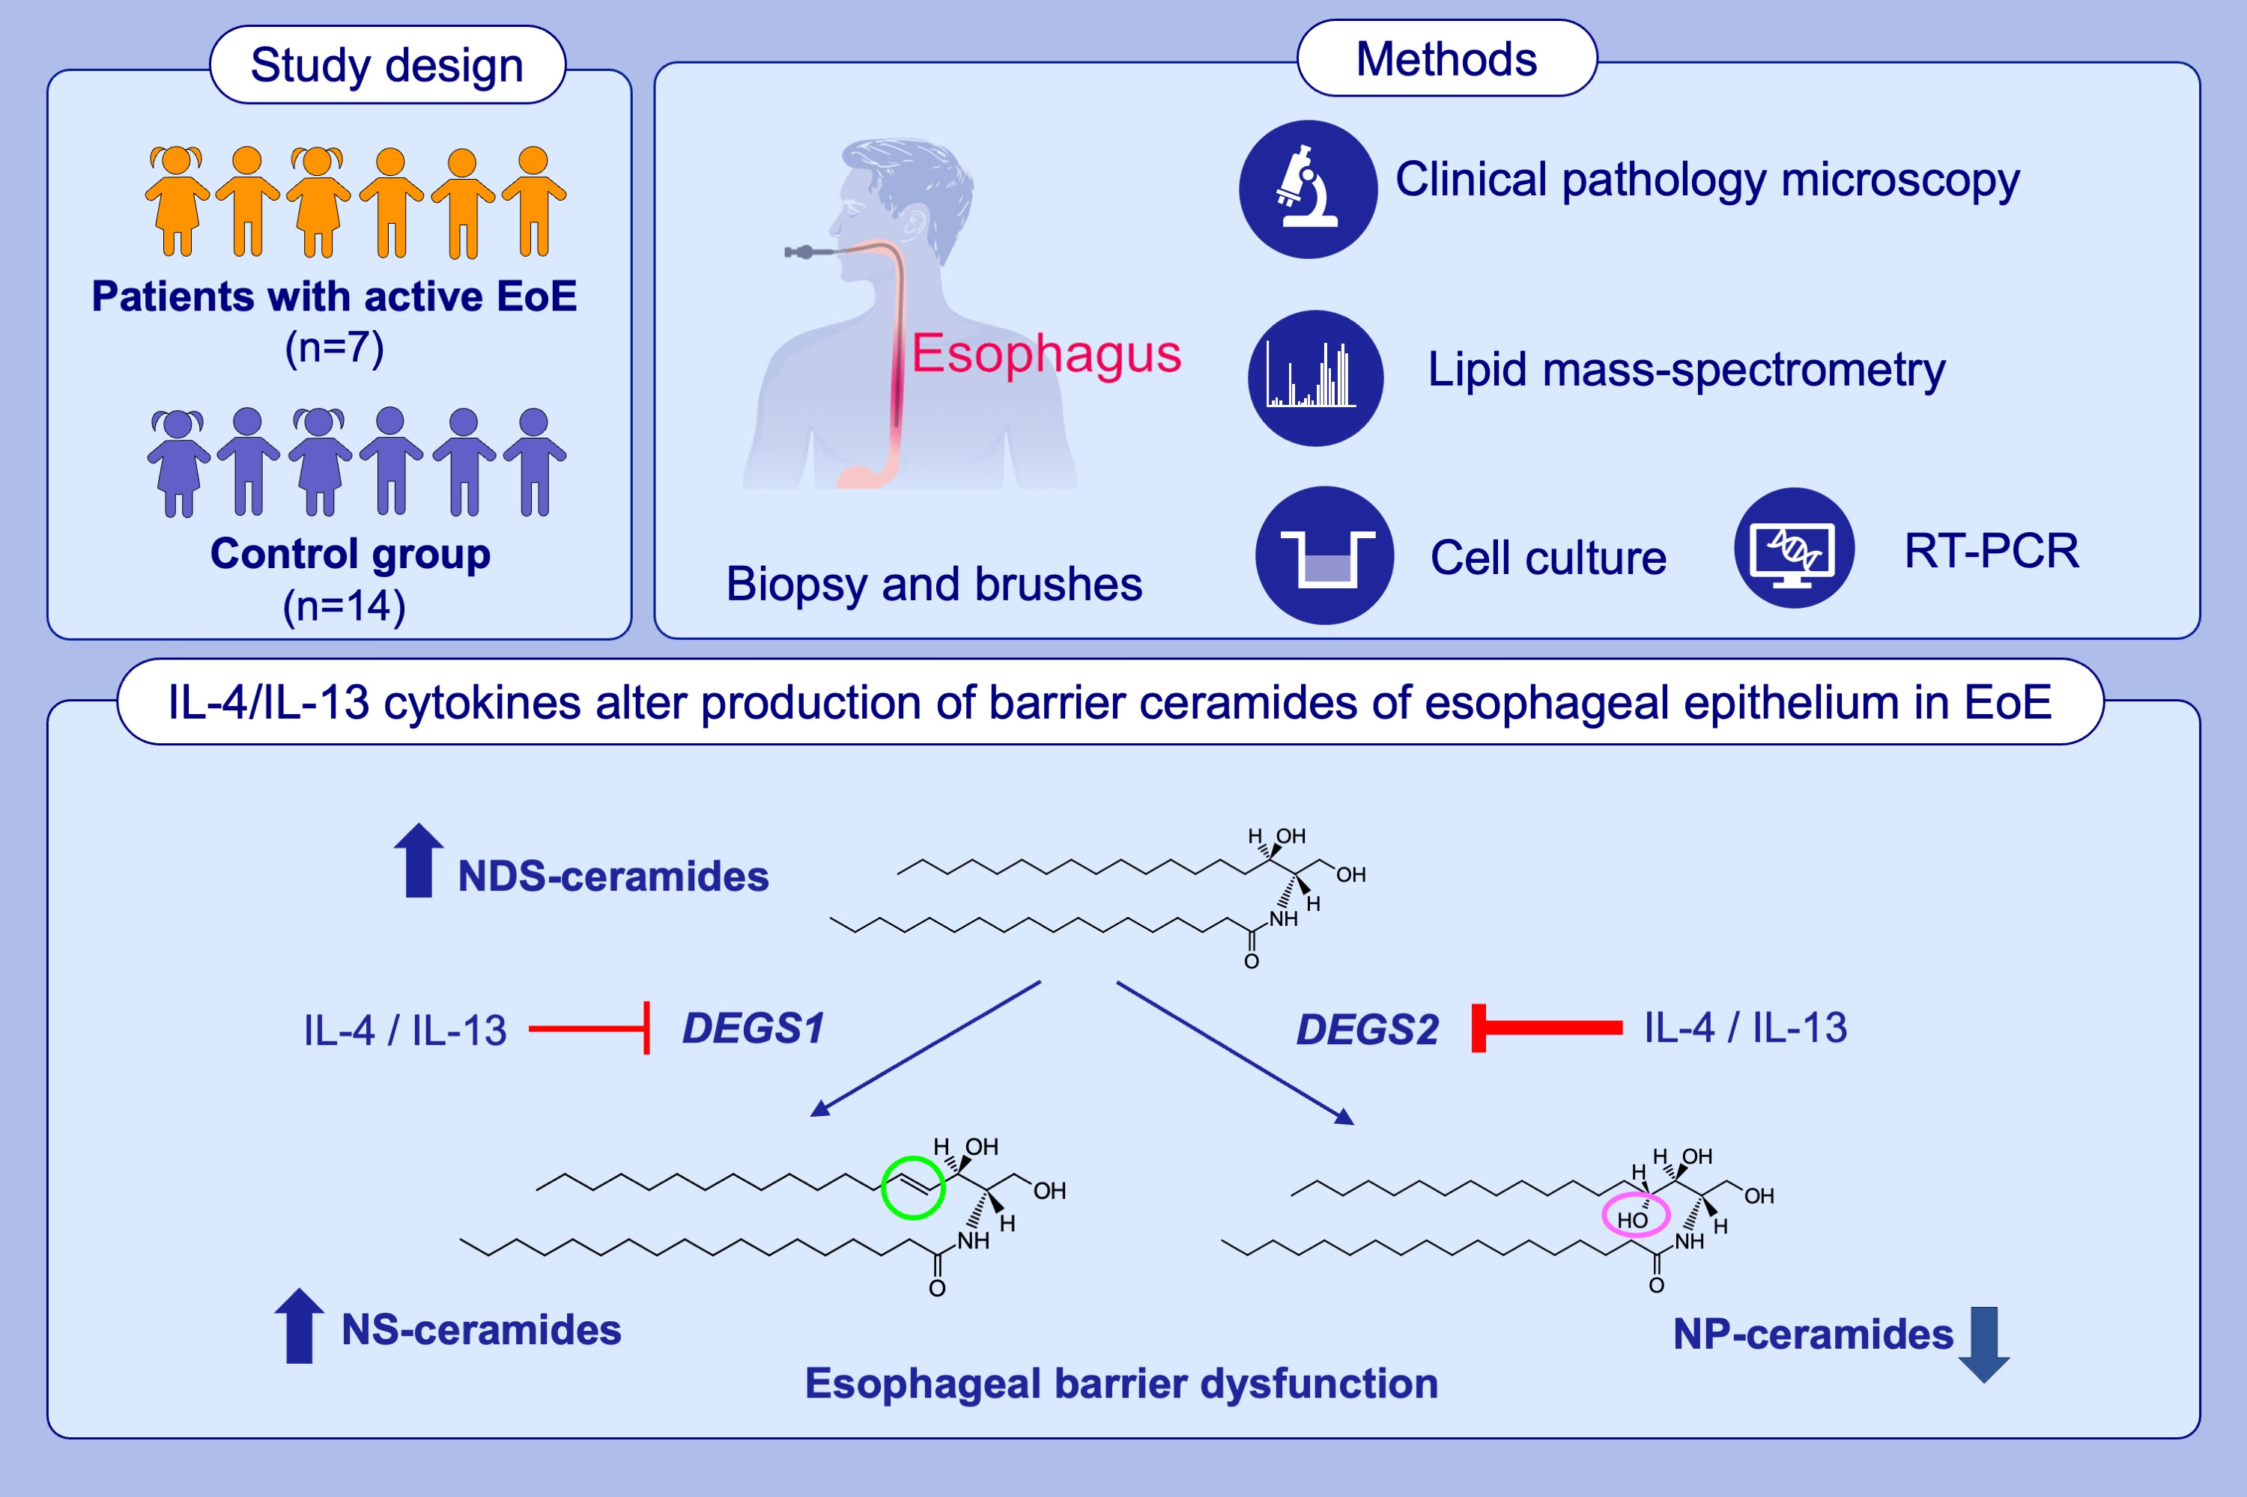
Lipidomic Analysis of Esophageal Epithelia Reveals a Distinctive Sphingolipid Profile in Eosinophilic Esophagitis
Melinda Braskett, Elena Goleva, Irina Bronova, Anna Sofia Bronoff, Katherine Lyubchenko, et al.
Allergy. 2025; Early view https://doi.org/10.1111/all.16660
© 2019 EAACI and John Wiley and Sons A/S. Published by John Wiley and Sons Ltd.
Notes:
HIGHLIGHTS
• NS- and NDS-ceramides are increased in esophageal brushes of EoE pediatric patients, with concomitant decrease in NP-ceramides, resulting in increased NS/NP-ceramide ratios.
• EoE epithelium has decreased expression of desaturases DEGS1 and DEGS2. These enzymes are involved in NS-and NP-ceramides biosynthesis and regulated by IL-4/IL-13.
• The unique alterations in sphingolipid biosynthesis and composition may contribute to EoE esophageal epithelia barrier dysfunction.

