Slide 1
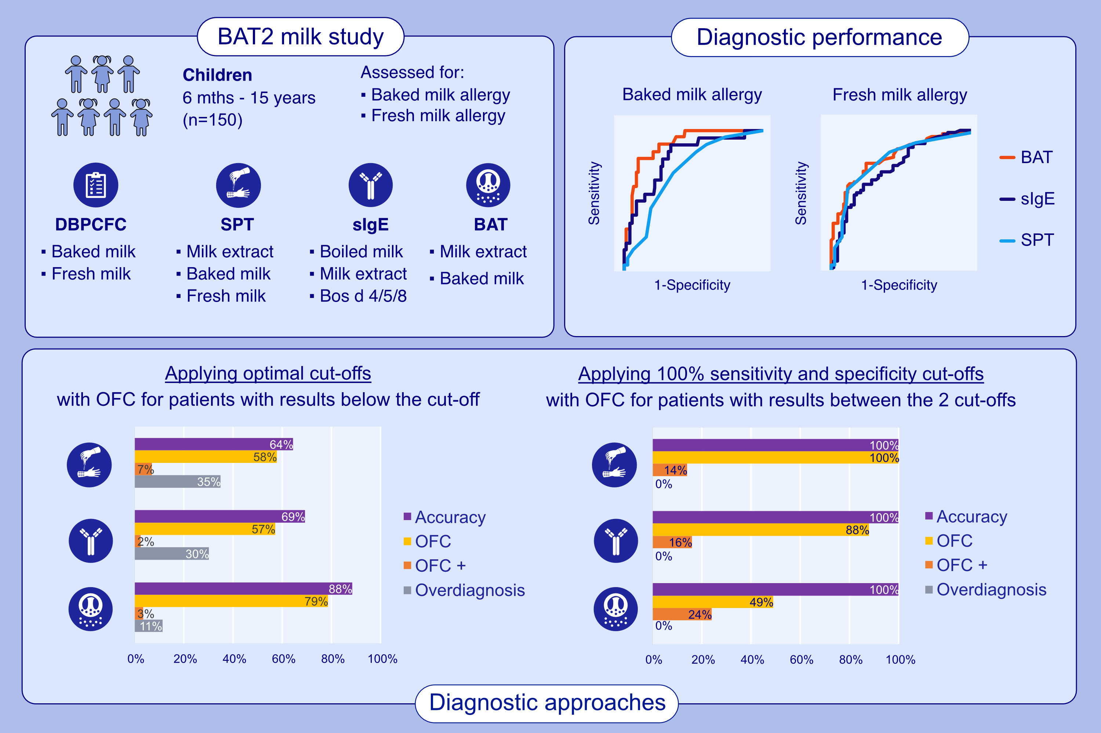
The Basophil Activation Test Is the Most Accurate Test in Predicting Allergic Reactions to Baked and Fresh Cow's Milk During Oral Food Challenges
Irene Bartha, Holly Boyd, Ru-Xin Foong, Marta Krawiec, Andreina Marques-Mejias, et al.
Allergy. 2025; Early view https://doi.org/10.1111/all.16675
© 2019 EAACI and John Wiley and Sons A/S. Published by John Wiley and Sons Ltd.
Notes:
HIGHLIGHTS
• The BAT had larger areas under the receiver-operator-characteristic curve to identify BM (0.90) and FM (0.81) allergies compared to SPT (0.70 and 0.78) and sIgE (0.79 and 0.74) to cow’s milk. • Using optimal cut-offs for BM allergy, sensitivity and specificity were 80/90% for BAT, 70/64% for SPT and 90/66% for sIgE to cow’s milk. • Using 100% sensitivity and 100% specificity cut-offs followed by OFC to BM led to 100% diagnostic accuracy with BAT requiring the lowest number of OFC (49%, 24% positive) compared to SPT (100%, 14% positive) and sIgE (88%, 16% positive).

