Slide 1
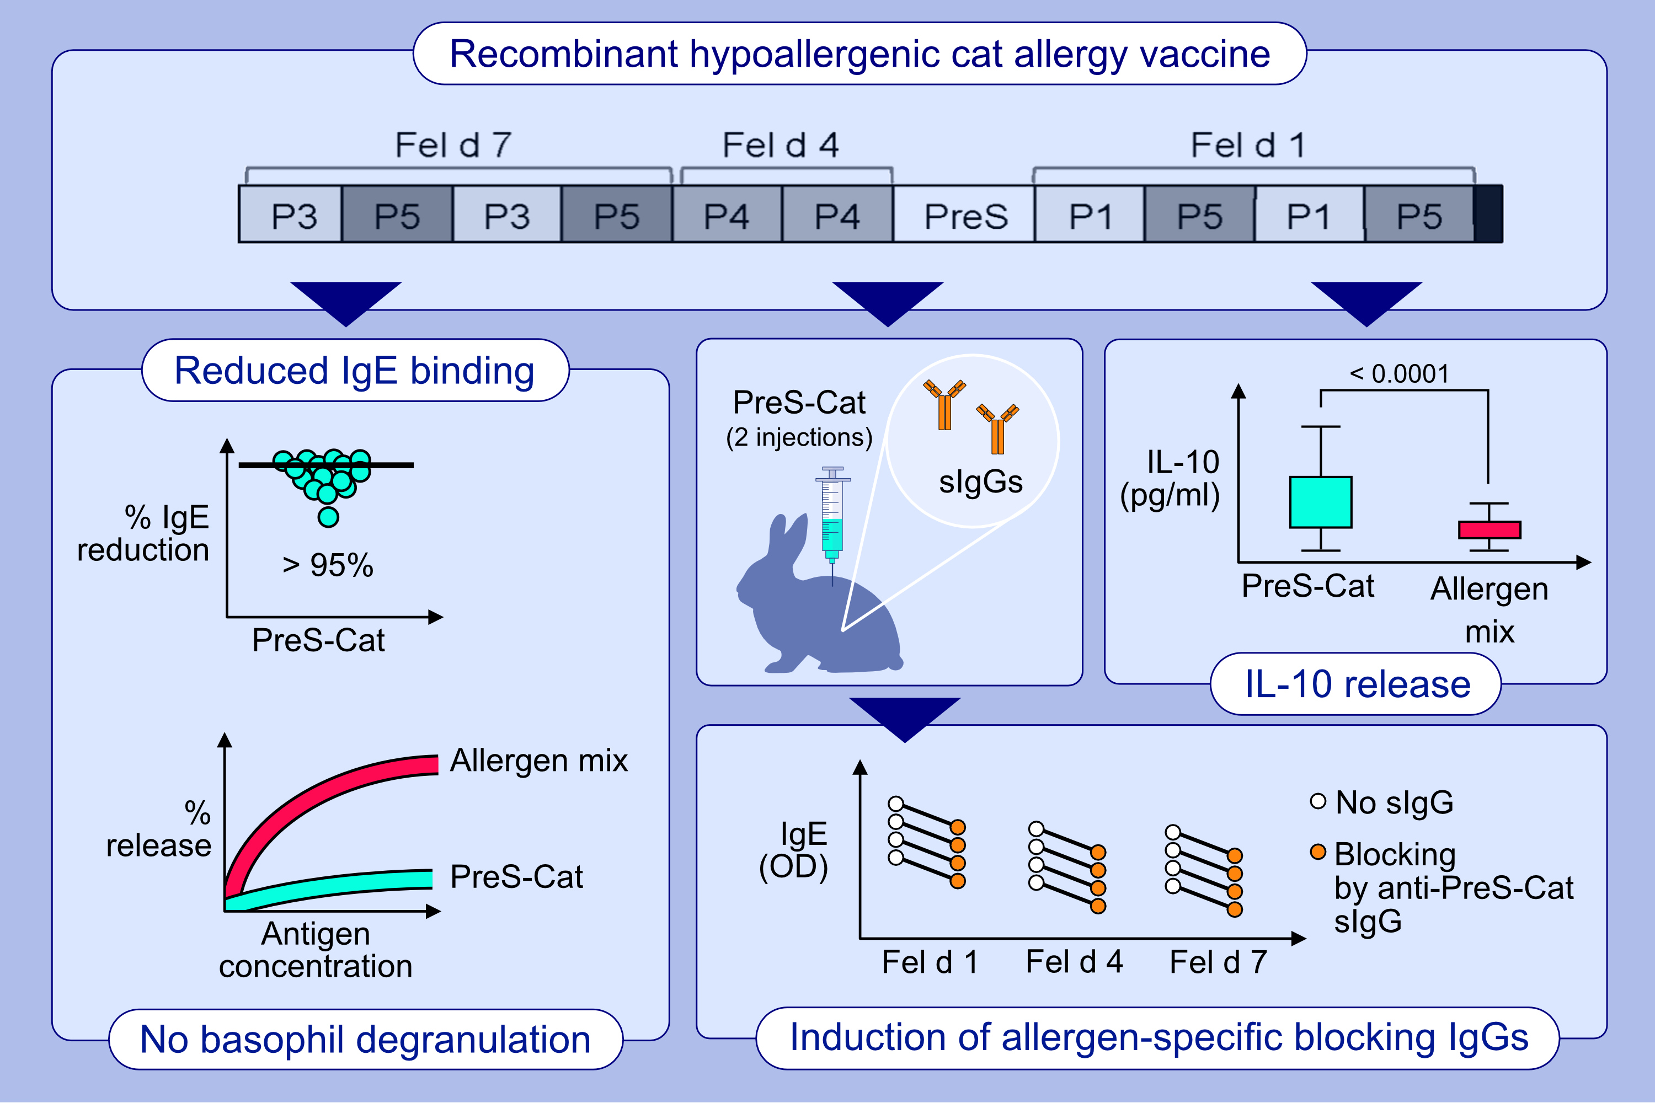
Recombinant Hypoallergenic Cat Allergy Vaccines
Daria Trifonova, Mirela Curin, Margarete Focke-Tejkl, Zicheng Liu, Kristina Borochova, et al.
Allergy. 2025; pages: 2622-2635
https://doi.org/10.1111/all.16542
© 2019 EAACI and John Wiley and Sons A/S. Published by John Wiley and Sons Ltd.
Notes:
HIGHLIGHTS
• This study reports the construction and preclinical characterization of peptide-carrier-based vaccines combining all three important cat allergens (Fel d 1, Fel d 4 and Fel d 7) within single vaccine antigens, termed PreS-Cat 1-PreS-Cat 5. •Two subcutaneous immunizations of rabbits with PreS-Cat 1-5 induce equal or better antibodies blocking allergic patients’ IgE binding to cat allergens than 6 to 15 immunizations with allergen extract-based vaccines. •PreS-Cat-specific antibodies strongly inhibit specific basophil activation. PreS-Cat induces significantly more IL-10 in cultured PBMCs from cat allergic patients than cat allergens. .

